Slide 1
Agile Testing
In a Waterfall World
Angela Dugan
QAI Quest 2013

Slide 2
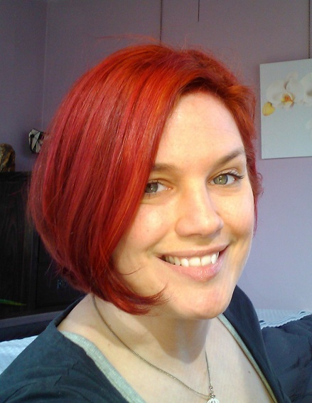

Application Lifecycle Management
Project Leadership
.NET Solutions
Mobile Solutions
Angela Dugan
ALM Practice Manager
http://polarissolutions.com
http://theTFSWhisperer.com
Angela.Dugan@PolarisSolutions.com

Slide 3
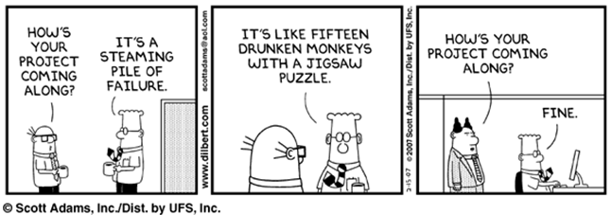
Token Icebreaker Cartoon
Of course this has NEVER happened to you... Right?

Slide 4
Let’s Talk About Waterfall
It is plan-driven, and plans are good right?
Pert charts, Gaant charts, Critical paths, OH MY!
Rules with an Iron Fist (A.K.A Microsoft Project)
Pre-defined Start Dates & End Dates
Teams operate in silos (Centers of Excellence)
It is not the devil, but it CAN be evil if its prescribed techniques are abused

Slide 5
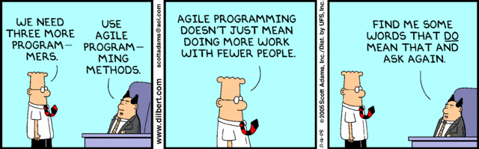
Quick review of agile
If you think Agile means cowboy programmers doing whatever they want with no requirements, no rules, no documentation, and no testing, you might read too much Dilbert ☺

Slide 6
Agile tenets
Individuals and interactions over processes and tools
Working software over comprehensive documentation
Customer collaboration over contract negotiation
Responding to change over following a plan

Slide 7
What is this “Agile” Thing Anyway?
Embraces uncertainty, software IS uncertain
Empirical (based on experience and observation)
Continuous improvement
“Forecast” rather than “commitment”
Self-organization and estimation by the “do-ers”
It is not the devil, but it CAN be evil if its prescribed techniques are abused
Notes:
Agile
Best summed up by someone throwing up their hands and saying "damned if I know"
Throw in the ideas of emergent architecture and it looks like we have no idea and no plan.
About self organizing teams and is by its nature driven by the "do-ers". The architects, developers, and testers.

Slide 8
Agile in practice
Daily standup INCLUDES people from multiple disciplines
Agile estimation leverages INSTINCT and EXPEREINCE to provide realistic expectations and more confident forecasts
Backlog grooming focuses team’s efforts on customer’s current PRIORITIES
An iterative process fueled by customer FEEDBACK ensures the team delivers the right functionality
A constant FOCUS ON QUALITY ensures that quality is built-in, not tested in
Retrospectives foster CONTINUOUS IMPROVEMENT by inspecting outcomes, sharing of best practices and honing the process

Slide 9
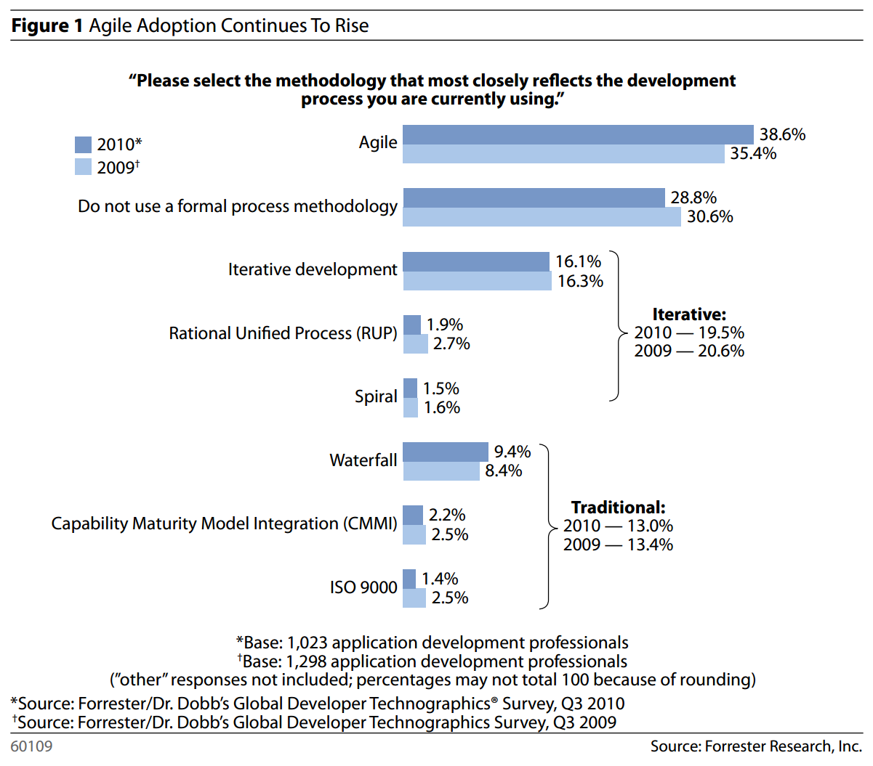
The reality
“Water-Scrum-Fall Is The Reality Of Agile For Most Organizations Today”
by Dave West
Forrester Research
July 26, 2011

Slide 10
Waterfall vs. Agile
Waterfall | Agile
Requirements documents | Just-in-time, informal requirements
Occasional “customer” involvement | Frequent “customer” involvement
Start-to-finish Project Plan | Product Backlog. Plan for Sprint. Details are sketchy beyond that. Priorities shift based on new data.
Tasks are assigned | Assigned tasks are a bottleneck
Potentially large team size | Teams of 3 – 9 people
Multiple phases, eventual delivery | Working software each Sprint / Iteration
Resistant to change | Change is expected
Contract says what we build, deliver | Contract is a lot closer to T&E

Slide 11
the old way vs. the new way
 | Waterfall | Agile
Test cases created from | Specifications | Acceptance criteria
Test cases are created | Manually | Manual Automated stubs from acceptance criteria
Test cases are created | Up front | Up front
Time commitment | Large | Minimal
Text execution is | Well defined steps Some automation | Defined steps/exploratory Some Automation
Tests executed by | QA Team | Everyone
Weaknesses | Communication overhead huge Sensitive to change | Coordination Skilled resources

Slide 12
Leverage the strengths of each
Agile for day-to-day dev/test activities
Detect problems and continuously improve with Sprints
Focus on Definition Of Done & delivering working software (a.k.a. value to customers)
Waterfall for multi-team coordination
Waterfall for release planning

Slide 13
The Good
More collaboration
Better overall visibility of status, progress, quality
Less bureaucracy to get in your way
Less impact from requirement churn
Testing is EVERYBODY’S concern, ALL the time!
Reduces resource bottlenecks
Less focus on output, more focus on quality
Everyone feels IS invested in the deliverable

Slide 14
The bad
More meetings (kind of)
Less (perceived) accountability
Less (unnecessary) documentation
More requirement churn
Shorter runway for writing tests
May require a new “toolbox”

Slide 15
The ugly
Change is hard, and this could be a BIG one
FAR greater levels of discipline required by EVERYONE on an agile team (yes, really)
Far more responsibility on Stakeholders and end-users
Management support can be difficult to achieve & maintain
Agile shines a light on existing dysfunction

Slide 16
Low Hanging Fruit
Collaborate: daily stand-ups amongst fellow testers first
Adopt a process (if it’s all ad-hoc today)
Adopt an integrated ALM tool (if you don’t have one)
Question anything that “smells”
Continuously improve, even if it is just the little things

Slide 17
Agile testing strategies
Get your developers involved (TDD, unit testing)
Automate regression tests
Scenario based testing when appropriate
Generate test case documentation whenever possible (from exploratory tests or acceptance criteria)
Involve stakeholders in testing (UAT)
Adopt a good toolset to assist with collaboration and automation

Slide 18
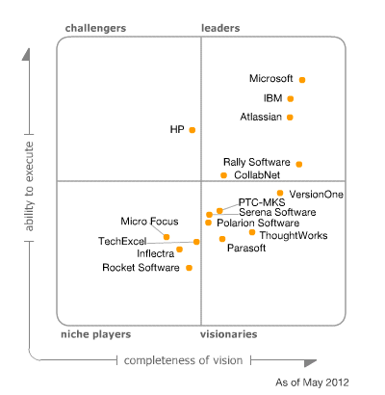
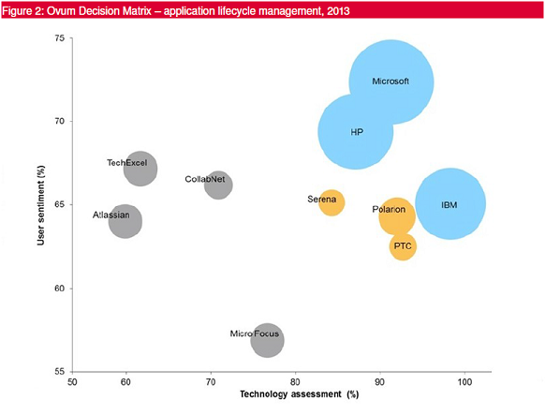
What the experts say about tools
Ovum Decision Matrix for ALM 2013
Gartner’s “Magic Quadrant” 2012

Slide 19
What I say about tools
Focus on tools that foster collaboration
Many tools can fit the bill
Best fit is not always “Best of Breed”
Tools can foster efficiency and collaboration
Tools cannot fix your people or process issues

Slide 20
My Weapon of Choice
TFS + Project Server (optional)
Track progress across many teams for a large effort
  Enterprise “roll-up” of milestones
Requirements stored/managed in Project Server and/or TFS
Implementation details created in TFS by teams
Modifications have an optional approval workflow
  Keeps Waterfall-centric managers in the loop
  Metrics don’t get in the way of the software team

Slide 21
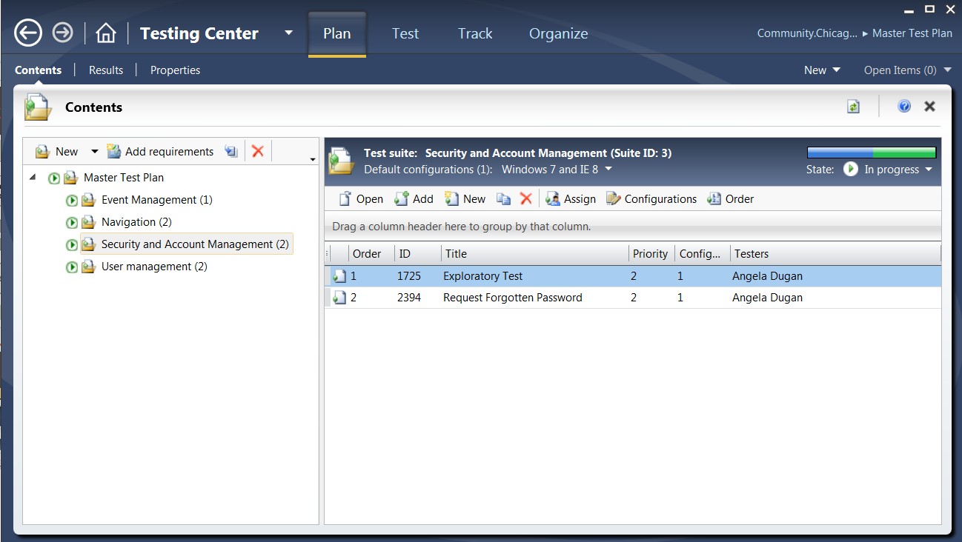
Centralized Test Management

Slide 22
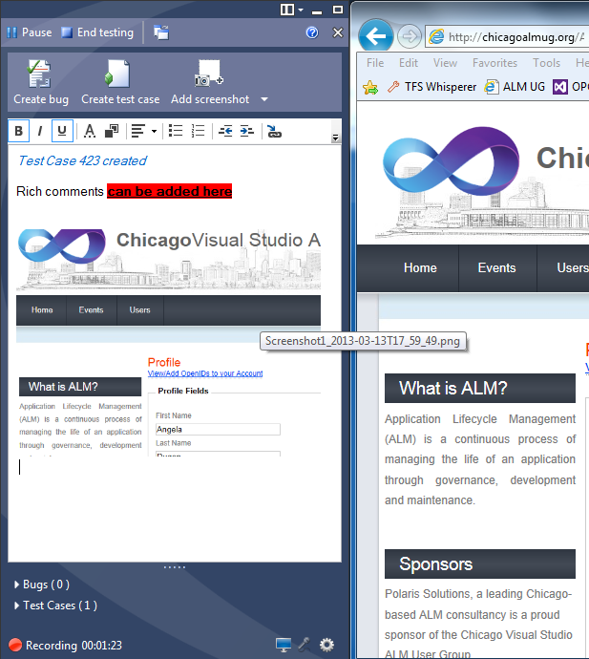
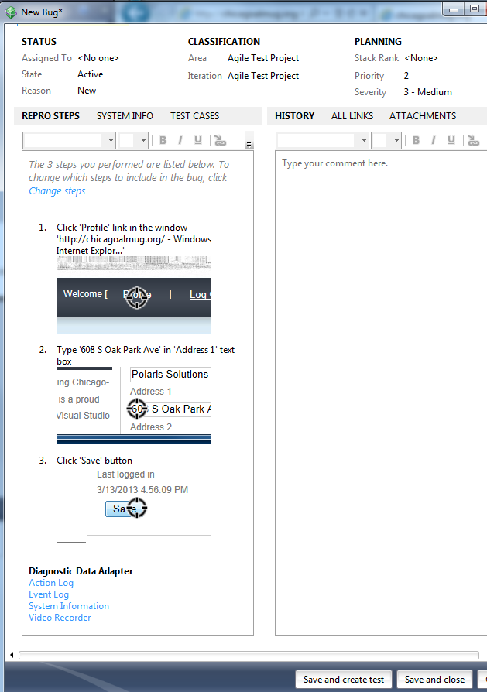
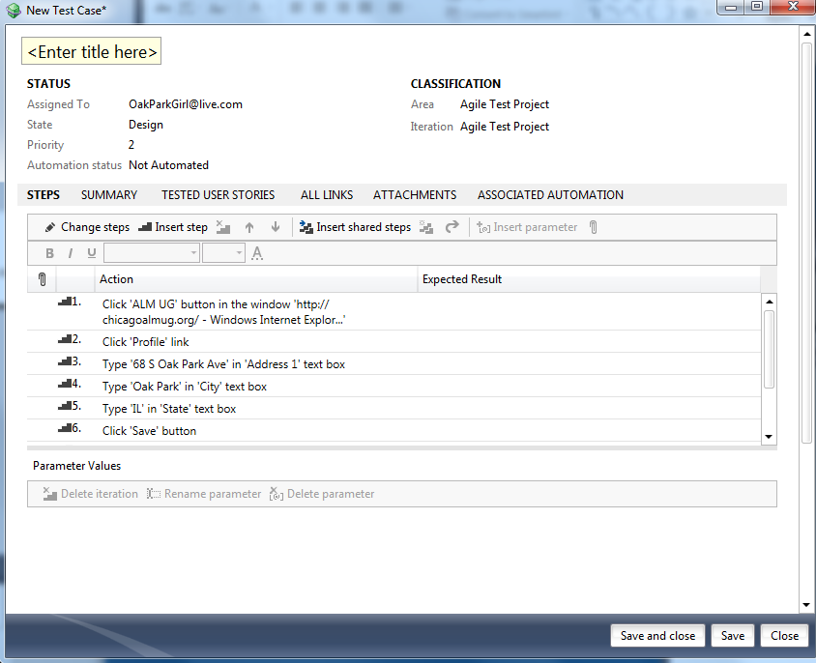
Exploratory Testing = FAST!

Slide 23
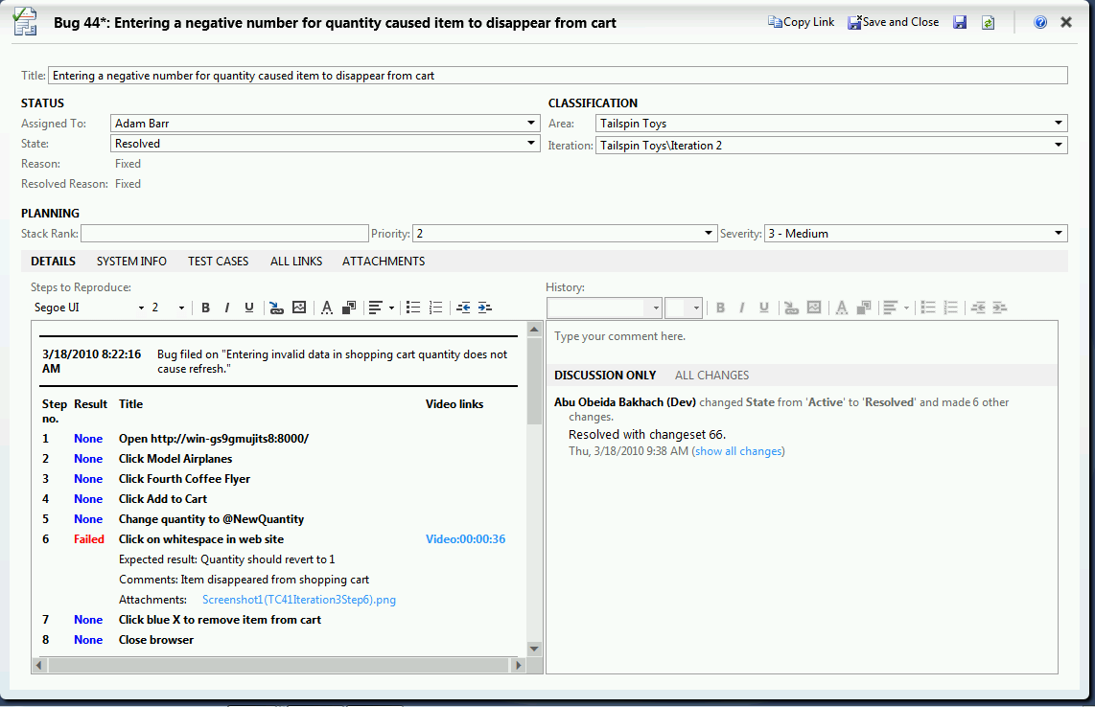
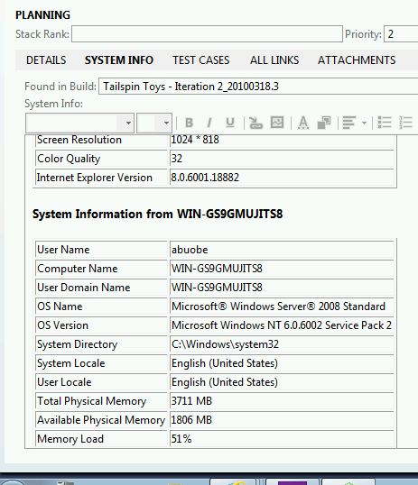
Rich Bug Creation = LESS CHURN

Slide 24
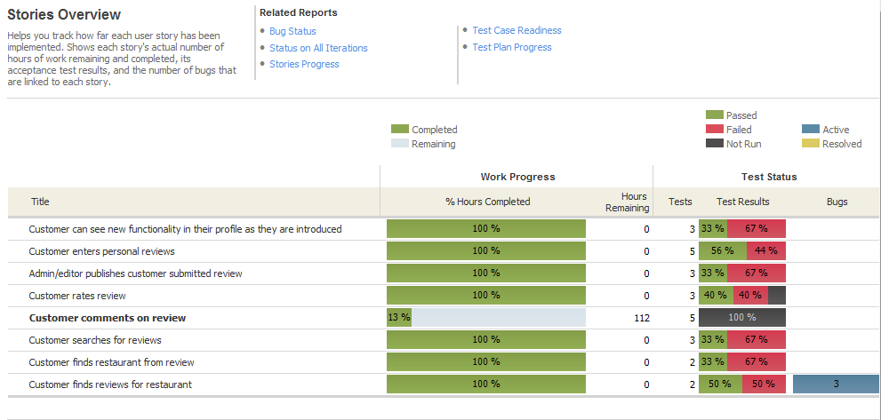
Cross Team Reporting = visibility
Notes:
Slide animation builds this out.

Slide 25
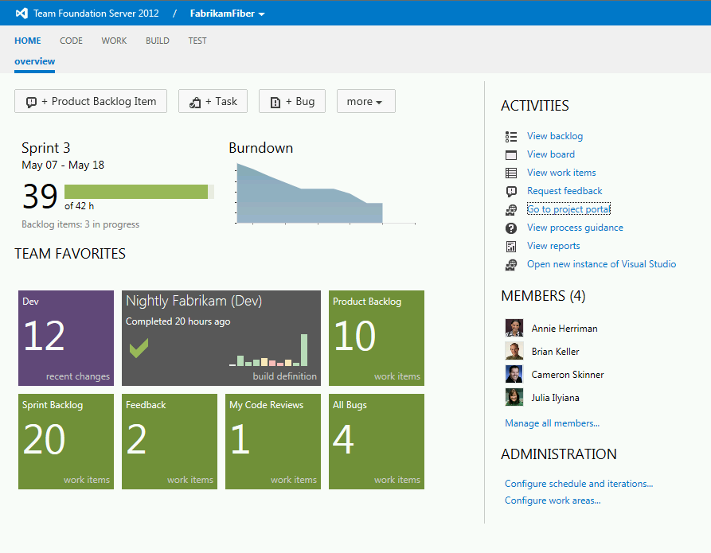
On-line planning tools = agility

Slide 26
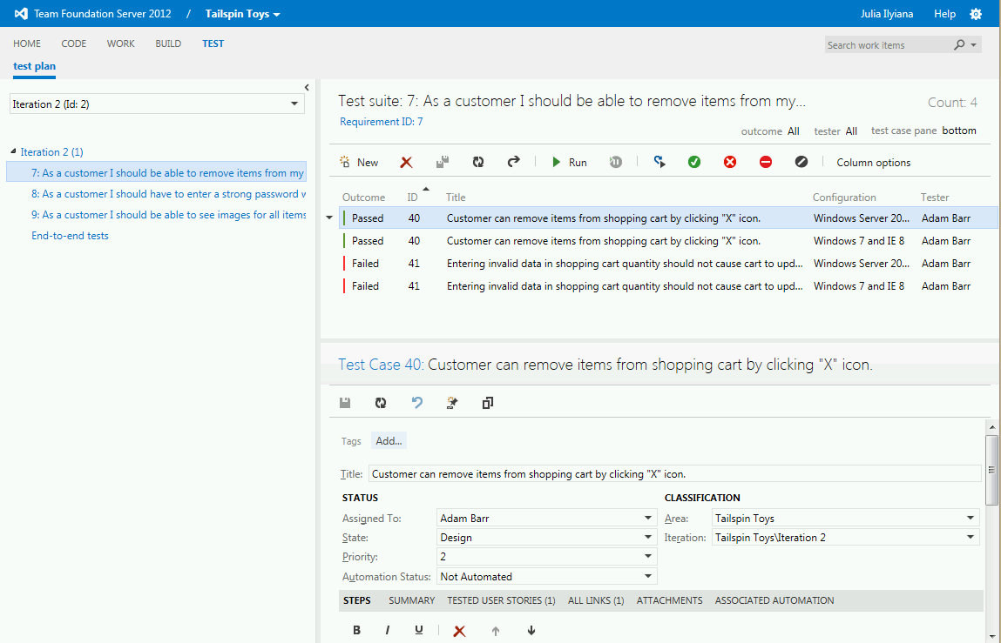
web client for mtm = more agility!!

Slide 27

Get this book now!
Drive: The Surprising Truth About What Motivates Us
Daniel Pink
Under $10 on Amazon
http://www.amazon.com/Drive-Surprising-Truth-About-Motivates/dp/1594484805/

Slide 28
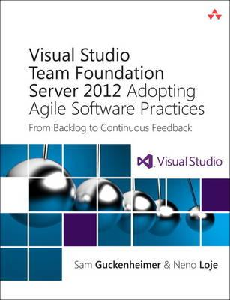
Resources
Visual Studio Team Foundation Server 2012: Adopting Agile Software Practices: From Backlog to Continuous Feedback
Sam Guckenheimer
Neno Loje
$30 on Amazon
http://www.amazon.com/Visual-Studio-Team-Foundation-Server/dp/0321864875

Slide 29
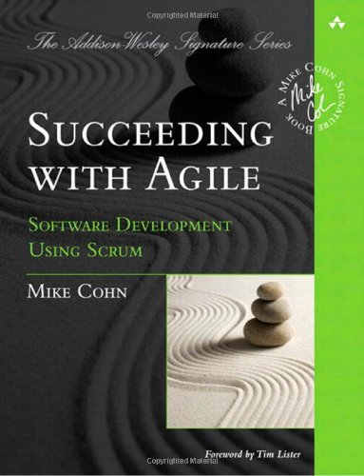
Resources
Succeeding with Agile
Mike Cohn
$35 on Amazon
http://www.amazon.com/Succeeding-Agile-Software-Development-Using/dp/0321579364

Slide 30

Resources
Agile Testing
Lisa Crispin
Janet Gregory
$40 on Amazon
http://www.amazon.com/Agile-Testing-Practical-Guide-Testers/dp/0321534468

Slide 31
And More Resources
Agile Software Testing in a Large Scale Project: http://www.slideshare.net/Softwarecentral/agile-software-testing-in-a-largescale-project
Great Testing Blog: http://blogs.msdn.com/b/anutthara/
Another Great Testing Blog: http://www.clemensreijnen.nl/search.aspx?q=testing
Forrester ALM Blogs: http://blogs.forrester.com/category/alm

Slide 32
Even More resources
Full VS 2012 Image with HOL: http://blogs.msdn.com/b/briankel/archive/2012/12/06/visual-studio-2012-update-1-alm-virtual-machine-now-available.aspx
ALM Summit Video: Testing and Agile: The Team Approach - http://channel9.msdn.com/Events/ALM-Summit/ALM-Summit-3/Testing-and-Agile-The-Team-Approach
ALM Summit Video: Agile Testing: http://channel9.msdn.com/Events/ALM-Summit/ALM-Summit-3/Agile-Testing
ALM Summit Video: Exploratory Testing: http://channel9.msdn.com/Events/ALM-Summit/2011/Exploratory-Testing

Slide 33
Q & A

