Slide 1
Mobile Device Quality Management
Jeff Larkin - Mobile Center of Excellence MCOE

Slide 2
What are the trends?

Slide 3
By 2018, 4 out of 5 IT initiatives will have a mobile component.
The Yankee Group
Notes:
My Experience is unless there is a specific mobile initiative, 1out of 6 projects at GM have a mobile component.

Slide 4
Apps are everywhere…
M
Notes:
While Apple and Droid dominate the app market for development and distribution through their app stores, medium to large companies will create more “intra company” app stores for employee and customer only use.

Slide 5
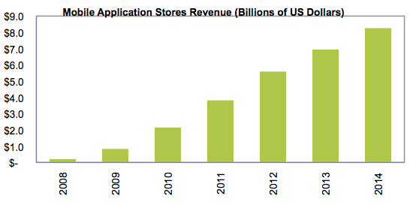
…and on the rise….
Sales of applications on mobile devices is expected to rise across the world; more than quadrupled in past 3 years.
M
Notes:
Purchases made through mobile will drive more and more of the initiatives for mobile apps.

Slide 6
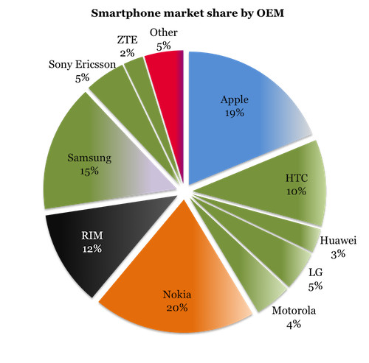
…in a constantly changing marketplace...
Android is coming on strong and Windows is expected to advance quickly
M
Notes:
Clearly the leaders in hardware are Apple and Droid platforms. Blackberry as a platform continues to shrink, although they report that government sales are on the rise.

Slide 7
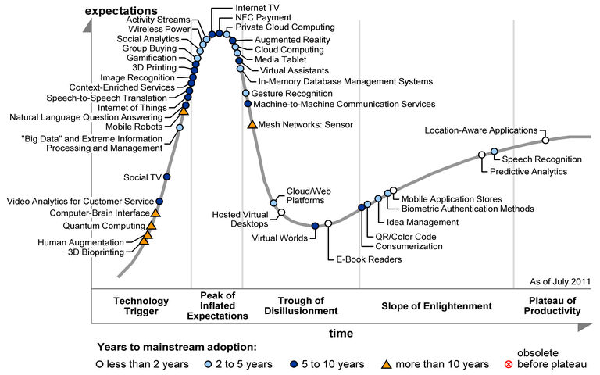
…with new capabilities...
M
Notes:
As apps and devices are more sophisticated, feature rich and integrated with other devices (machine to machine) the challenge for app developers will be to find the right balance of utility with performance, security and back-end data enrichment. By data enrichment, I mean a twofold view of data, what does the consumer of the app get in terms of integrated enriched data i.e. manage all of my Social networking from one place OR from the corporations point of view, what are the buying habits my consumers.

Slide 8
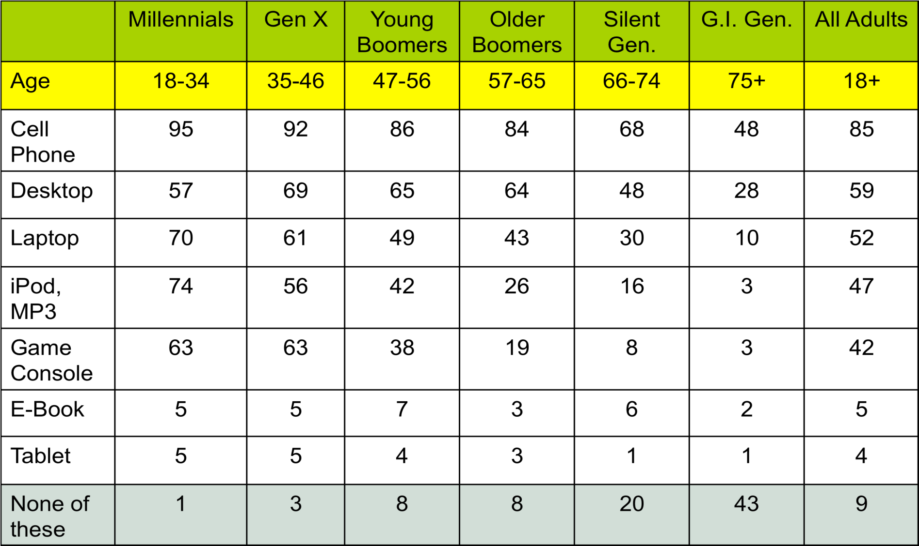
… spanning all demographics...
Pew Research Center’s Internet and American Life Project, Sept. 13, 2010
M
Notes:
As all demographics become users of mobile, Performance and Usability will be key testing focuses.

Slide 9
..with dominant players in the market…..
25B
downloads from Apple’s App Store
19%
of total global mobile data traffic comes from YouTube
400M
users accessing Facebook through their mobile devices
Notes:
App Store – sheer numbers and recognition
You Tube – more and more demands for throughput
Facebook – data enrichment

Slide 10
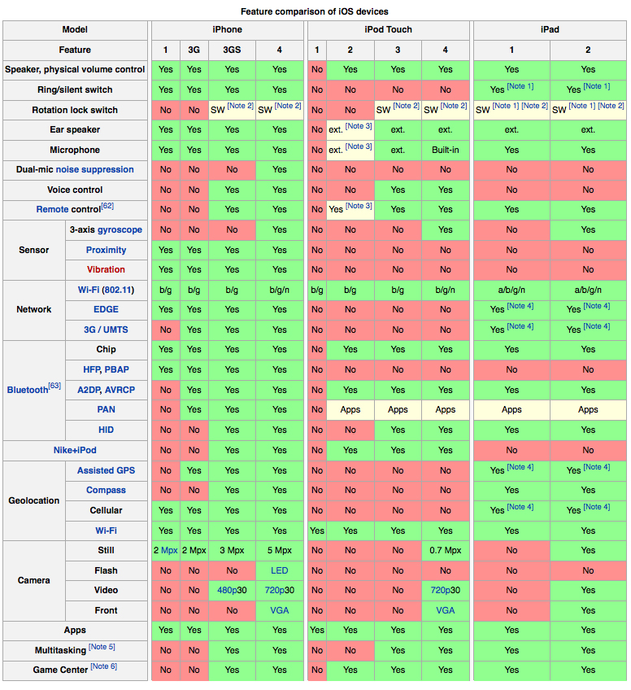
… challenged by quickly changing technology…
M
Notes:
Let’s not forget about platform certification testing

Slide 11
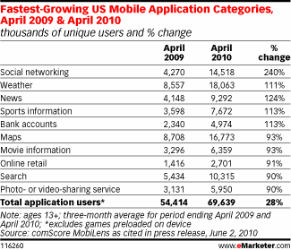
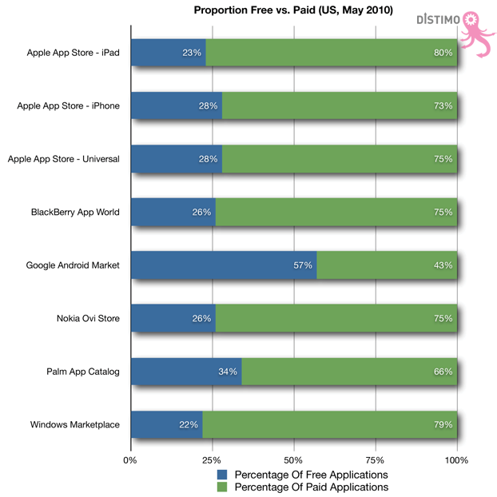
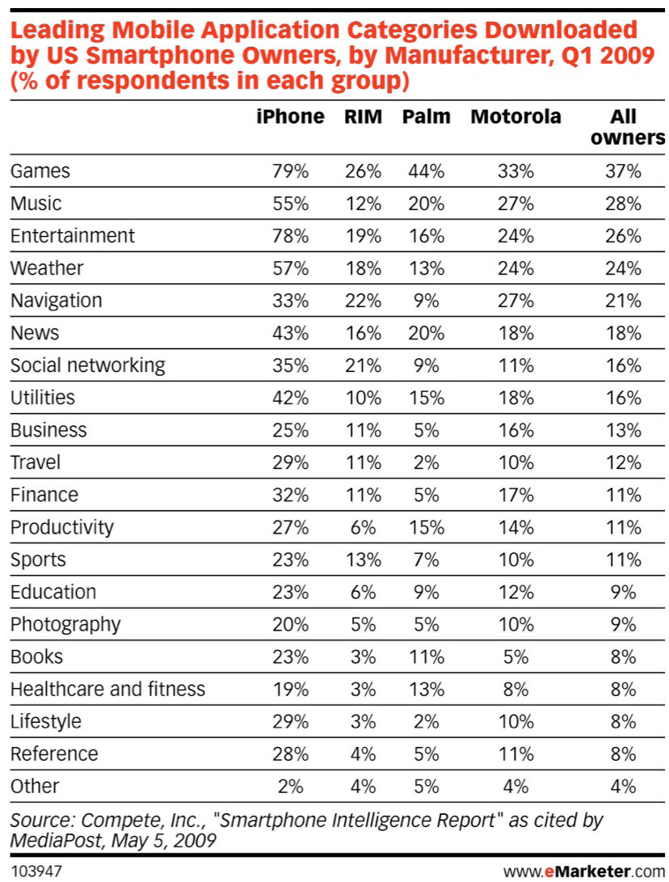
…across a number of different platforms…
Gartner forecasts the total app revenue will increase to nearly $30 billion by 2013 with over 21 billion downloads. The number of free or ad-funded apps will increase to 87%.
iPhone has a larger market share in Mobile Business Applications
M
Notes:
It can be a daunting challenge to react to the time to market demands and maintain standards of quality

Slide 12
But, if you can figure it out…

Slide 13
Introduction
Getting started

Slide 14
Compuware’s Mobile QA Landscape
On site client driven teams – Mobile Web Team (GM)
On site with client self contained teams – NOMAD (NOrth American Mobile App Development (GM)
Fully self contained teams serving multiple clients with diverse mobile solutions – Compuware’s Mobile Center of Excellence (Compuware MCoE)

Slide 15
Goals Today:
1
Understand Testing Types Required for Mobile Apps
2
Adapt to Various Project Types
3
Be Aware of External Challenges and Influences
4
Select Tools that Fit Your Organization

Slide 16
Testing Types
An overview of the most critical mobile testing types
Notes:
Jeff

Slide 17
Meet your new (global) consumer
“I expect …
you to understand my needs, not sell to me.”
to access my data anywhere, anytime.”
to receive information that’s relevant to me.”
to use any device that I choose.”
an engaging, rich media experience.”

Slide 18
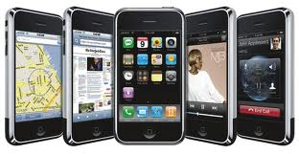
Testing Types
User Interface Testing
External Factor
Performance
Security Testing
Device Certification

Slide 19
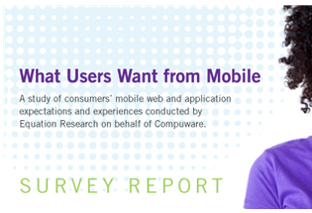
What do companies need to do?
Make sure all stakeholders are aligned to the business objectives
"How Mature Is Your Mobility Strategy"
"Just 45% of our respondents with a mobile strategy in place stated that they have a shared mobile vision across the organization, and only 44% have created a mobile task force to agree on mobile objectives."
"Do you believe that your mobility security strategies would satisfy an auditor? Just over 18% said it would, just over 45% said it wouldn't and the remainder were unsure."
Do you really understand your customers' mobility expectations?
There is zero tolerance for sites that don’t deliver a near perfect experience.
"71% stated they expect websites to load as quickly, almost as quickly or faster on their mobile phone compared to the computer they use at home"
http://blog.hubspot.com/blog/tabid/6307/bid/14281/33-of-Companies-Have-a-Mobile-Marketing-Strategy-New-Data.aspx?source=BlogTwitter_%5B33%25%20of%20Companies%20Hav%5D
http://blogs.forrester.com/thomas_husson/10-10-19-how_mature_is_your_mobile_strategy
Notes:
Forrester – Do companies know why they are getting into mobile? Do they have a solid strategy as to how mobile will
Make money
Reduce costs
Increase recognition
Gartner – Security strategies will determine what companies can do for customers and what they can’t.
Econsultancy – customer’s expect perfect performance anytime, anywhere, any device
All of these factors drive the standards for quality expected by the end users and therefore drive the details for MDQM Testing Strategies.

Slide 20
User Interface Testing
Comparing your application with other native applications
Screen orientation / resolution
Touch screens
Trackballs, Track wheels, and Touchpad's
Soft Keyboard / Hard Keyboard
Shortcuts
Notes:
1. Overall color scheme/theme of the device. For example,
BlackBerry has several themes that differ between its own models.
2. Style and color of icons. For example, Android has well-defined
icon design guidelines.
3. Progress indicators. Graphic representation of when pages are
loading.
4. Menus. How they are invoked and typical items they contain.
5. Responsiveness. How an application on this device is responding
overall.
Orientation and Resolution:
All pages of the app need to be tested in both orientations and with screen lock functions.
Multi-touch (pinch and zoom) vs. single touch actions.
Short touch v. long touch
Button size and position
App workflow: wizard, radio buttons and check boxes for configuration.
Soft Keyboard
1. Does the soft keyboard automatically appear if the user’s main
objective is to enter some text?
2. Does the first layer of the soft keyboard include shortcut “@”
and “.com” keys if the highlighted field is for entering email
addresses? If validating Android devices, the quality management
staff can validate this action by using the “textEmailAddress”
attribute.
3. Does the device enable a long touch on a soft character key to
bring up several different character choices for that input, such as
different accents and symbols on a Windows Mobile device when
entering contact information?
4. Can the soft keyboard be used, dismissed and re-displayed easily?
5. Can the soft and hard keyboards be used interchangeably (if the
device in question has both)?
6. Do the soft keyboard characters entered in password fields display
only as ****?
Hard Keys
Quality management must ensure extensive testing around the use
of the device’s available hard keys such as “Start,” “Home,” “Menu”
and “Back.”
App to App
Contacts
Phone
Email
Maps
Settings
Screen Layout and touch

Slide 21
External Factor
Browser
Back end data connectivity
Security
Social Media
Notes:
Phone Calls and Other Interruptions
If the mobile device being addressed is also capable of making and
receiving phone calls, ensure to test the below referenced scenarios
in order to gauge how the application reacts before, during and after
phone calls:
1. The application is interrupted by an incoming call, originator hangs
up the call.
2. The application is interrupted by an incoming call, terminator
hangs up on the call.
3. The application is interrupted by placing an outgoing call,
originator hangs up the call.
4. The application is interrupted by placing an outgoing call,
terminator hangs up on the call.
In addition, quality management should take into consideration such
interruptions as:
1. text messages
2. voicemail notifications
3. calendar events
4. social media notifications (Facebook, Twitter, etc.)
5. alarm clocks
6. low battery notifications,
Any of the above may have an impact on the functionality or overall
responsiveness of the application.
Security
1. Most mobile devices operate on the assumption of a single user;
they usually do not have multiple accounts (except in the case of
multiple email addresses configured per device, which, in turn, is
to be tested if the application deals with the devices’ “Contacts”
or “Email” functions).
2. Basically, it is up to the user whether or not they configure a
password or unlock pattern for their device.
3. All necessary encryption needs to take place at the application
level, as the device more than likely will not handle this
requirement.
4. Any outside communication of any sensitive data should be done
over SSL/TLS since it can’t be assumed that the device user will
configure Wi-Fi to be secure.

Slide 22
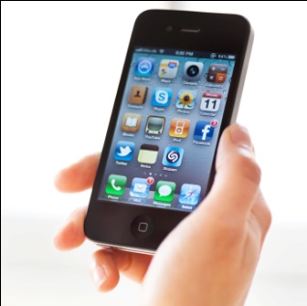
Performance
Monitoring Systems and Usage
Focus on architecture and testing to ensure the quality of the application and infrastructure so they are primed to deliver and maintain.
Monitor behavior and usage to optimize long term design solution.
The Compelling Market Shift > Mobile and Internet Mature
Customer PERCEIVES the Entire Services Delivery Chain as the Carriers Responsibility
Customer Requests Value at Device
Customer Realizes Value as Content Delivered
Device
(Laptop, Handset)
Application
(Browser, Client, Mail, etc…)
Network
(Access)
Content
(E-Mail, YouTube, Stock quote, etc)
Customer Satisfaction is MEASURED and EARNED across the entire Service Delivery Chain
S
Notes:
Consider that the Device – Application – Network – Content “network” represents the Service Delivery Chain. The customer satisfaction will be measured and earned against the weakest link in this chain.

Slide 23
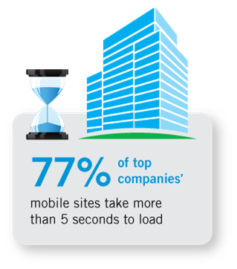
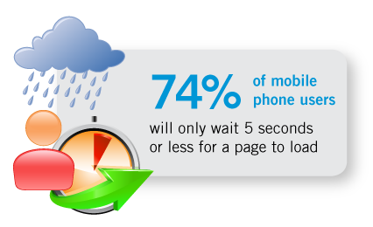
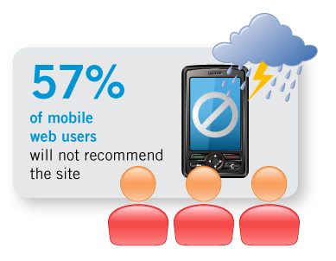
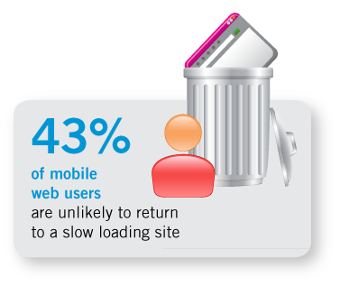
Performance can’t be an afterthought
Consumer expectation
Reality
The result
Lost Revenue
&
Lost Credibility
Notes:
Designing in performance through out app development will be crucial.
Testing and design working together can ensure greater chance for success.
Not to do so will result in lost revenue and lost credibility

Slide 24
How quickly should your web site load on your tablet?
32%
24%
20%
13%
11%
2 SECONDS
-------------------------------------------------
MEDIAN EXPECTED LOAD TIME

Slide 25
Performance
Individual App
Device
System Integration
Memory Usage
Battery Life
Notes:
1. Load the application with as much data as possible in order
to reach its break point. This step can be illustrated by using
Windows Mobile devices (as an example) and ActiveSync
(Windows XP) or Windows Mobile Device Center (Windows Vista).
This step allows quality management full access to the Windows
file system on the device in order to add the necessary testing
files where required.
2. Perform the same functions/operations repeatedly, particularly
those that load large amounts of data.
3. Perform the repeated operations at varying speeds.
4. Leave the application running for an extended period of time,
interacting with the device and just letting it sit idle, or activating
an automatic task that is extremely time consuming (for example,
displaying a 150-photo slideshow).
5. Randomly send screen entries and keystrokes to the application.
6. Have multiple applications running on the device in order to switch
between the application and other device applications often, and
at different states with the application.
a. O n BlackBerry and Android devices you can press and hold the
hard “Home” or “Menu” key, respectively, to quickly switch
between active, running applications.
b. Utilize all methods to launch the application. For example, on
Windows mobile, use the Touch Flo, the file explorer and, if
the application is already launched, perform “maximize” and
“minimize” actions.

Slide 26
App Store Standards Drive Certification Requirements…

Slide 27
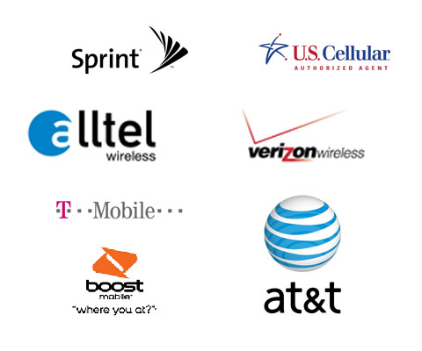
Carrier network Drive Certification Requirements…

Slide 28
Device Certification
Manufacturer
Operating System
Carrier
Notes:
1. only 4G LTE connection
2. only 4G connection
3. only 3G connection
5. only Wi-Fi connection
6. with no SIM card in the device
7. in “airplane” mode (or all connections disabled)
8. using the network through a USB connection that a user might
encounter in the real world:
a. distance yourself out of Wi-Fi range so the connection
automatically switches to 3G/2G.
b. plan a scenario in which a tester rides in a elevator or on a train
where network connectivity may go up and down.
c. no network connection available at all.

Slide 29
Goals Today:
1
Understand Testing Types Required for the App
2
Adapt to Various Project Types

Slide 30
Project Types
Comparing different types of mobile projects and how testing needs vary
Notes:
Steve

Slide 31
Project Types
Waterfall
Agile
Assessment

Slide 32
Waterfall Mobile Development
Notes:
Sample SDLC
Highlight Entry Points
Common Deliverables
Requirements documentation
Test Plan
Test Cases
Test Data
Defect Tracking

Slide 33
Mobile Team – Waterfall approach
Don Vendor 1 PM
Vendor 1 Team
Jane the Client
Betty Vendor 2 PM
Test Team
Vendor 2 Team

Slide 34
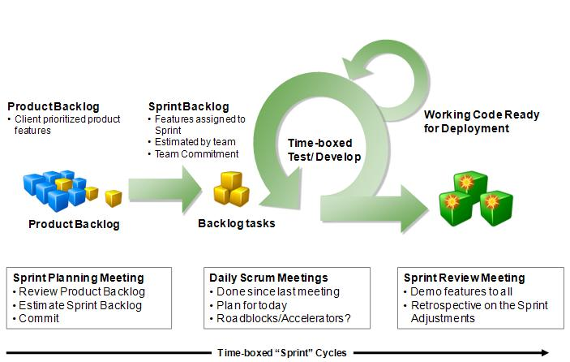
Agile
Notes:
Sample Sprint
Highlight Entry Points
Common Deliverables
User Stories
Test Plan
Test Cases
Test Data
Continuous Testing
Defect Tracking
Product Owner Demo

Slide 35
MCoE – Agile approach
External Team
Dev Pair
Ted Scrum Master
Frank the Product Owner
Ravi QA
Sue BA
Dev Pair

Slide 36
Assessment
Readiness for MDQM
Factors
Criteria
Benchmarks
Technical and Non-technical

Slide 37
Goals Today:
1
Understand Testing Types Required for the App
2
Adapt to Various Project Types
3
Be Aware of External Challenges and Influences

Slide 38
External Challenges and Influences
Exploring the challenges and influences shaping mobile quality
Notes:
Bob

Slide 39
External Challenges and Influences
Government Influences
Device preferences
Standards
Verizon / AT&T / Apple / Motorola
Network
Standards
Partnerships
Get Connected with mobile associations
Professional Societies with mobile special interest groups
InfraGard’s Chicago Chapter
Mobile Mondays

Slide 40
Goals Today:
1
Understand Testing Types Required for the App
2
Adapt to Various Project Types
3
Be Aware of External Challenges and Influences
4
Select Tools that Fit Your Organization

Slide 41
Tool Selection
Identifying the right tools for the job
Notes:
Steve

Slide 42
The Art and Science of MDQM
Each team needs to find the right blend of the Art and Science of testing…
M

Slide 43
Tool Assessment
Emulators and Simulators
Automation
Continuous Integration
Performance
Notes:
1. Not all activities can be realistically emulated, such as switching
network connections, or using device visuals (videos and pictures).
2. Certain activities don’t work at all on emulators, such as streaming
video on a BlackBerry emulator.
3. Due to lower device power and memory, the application could
display slower performance overall when run on an actual device
(versus an emulator installed on a more powerful desktop
computer).
4. If the emulator and actual device have different DPI resolutions,
screens may not be displayed as expected.
5. Device simulators are run from a desktop and are controlled by
mouse and keyboard actions, whereas emulators replicate the
actual device features and functions and will more accurately
mirror the handheld device (touchscreens, soft keyboards,
trackballs, etc.).

Slide 44
Emulators and Simulators
The difference…
The Simulator tries to duplicate the behavior of the device.
The Emulator tries to duplicate the inner workings of the device.
Notes:
Selection Criteria
Factor Weighting
Names
Decision Analysis
The emulator acts exactly like the real device would. For example, a NES emulator implements the CPU, the sound chip, the video output, the controller signals, etc. The unmodified code from a NES cartridge can be dumped and then the resulting image can be loaded into our emulator and played. Suited for both UI and External Factor testing
A simulator is a partial implementation of a device/platform, it does just enough for its own purposes.

Slide 45
Emulators and Simulators
The tools…
NAME | PLATFORM | TYPE
Android Emulator | Android | Emulator
BlackBerry Simulator | RIM OS | Emulator
BlackBerry Playbook Simulator | Tablet OS | Virtual Machine
Mobile Device Automation Test Tools
FoneMonkey | iOS | Automated Testing
TestQuest Pro | RIM OS, iOS, Android | Automated Testing
Robotium | Android | Automated Testing
Hopper (Stress testing) | Windows Mobile | Automated Testing
Notes:
Selection Criteria
Factor Weighting
Names
Decision Analysis
The emulator acts exactly like the real device would. For example, a NES emulator implements the CPU, the sound chip, the video output, the controller signals, etc. The unmodified code from a NES cartridge can be dumped and then the resulting image can be loaded into our emulator and played. Suited for both UI and External Factor testing
A simulator is a partial implementation of a device/platform, it does just enough for its own purposes.

Slide 46
MDQM Project Quality Pyramid
Manual
Robotium – Automated Test
OC Unit – iOS Unit Testing
Hudson – Continuous Integration

Slide 47
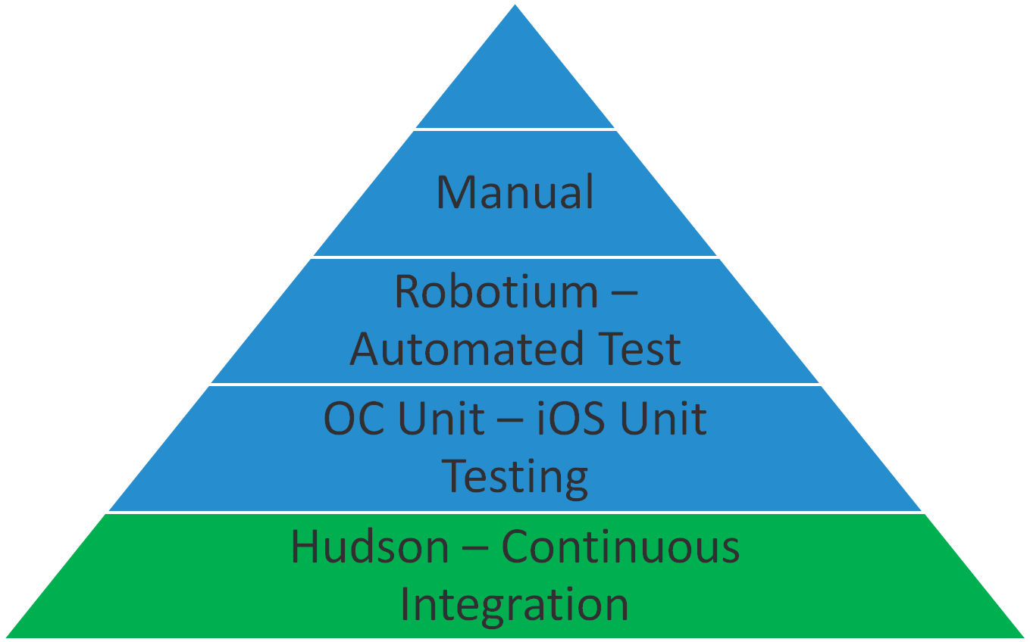
Continuous Testing
Hudson – Build / continuous integration server
Hudson monitors executions of repeated jobs, such as building a software project or jobs run by cron. Among those things, current Hudson focuses on the following two jobs:
Building/testing software projects continuously
Monitoring executions of externally-run jobs

Slide 48
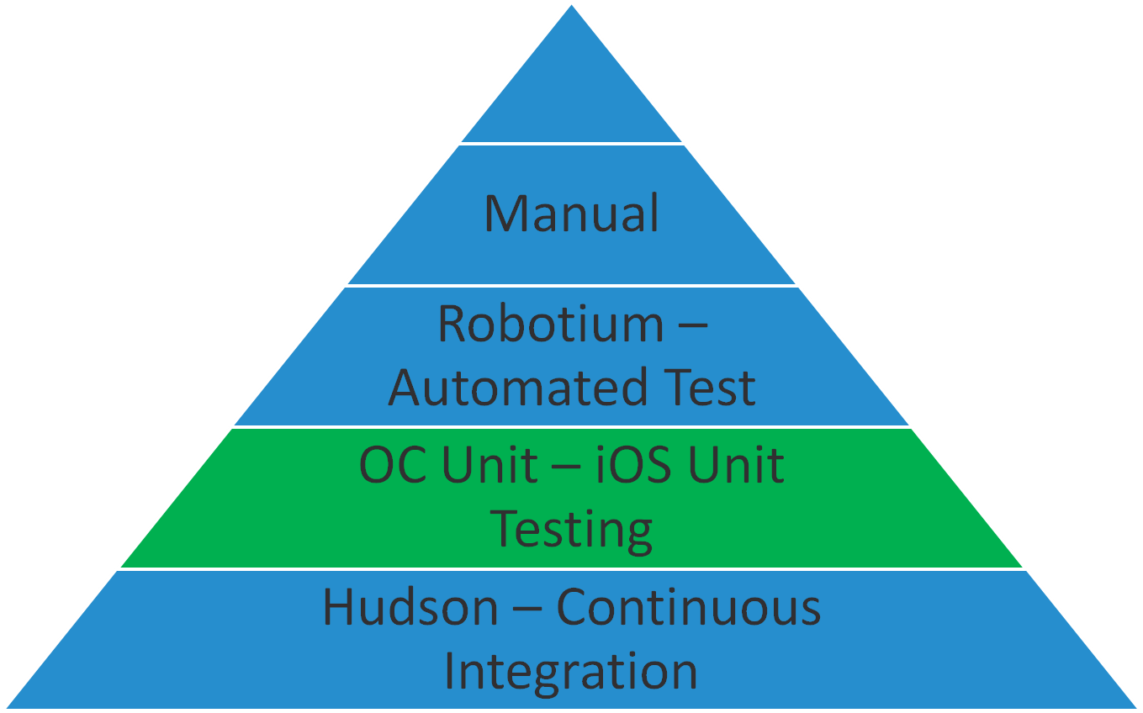
Continuous Testing - iOS
OC Unit – This is a unit testing tool for iOS
Integrates with the build tool Hudson
Allows for retest every time code is checked in
Integrated with Xcode
Notes:
Hudson – This is our build / continuous integration server. This server pulls the code from source control (Git), compiles it, created a installable package (APK for Android / IPA for iOS) and runs any unit tests and displays the results. We set this up to build on a frequent basis, or on every check in so we can quickly identify any ‘bad’ code that’s been introduced into the system.
Robotium – This is the test automation ‘framework/tool’ for android. It’s like selenium (automation tool for web testing) but for android applications. We can run Robotium tests automatically in an emulator from Hudson.
OC Unit – This is a unit testing tool for iOS. This is a iOS tool for we use like Robotium to run unit and functional automated tests as part of the build process from Hudson.
VersionOne – this is our agile project management tool. From this we track the user stories we are working on in a sprint. The user stories are broken down into tasks. We typically create tasks for unit testing, functional automation and manual testing. VersionOne has the capability to create the manual tests and show results in the content of the user story. If we find defect they we deem need to be tracked, we enter those defects in versionone.

Slide 49
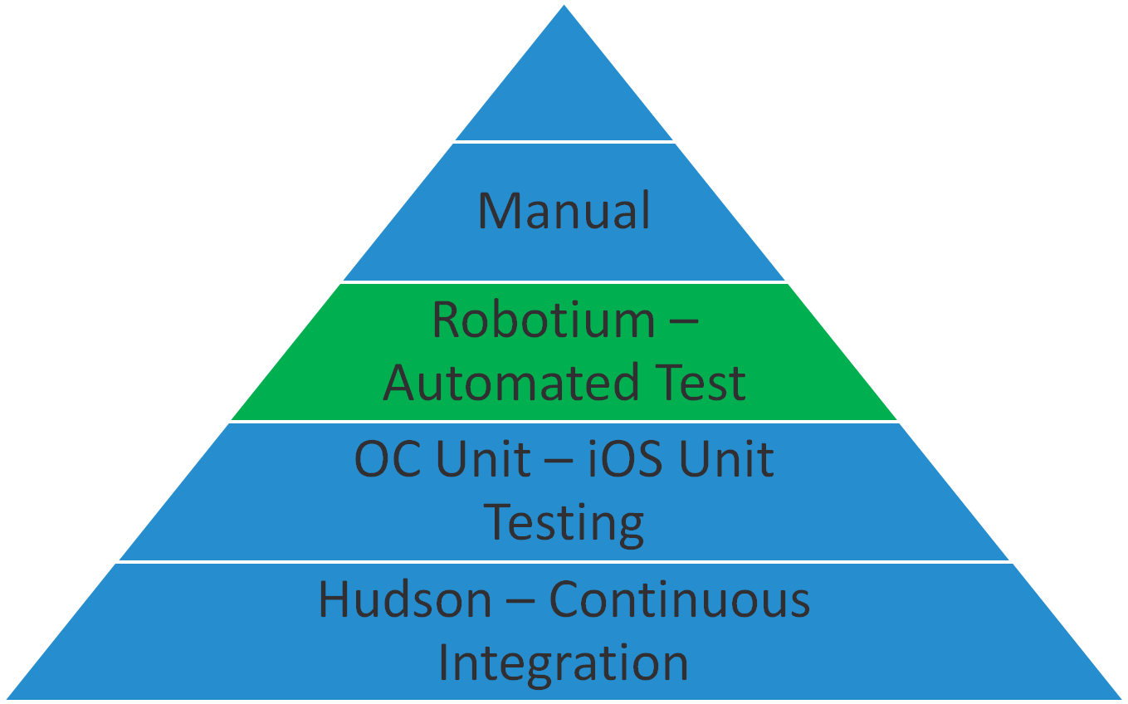
Automation
Robotium – This is the test automation ‘framework/tool’ for android.
Allows for robust record and play back testing
Selenium based

Slide 50
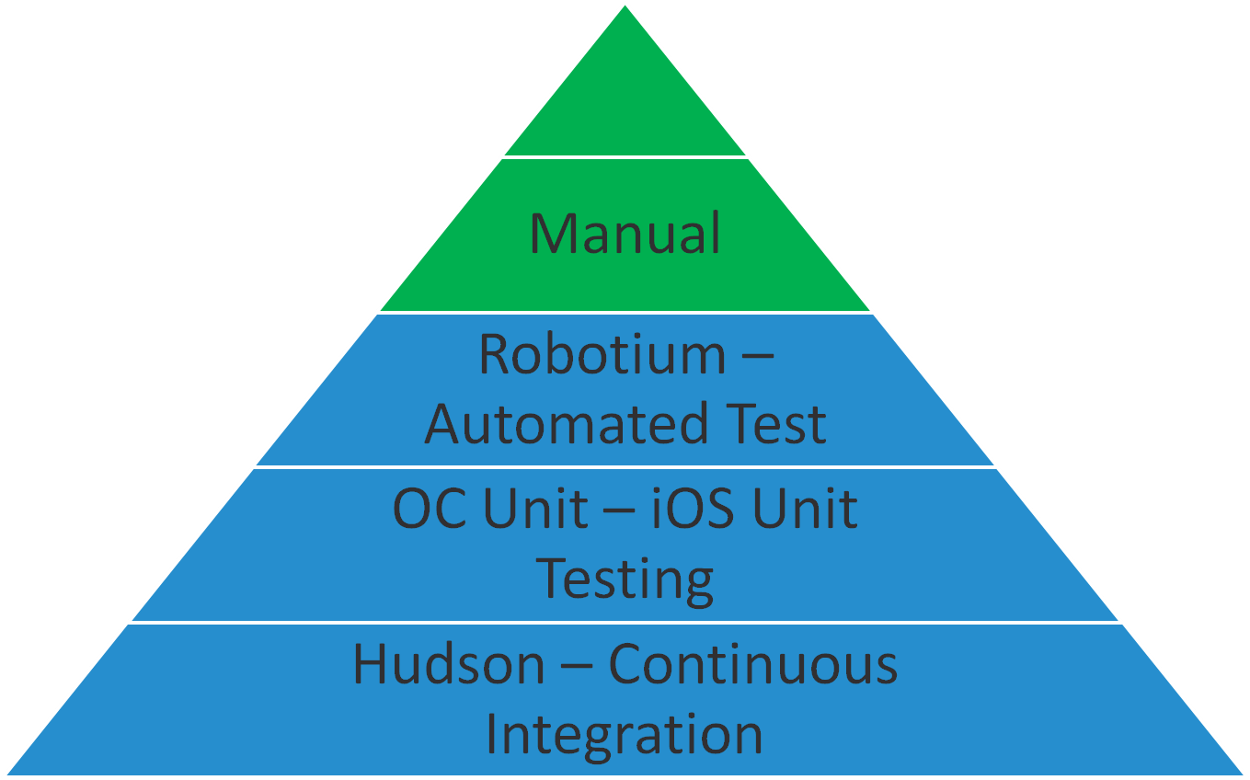
Manual Testing
Manual Testing
Testing Lab with selected devices
UAT/Final demo with the product owner

Slide 51
Performance
Gomez Mobile Real User Monitoring (RUM)
measures performance and traffic metrics directly from your end user’s browsers and mobile devices
links page views and conversion/abandonment rates to mobile site and application performance and end-user satisfaction.

Slide 52
Questions

Slide 55
The Slide Parking Lot
Holding area for slides that are de-scoped or under review

Slide 56
Themes
New Team
Existing Team
Multi-vendor
Single Vendor

Slide 57
Mobile Device Troubleshooting
Best practices for problem solving and exhaustive testing for mobile
Notes:
Jeff (Steve and I are not sure how much might exist for this topic).

Slide 58
Mobile Device Troubleshooting
Skills
Tools
QA Analyst
Developer

