Slide 1
Creating a Culture of Quality
Kristin Jackvony
Chicago Quality Assurance Association
March 22, 2023

Slide 2
About ME:
Principal Engineer III, Software Testing: Paylocity
Blogger: Think Like a Tester (thinkingtester.com)
LinkedIn Learning Course Author: Postman Essential Training
Author: The Complete Software Tester (available on Amazon)

Slide 3
Why the Whole team needs to own quality

Slide 4
From “Accelerate” by Nicole Forsgren, Jez Humble, Gene Kim
“It’s interesting to note that having automated tests primarily created and maintained either by QA or an outsourced party is not correlated with IT performance. The theory behind this is that when developers are involved in creating and maintaining acceptance tests, there are two important effects. First, the code becomes more testable when developers write tests...Second, when developers are responsible for the automated tests, they care more about them and will invest more effort into maintaining and fixing them.”

Slide 5
From “Clean Code” by Robert C. Martin
“...having dirty tests is equivalent to, if not worse than, having no tests. The problem is that tests must change as the production code evolves. The dirtier the tests, the harder they are to change. The more tangled the test code, the more likely it is that you will spend more time cramming new tests into the suite than it takes to write the new production code. As you modify the production code, old tests start to fail, and the mess in the test code makes it hard to get those tests to pass again.”

Slide 6
Chapter one: Paylocity’s quality initiative

Slide 7
About paylocity
Founded in 1997, Paylocity is a cutting-edge Human Resources and Payroll tech company.
We were listed in Glassdoor’s Best Places to Work in 2019, 2018, 2017, and 2014
We are a fast-growing company; in the last seven years, we’ve grown from ten development teams to over 50!

Slide 8
The problem
The fast growth of the company, combined with the fast-paced development to keep up with competitors was putting a strain on teams
Testing was seen as an activity for the QAs only, and QAs were expected to do all the manual testing in addition to all of the test automation
Some QAs did not have automation skills, which meant that some teams were slowed down by relying on manual tests
Rushing to get features out the door meant that not everything was tested, resulting in bugs that escaped to production

Slide 9
The Quality Initiative
Assessing our current QA engineers
Creating a Quality Maturity Model
Asking each team to create a Quality Strategy

Slide 10
QA reassessment
QA became “Software Test Engineer” (STE), to reflect that we wanted testers who could automate
All QAs were given the choice of the STE path or the Product Analyst path
All testers who chose the STE path were assessed as Associate Software Test Engineers, Software Test Engineers, or Senior Software Test Engineers

Slide 11
The definition of quality
We needed to determine what we wanted “Quality” to look like at Paylocity
We first developed a definition of Quality:
Valuable- it provides value to the customer
Functional- it behaves the way the customer expects
Reliable- it is available whenever the customer needs it
Secure- it protects customer and company information
Performant- it responds in an appropriate time
Usable- as many people as possible are able to use it
Maintainable- teams are able to easily maintain the software

Slide 12
The quality maturity model
After we had defined quality, we came up with a series of behaviors that exemplified each of the facets of quality
The behaviors were organized into “Minimum”, ”Standard”, and “Excellent”:
Minimum- the bare minimum of what we wanted each team to do
Standard- what we would expect every mature team to do
Excellent- behaviors that went above and beyond our expectations

Slide 13
Fragment of quality maturity model

Slide 14
The quality strategy
We expected each team to have at least one STE, but possibly only one per team
We announced that the whole team would own quality, which meant that developers would be responsible for contributing to testing efforts
This could mean that the whole team participated in manual regression testing before a release, or that the developers were responsible for maintaining the automated test framework, or some variation on both
We asked each team to create a Quality Strategy, which served as a description of how the team would own quality

Slide 15
Features of The quality strategy
How does the team decide what to work on?
How are features crafted into stories? Who contributes to that process?
How do we determine when a story is ready for testing?
How is the story handed off?
Who will be doing the testing? Who creates the test plans?
What is the procedure for logging and fixing bugs?

Slide 16
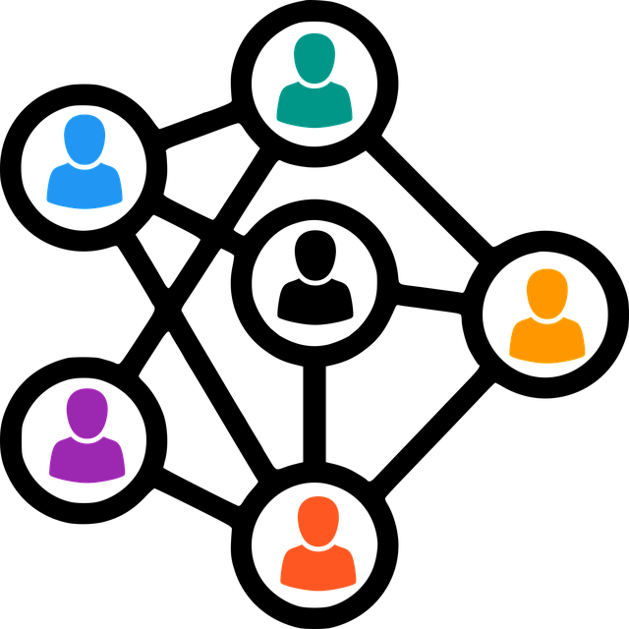
Features of The quality strategy- Continued
Who will write the test automation? Which group will be responsible for which automated tests?
Who will maintain the test automation?
Who will be doing other non-functional testing, such as security, performance, and accessibility testing?
What tools will be used for testing?
How will the software be released?
How will the team measure the success of the release?
How will the team monitor the health of their application?

Slide 17
Fragment of quality strategy

Slide 18
implementation
The Quality Maturity Model was announced with great fanfare in the Summer of 2020
I met with every manager, tester, and developer to answer questions about the program
Each team was challenged with getting to 100% Minimum compliance by the end of the fiscal year
I set up monthly meetings with representatives from every team to talk about their progress and help solve challenges
I met with senior managers bi-weekly to report on the progress of the initiative

Slide 19
Chapter TWO: the challenges

Slide 20
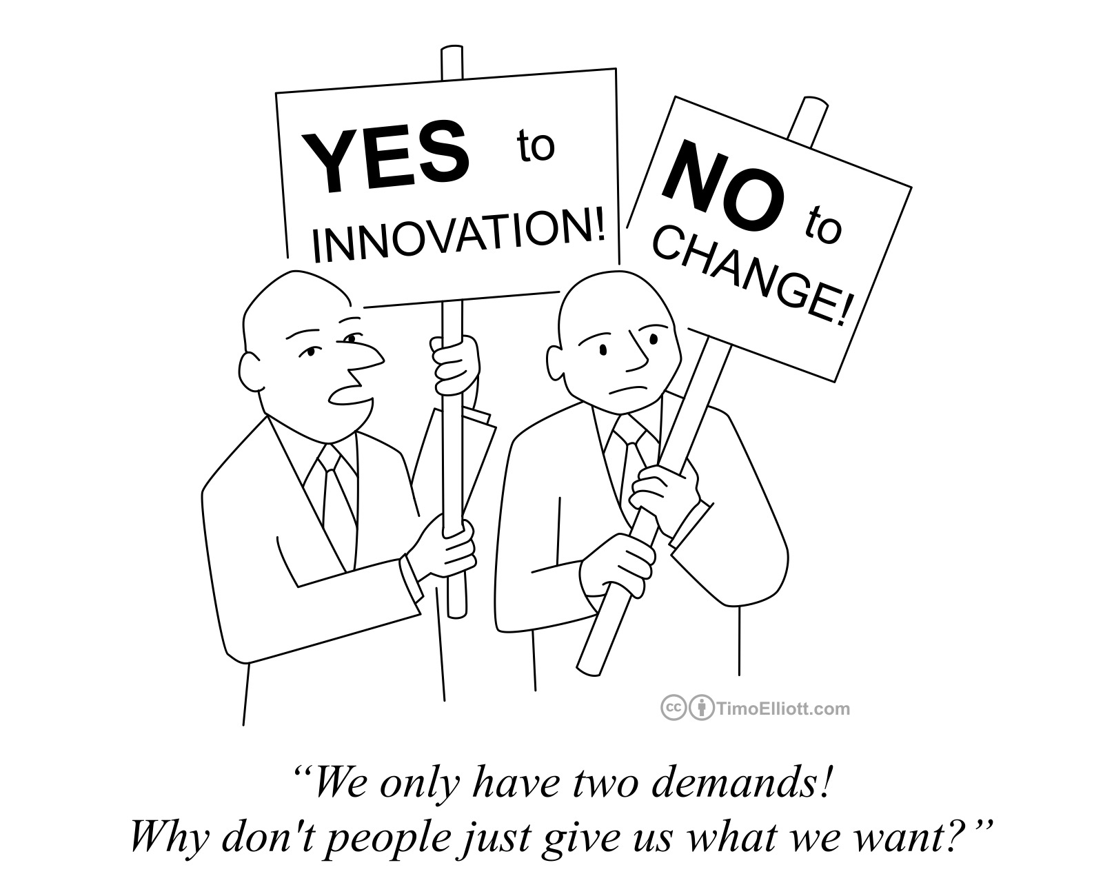
Change is hard!
Needing to level up the Associate Software Test Engineers
Objections from developers and managers
Time and logistic constraints
Keeping up momentum

Slide 21
Leveling up the ASTEs
We created a self-paced learning program- STE Academy- designed to help ASTEs level up their skills
Every ASTE was assigned a mentor who helped guide them through the program
The program included courses such as Cypress, Postman, SQL, Debugging, Git, TeamCity
All but one of the assessed ASTEs has since advanced to STE or above!
The program has also proved very helpful for people outside the technology department who wanted to become testers (3 graduates), and for novice software engineers who wanted to change career paths (3 graduates)

Slide 22
Objections from developers and managers
We don’t have time to participate in testing:
Sharing responsibility means more reliable test automation and fewer escaped defects
One team was able to change their frequency of releases from monthly to biweekly
It’s not our job:
Testers are writing code; what if they said it wasn’t their job?
Do you want to find the bugs while you remember what you coded, or six months from now when you don’t remember?
We don’t need this program because we’re already releasing with great quality
Show examples of what other teams are doing
Be a good example to others by participating

Slide 23
Time and logistic constraints
Meeting monthly with 50 teams was WAY too much for one person
Enter the Category Quality Leads!
Each Category Quality Lead is an STE who is assigned 3 to 6 teams to meet with on a monthly basis
All the Category Quality Leads meet monthly to share successes and challenges
Teams were encouraged to create quarterly goals, and to put those goals in JIRA stories so they wouldn’t be forgotten
Some teams were unable to meet some of the minimum requirements because of crushing tech debt
Those teams were encouraged to make the changes that they could

Slide 24
Keeping Up Momentum
At first, the senior managers were thrilled and excited about the Quality Initiative
As priorities changed, they began to lose interest
We tried to keep up momentum by publicly sharing the progress of the initiative
Which teams had achieved 100% Minimum or 100% Standard
Which teams were most improved
Success stories- fewer defects released to production, improved team velocity, etc.

Slide 25
Chapter Three: the results

Slide 26
How we measured results
The number of teams that achieved 100% Minimum or 100% Standard
The average number of adopted behaviors per team/category
Indicators for each facet of quality:
Valuable- percent of monthly active users
Functional- percent of releases to production that resulted in a major incident
Reliable- percent uptime
Secure- number of critical security issues found
Performant- percent of API calls that took less than 200 ms
Usable- number of critical customer complaints
Maintainable- percent of releases executed in less than four weeks

Slide 27
Quality maturity model adoption stats
After two years, 77% of teams had achieved 100% of the Minimum behaviors
18% of teams had achieved 100% of the Standard behaviors
At the beginning of the program, the average number of behaviors per team was 58, and after two years of the program, the average number of behaviors per team was 75 (out of a possible 104)

Slide 28
Key indicator successes
Valuable- the number of monthly active users increased from 52.9% to 66.4%
Functional- the average percent of releases that resulted in Production incidents went from 4.37% to 0.96%
Secure- the average monthly number of security issues per team found in penetration tests went from 2.41 to 2.00
Usable- the average monthly number of critical customer complaints per team went from 8.33 to 4.66

Slide 29
Less success
Reliable- percent uptime- too difficult to measure by team- did see a small amount of overall improvement
Performant- speed of API calls- too difficult to measure by team- we now have DataDog metrics and golden signals
Maintainable- difficult to measure the frequency of releases, because of lack of clarity with who owns what

Slide 30
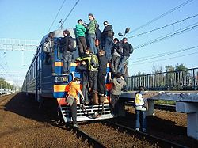
An unexpected result
Because of the visibility of the Quality Maturity Model program, many interested parties wanted to get their initiatives into the model
Sometimes this aligned well with the model, such as when we included accessibility items in the Usable category
Sometimes this did not align well with the model, such as when the mobile team asked us to include a special section for mobile testing

Slide 31
Chapter four: Changes, and Looking ahead

Slide 32
Recent changes
Updates to the Quality Maturity Model were usually made by an architecture board; we proposed that the Category Quality Leads make the changes
We decided not to have “Minimum”, “Standard”, and “Excellent” levels, and instead changed to Level 1, Level 2, and Level 3
Rather than pushing everyone to reach 100% in a certain column, we opted to let teams “choose their own adventure”. This way teams could choose to work on the items that would have the most impact.
We renamed the Category Quality Leads to Category Quality Coaches, to emphasize their coaching role

Slide 33
What does the future hold?
The company has adopted DataDog to monitor our applications, and we’ve already included the SLO team’s goals into our Performant category
We’d like to continue aligning the Quality Maturity Model with other company initiatives, hoping to have better ways to measure reliability and release cadences
Ultimately, it would be nice to have the Quality Maturity Model behaviors serve as gates for releases: e.g. you can release during the workday instead of after hours if you’ve met certain quality objectives

Slide 34
Questions?

Slide 35
Thank You!
GitHub Repo with examples: https://github.com/kristinjackvony/QualityInitiativeSamples
LinkedIn: https://linkedin/in/kristinjackvony
Twitter: https://twitter.com/kristinjackvony
Think Like a Tester: https://thinkingtester.com/
Postman Essential Training- https://www.linkedin.com/learning/postman-essential-training/
The Complete Software Tester- https://www.amazon.com/Complete-Software-Tester-Strategies-High-Quality-ebook/dp/B09NGVVCJ9/

