Slide 1
DISTRIBUTED TEAMS THAT POP
(2022 Edition)
CQAA, February 16, 2022
Cindy Glaser, Life Fitness
Caption

Slide 4
DISTRibuted Work - 2011
2011
800,000 jobs would be moved offshore by end of year
80% of respondents worked from home at least part of their workday
66% of respondents believed that their jobs could be worked virtually
100% work from home jobs were 4.3 percent
Home-based work increased 70% between 2000 and 2010

Slide 5
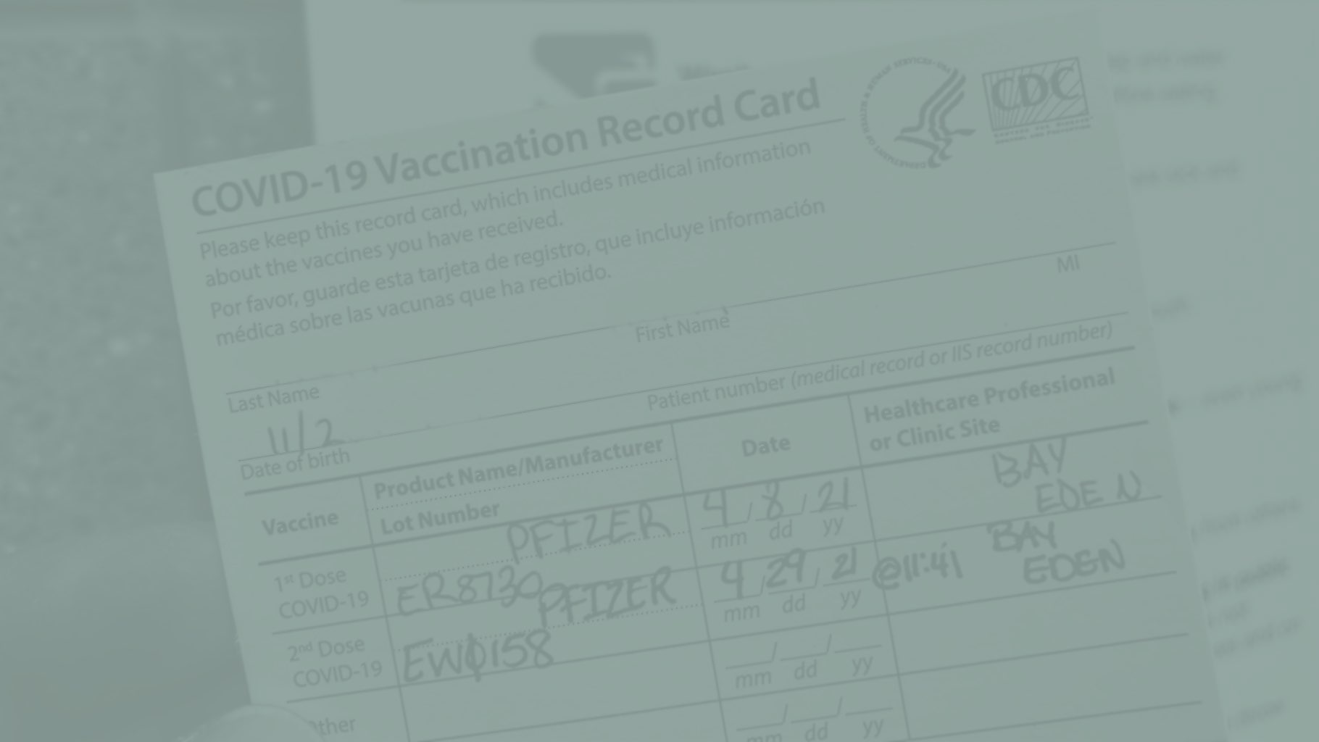
Distributed Work Today
16% of companies are fully remote (Owl Labs)
62% of people are working remotely due to COVID (Gallup)
After COVID, 92% of people surveyed expect to work from home 1 day per week, 80% expect to work 3 days a week from home (Owl Labs)
72% of workers would prefer to work from home at least 2 days a week (Slack)
Outsourcing/Offshoring is not going away: 65% of CISOs outsourced 21-30% of operations in 2021 (Deloitte)
Global IT outsourcing as an industry is expected to grow 98B by 2024. (Computer Economics’ IT Outsourcing Statistics (2020/2021)
Positions in and of themselves are more likely to be filled with an offsite person

Slide 6
“THE great resignation?”
Is remote work and the desire for flexibility driving this trend?
Possibly…24% of those surveyed who changed jobs during the pandemic did so due to the option to work remotely (The Conference Board). Only “Better Pay” and “Career Advancement placed higher.
…but maybe not. Per the Harvard Business Review, “Employees that work hybrid or remotely have fewer friends at work and thus weaker social and emotional connections with their coworkers. These weaker connections make it easier for employees to quit their job by reducing the social pressure that can encourage employees to stay longer.”

Slide 7
Inventory
Team Makeup
Limitations
Strengths
What’s our goal?
What are our priorities?

Slide 8
COMMUNICATION CHALLENGES
2011
Large geographic distribution
Time zone distribution
Lack of tools, or slow adoption
Cultural Challenges
Lack of sophistication and experience
Today
Large geographic distribution
Small geographic distribution
Offshore workers are remote too!
Time zone distribution
Consistent use of tools
Cultural Challenges - Company Culture
No more water cooler
More reasons for being remote, so your metrics are changing

Slide 9
ARE
ZOOM
MEETINGS
HERE
TO
STAY?

Slide 11
WHAT’S
YOUR
MOON
MISSION

Slide 12
ACCOUNTABILITY
Clear OKRs and Metrics
cascade if possible
Meet frequently to discuss
Center the discussion around development as much as accountability, it goes both ways
Come to terms with anxiety
Team norms and definition of done (even if you’re not on an Agile team)

Slide 13
Fake it til we make it
Be Open, there’s no roadmap
Ask for feedback - inspect and adapt
What’s working and what’s not
What are we trying to achieve?
What is impeding us?
Don’t be afraid to use humor (but be careful)!
Give your teams autonomy and share ownership
Don’t lose sight of development opportunities
Acknowledge and manage anxiety where you can

Slide 14
FAILURE IS AWESOME
This is new to all of us, let’s use this unique time as a chance to learn

