Slide 1
Emotional Intelligence: Bringing Heart into Testingl

Slide 2
EXERCISE

Slide 3
Your experience of Emotional Intelligence
Think of your best ever boss, coworker, mentor, coach, teacher, etc
Write their name at the top of your paper and draw a line underneath.

Slide 4
Jane Doe
1.
2.
3.
4.
5
6.
Leave some space underneath

Slide 5
1.
2.
3.
4.
5
6.
Significantly less than others
Less than others
About typical
More than others
Significantly more than others
What is YOUR experience?
Demonstrates awareness of their mood and emotions
Makes others feel appreciated
Is open and honest about mistakes
Makes ethical decisions
Manages their emotions effectively in difficult situations
Recognizes others’ hard work and achievements
Notes:
Sum up the total number

Slide 6
How did they make you feel?
Consider how you felt around this person.
Underneath your ratings, write down the feelings and/or emotions that come to mind about this person.

Slide 7
Your experience of Emotional Intelligence
Think of your WORST ever boss, coworker, mentor, coach, teacher, etc
Write their name at the top of your paper and draw a line underneath.

Slide 8
Bob Backbreaker
1.
2.
3.
4.
5
6.
Leave some space underneath

Slide 9
1.
2.
3.
4.
5
6.
Significantly less than others
Less than others
About typical
More than others
Significantly more than others
What is YOUR experience?
Demonstrates awareness of their mood and emotions
Makes others feel appreciated
Is open and honest about mistakes
Makes ethical decisions
Manages their emotions effectively in difficult situations
Recognizes others’ hard work and achievements
Notes:
Sum up the total number

Slide 10
How did they make you feel?
Consider how you felt around this person.
Underneath your ratings, write down the feelings and/or emotions that come to mind about this person.

Slide 11
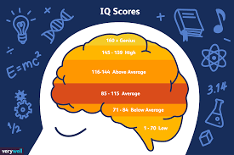
Best scores?
Worst scores?
Best feelings?
Worst feelings?

Slide 12
You just assessed this person’s demonstrated emotional intelligence.

Slide 13
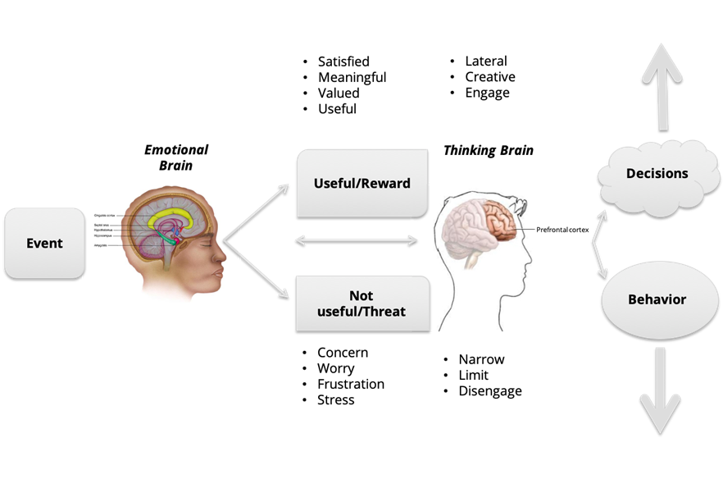
The Science of Emotions

Slide 14
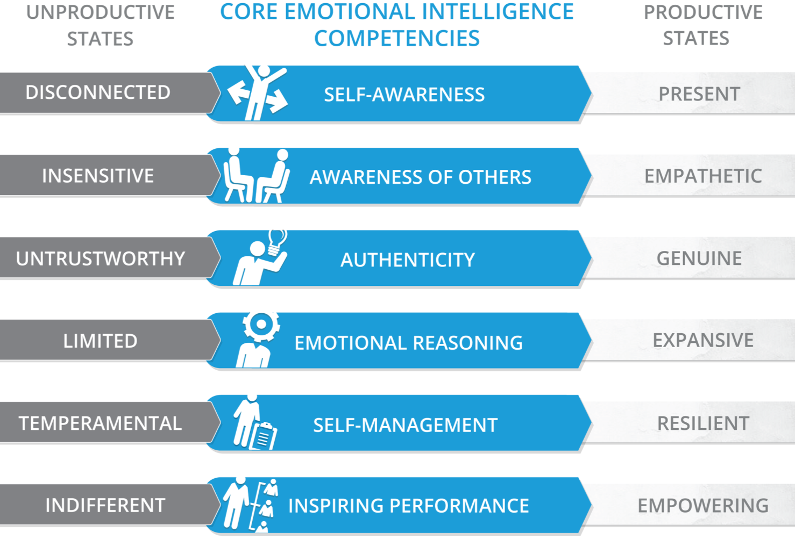

Slide 15
It’s not the code. It’s not the product. It’s not the bugs. It’s not the tests.
It’s people.

Slide 16
More than any technical skill, this is what you should be putting your personal development towards.

Slide 17
So what does all this have to do with QA, anyway?
Let’s deep dive to find out

Slide 18
Awareness of Others
Balances achieving results with others’ needs.
Notices when someone needs support and responds effectively.
CEO
CFO
Sales Director
Wendy Writer

Slide 19
Authenticity
Self-Management
Responds effectively when challenged.
Quickly adapts to new circumstances.
CEO
CFO
Sales Director
Vinny Viewer
Wendy Writer

Slide 20
Mike Kaufman
Executive and Team Coach
/in/mkaufman811
@mkaufman811
mike@kaufman-consulting.ca
www.kaufman-consulting.ca

Slide 21
Thank you.

