Slide 1
Regression Testing – Scenario Identification, Prioritization and Optimization
Presented by: Bindhya Sathyapal
Quality Assurance Lead - eCommerce
W.W.Grainger Inc.

Slide 2
Agenda
Regression testing and why it’s needed
Identifying the core regression scenarios
Prioritizing regression tests
Automating regression tests
Ongoing maintenance and optimization of a regression test suite
Automation Test Life Cycle

Slide 3
OUR GUIDING PRINCIPLE FOR THIS Session

Slide 4
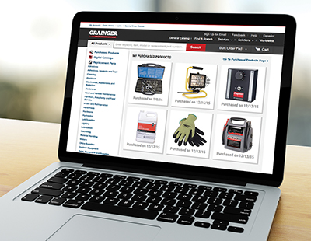
Grainger: Facts and Figures
Grainger, established in 1927, is a Fortune 500 MRO (maintenance, repair and operations) company
$11.2 billion in sales in 2018
11th largest e-retailer in the United States and Canada
71 percent of orders originate online in the U.S.
1.7 million products stocked
More than 5,000 key product suppliers
456 branches
30 distribution centers
~25,000 team members
More than 3.5 million active customers

Slide 5
Intro
Bachelor’s in Electronic and Communication
Previous Gigs
Nordstrom
Sears
11+ years in IT, 7+ years at Grainger
QA lead for Grainger.com
Experienced in Account and Order Management, ePro, KeepStock, Product Search, AGI, Mexico ,Regression and Release Management
QA and Agile Processes and Best Practices Advocate
Privacy champion, active member of Women in IT Business Council and campus recruitments
Interests :
Travelling, Dancing, Painting
Fun Fact :
Avid road tripper- covered 44 states by road so far, 6 more to go!

Slide 6
WHY Regression testing ?
Customer Requirements
and Business Priority Changes
Add/Modify/Delete Code
Reused or Referenced Modules
Directly Related Features
Regression testing is the type of testing aimed at testing all major functionalities in the application to ensure any new changes have not negatively affected current application behavior and is business ready
Regression testing unmasks:
new issues introduced by updates or fixes
issues that already existed but uncovered with the new changes
new code fragments corrupting any part of the already existing feature

Slide 7
Identification of regression scenarios
Core features of the application
Recently modified and frequently modified functionalities
Complex test cases
Most used and most visible features to customers
Biggest revenue generators
All integration tests and E2E tests with connected systems

Slide 8
Identification of regression scenarios
Let’s reflect and share…

Slide 9
Prioritization of regression test cases
Fault impact based prioritization-
tests that has highest customer or revenue impacts from defects
test cases that have a higher fault detection capability
History based prioritization-
past failure rates of tests
Customer requirement based prioritization-
customer priority
requirement complexity
requirement fluidity
constantly passing tests
Cost effectiveness based prioritization-
cost of execution and validation
cost of data preparation,
cost of analysis and fixing the bug

Slide 10
Prioritization of regression test cases (Contd.)
Priority Levels:
HIGH
MEDIUM
LOW
Execution in order of priority allows early detection and fix of critical issues
Regression Levels :
Core test cases-
executed every regression cycle, no matter what changes were applied to the system
Conditional test cases-
not run every single regression cycle
only pulled in for run if a particular module or feature is impacted
This categorization helps minimize the cost of regression test execution

Slide 11
Prioritization of regression test cases
Let’s reflect and share…

Slide 12
Automation of regression tests
Scope of Automation
Pros and Cons
IN SCOPE:
Test cases that remain reusable for years to come
Stable functionalities
Test cases that constantly pass
OUT OF SCOPE:
End-to-End test cases that has time lags and lots of systems data passes through
Heavy dependency on newly created data on every run
Functionality that constantly undergoes change
PROS:
Speeds up test execution
Increases browser coverage
Reduces cost for manual labor
Repeatable, reusable and reliable
CONS:
False failures and complex analysis/debugging
Significant time for initial development and script maintenance
Requires a higher skill level of team members
Increase tool needs (test runners, frameworks, etc.)

Slide 13
Automation of regression tests
Let’s reflect and share…

Slide 14
Ongoing Maintenance and Regression suite Optimization
Using CRUDE method to minimize test suite while achieving maximum test coverage:
Consolidation of test cases
Reprioritization with business owners
Updating of test cases based on new or modified requirements
Deletion of obsolete test cases
Elimination of redundant test cases

Slide 15
MAINTENANCE of regression tests
Let’s reflect and share…

Slide 16
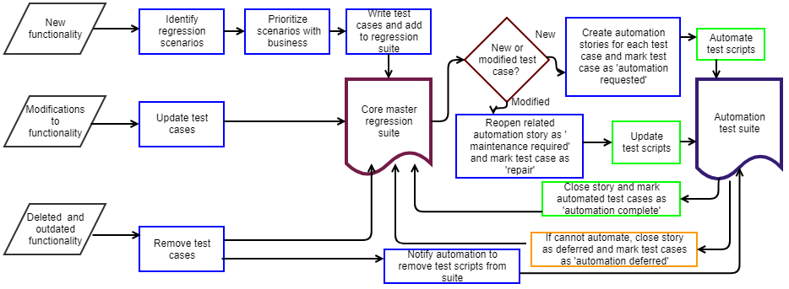
Regression AUTOMATION CYCLE

Slide 18
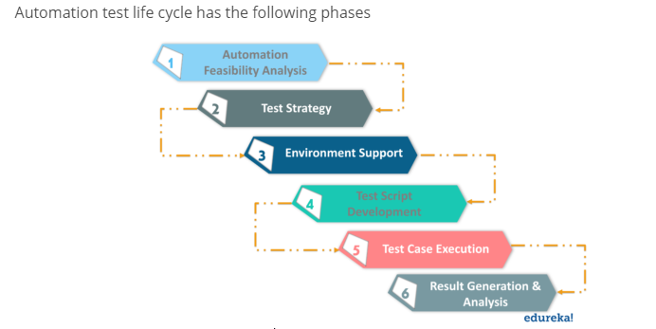
Automation TEST LIFE CYCLE
Automation process should be well defined and structured. It should be cost-effective and result-oriented.

Slide 19
Automation FEASIBILITY ANALYSIS
Feasibility analysis includes selection of the candidate tests to automate
Needs to be looked at a few different levels and here are some questions to ask:
Application Level:
Can the application being tested be automated?
How often does application undergo change?
Will automation maintenance outweigh the benefits gained from automating it?
Is the existing tools/framework compatible with the application’s technologies?
Scenario Level:
Is the use case easy to automate?
Is the execution time for automation less than manual? (e.g.: any wait time)
What are the chances of finding critical bugs if automated vs running manually?
Are there external dependencies that may lead to occasional failures?

Slide 20
TEST STRATEGY
Benefits of having a Test Automation Strategy:
Provides widespread testing
Reuse of critical components
Reduces maintenance costs
Setting standards for an organization-wide test strategy
Key Components of Test Strategy:
Should be tailored to the needs of the project/team/application being tested
Selection of appropriate framework/tools should be part of the strategy
Determining which level the tests should exist at (e.g.: Test Pyramid)
Identifying browsers across which tests should run

Slide 21
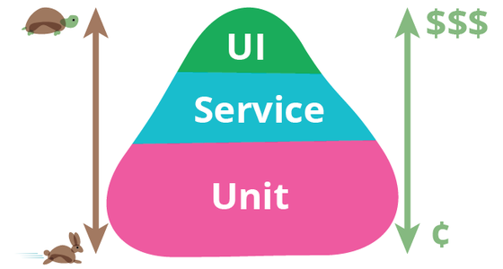
A DEEP DIVE INTO Mike Cohn’s Test PYRAMID
The test pyramid comprises of Unit, API and UI tests from bottom up.
Unit tests
first level of tests
quick to write and fast to run
highest ROI(Return of Investment)
API or service layer tests
external APIs or internal APIs that bridge backend and front end code
faster and cheaper than UI tests
UI(User Interface) tests
expensive, slow and require high maintenance
very flaky returning false positives/negatives

Slide 22
Environment Setup AND TEST DATA HANDLING
Environment Setup:
Setting up the testing environment and required hardware and software
Determining what environments the tests should run (local vs dev vs QA vs PROD)
Frequency of test runs (on every build/deploy, hourly, nightly, timed, etc.)
Data Handling:
Where to store the test data?
Should the data be masked?
What happens to the data after testing?
Hardcoding vs dynamically creating vs querying real time

Slide 23
TEST SCRIPT DEVELOPMENT AND EXECUTION
Test Script Development
Creation/updating/deletion of scripts based on user stories
Reuse of scripts wherever possible and following coding standards
Scripts should be tested for robustness before adding to suite for execution
Test Case Execution
Execution in the previously defined environments
Guidelines for daily activities related to automation should be clearly communicated
Responsibilities of various team members should be defined
Execution status should result in a Pass or Fail

Slide 24
Monitoring AND ANALYSIS
Test Run Monitoring and Analysis:
Thorough analysis of failures
Have a plan for how to analyze the failed test cases and resolve them
Based on errors, different kind of issues are created:
Bugs in application under test ends up as defects for development team
Bugs in automation scripts ends up as tasks for the testing team to address
Set SLAs for resolution of bugs and script failures
Document all automation procedures for future reference. Then you continuously improve your test automation strategy by learning from any mistakes!!

Slide 25
STATUS REPORTING
Final Step is to report the automation status including failure analysis and trends to various stakeholders.
Reporting can be based on both quantitative and qualitative measures, some examples below:
No. of tests automated/ percentage automated
No. of new failures/bugs every cycle
Trend of bugs found in test vs PROD. ( faster feedback)
Trend of scripts failing due to bugs vs flaky tests/data issues
Time to automate
Time to market
*Qualitative measurements can help with continuous improvements of the automation process

Slide 26
AUTOMATION LIFE CYCLE
Let’s reflect and share…

