Slide 1
What’s next for Traditional Functional QA Managers?
Jim Trentadue
December 18th, 2019
Jim.Trentadue@outlook.com

Slide 2
Agenda
Agile evolution of test and quality ownership
Eight areas for QA Managers to focus on
Breakout of the process-oriented roles
Breakout of the technically-oriented roles
Presentation recap

Slide 3
AGILE evolution
How has the testing ownership changed since the advent of Agile? Consider this…
Role
Project Manager / Project Coordinator
Business Analysts / BA Managers
Developers / Development Managers
Testers / Testing Managers
Waterfall Role
Contributes to the testing scope definition
Contributes to the testing scope definition
Contributes to the testing scope definition
Contributes to the testing scope definition
Agile Role
Many converted to Scrum Masters
Many converted to Scrum Masters or Product Owners
Still own the technologies used; define development project activities
Some managers have gone the way of Scrum Masters, others still own quality, but not readily enforceable
Agile Testing role
Contributes to the testing scope definition
Contributes to the testing scope definition
Contributes to the testing scope definition
Contributes to the testing scope definition

Slide 4
Eight focus areas for Functional QA Managers

Slide 5
eight focus areas
Divided between process-oriented and technical-oriented roles
Process-Oriented
Process owner for Quality & Test guidelines
Agile Planning Tool Process Owner
Technically-Oriented
Test Management Administrator
Operational Manager of Automation & Performance
Agile Release Manager
Product Owner for Test Automation
Performance Test Strategist
Security Test Strategist

Slide 6
process owner for quality & test
What are attributes of high-quality test cases and what test types should be used?
Tests must be written with clear starting and end points
Tests need to be written in so anyone can execute them
Tests must be written using a modular approach to enable Automation quicker
Test author provides an appendix spelling out any and all acronyms used in test case
Test data is not using hard-coded data
Test Types
Negative | Boundary
Equivalent Class | Security
Component | Exploratory
Governance
Expansion
Process-Oriented

Slide 7
agile planning tool process owner
Let’s examine a typical Agile environment and where QA leadership can fit…
Agile Artifact
Epic
Stories
Defects
Test Results
What is the quality criteria?
Who governs this for the rest of the team? The Product Owners own this, but quality leaders can assist greatly.
What are the guidelines for how a story should be written including details and measuring the story-effectiveness?
How many times does a story have to go back for rework? How many hours or days were impacted because of this?
Quality leaders can help measure the effectiveness of a story.
Is there a quality defect review for defects reported?
By having base criteria documented and under review from QA Management for adherence, the defect process can be more solidified for the Product Owner to accept the defect in the sprint / release.
Is there a quality review of test results?
Do you need accompanying screen shots for the validation points in your test or do you need to show a pass / fail on each corresponding step? This part is well drawn out for QA Leadership to assist and consult Product Owners.
Process-Oriented

Slide 8
agile release manager
Who provides the Product Owners with the set of tasks for Release Mgmt.?
DEVELOPMENT
TESTING / QA
PRODUCTION
RELEASE MANAGEMENT
Build Release
Release Policy
Release Accepted
Verify Implementation
Configure Release
Release Planning
Training Plan
Implement Release
Rollout Plan
HW / SW Design
Quality Review
Process-Oriented

Slide 9
product owner for test automation
If automation specialists are not deployed on specific agile teams, who manages the work?
Solution
Ownership of the Automation solution
Program
Total ownership of the program
Defines the vision of what automation will test and what it will not, manages the backlog and implements in sprint or regression cycles, and prioritizes all items often and as appropriate
Stories
Writes the epic or story
After the epic is defined, drafts each automation story, understanding the technical dependency on how each outweigh the manual testing effort
Acceptance
Define criteria
The automation module should execute without failure, work with the module that flows before and after logically, and meet the standards of the overall framework
Stays on top of product updates, upgrades, new libraries, licensing and solution alignment with the systems being tested
Process-Oriented

Slide 10
test management administrator
Potentially the most natural fit for QA Managers to take ownership
Defined | Configured | Connected
Requirement records | Requirement → Test Case workflow | Agile Planning
Test Plan entities | Test Case → Defect workflow | Continuous Integration
Test Design template | Defect → Test Case workflow | Test Automation
Test Case forms | Test Case → Requirement workflow | Performance Test
Test Execution records | Defect → Requirement workflow | Configuration Management
Defect forms |  | Alternate Defect workflow
Defect reports |  | Alternate Defect workflow
Defined | Configured
Requirement records | Requirement → Test Case workflow
Test Plan entities | Test Case → Defect workflow
Test Design template | Defect → Test Case workflow
Test Case forms | Test Case → Requirement workflow
Test Execution records | Defect → Requirement workflow
Defect forms | Defect → Test Case workflow
Defect reports | Defect → Story workflow
Defined
Requirement records
Test Plan entities
Test Design template
Test Case forms
Test Execution records
Defect forms
Defect reports
Technically-Oriented

Slide 11
automation & performance ops mgr
Sprint 1
PASS
Sprint 2
PASS
Sprint 3
PASS
Sprint 4
FAIL
Walking through a typical automation example within the sprint
Sprint 1 has automation work and is completed in sprint 1
Sprint 2 has automation work built on sprint 1 and is completed in sprint 2
Sprint 3 has automation work built on sprints 1 & 2 and is completed in sprint 3
Sprint 4 has automation work built on sprints 1-3, but is broken from a change
Automation Operations Team
Resolves technical debt as tune ups
Helps define regression test bed
Leads integrated testing effort
Trainers & enablers for manual QA
Who is managing the change process for this?
Where this is fixed & how is deployed to sprint teams?
Technically-Oriented

Slide 12
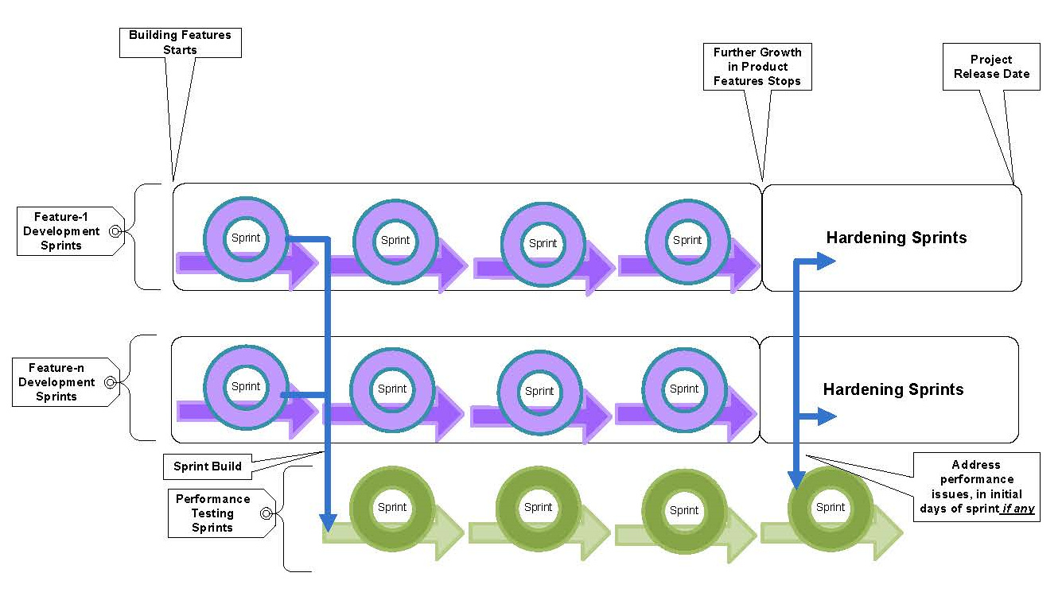
performance test strategist
Strategy to devise
Bottlenecks identified and remediated early in sprint
Continuous performance tests run like functional tests
Additional infrastructure needs identified early for next sprints
Code modifications made early as opposed to the very end, usually crashing schedules
Technically-Oriented
http://scrumalliance.org/system/resource_files/0000/4359/052713.Agile_Performance_Testing_IMAGE.Prakash_Mallappa_Pujar__2_.jpg

Slide 13
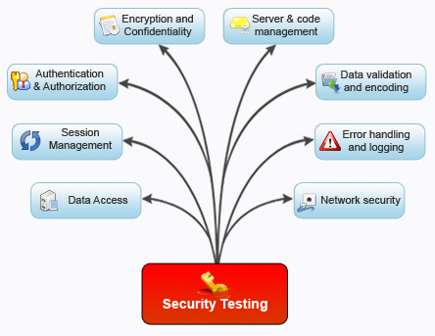
security test strategist
Which of these areas needs to be accounted for in which sprints?
Technically-Oriented
http://www.ispace.com/img/websecuritytestingservices.jpg

Slide 14
session recap
Quality & Testing belong to the PO & team, but there is great value for the QA Manager
Hone-in on a path for process or technically oriented or a little of both
Partnership and alignment is key
Process-oriented needs to stay close with Product Owners & Scrum Masters
Technically-oriented needs to stay connected with product vendors
Embrace new roles as a new charter for your career

Slide 15
Thank you for attending!
Jim Trentadue
December 18th, 2019
Jim.Trentadue@outlook.com

