Slide 1
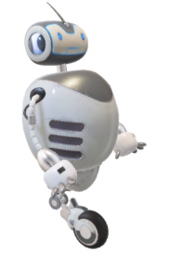
The New Test Automation Toolkit:
From Cloud to Code Analysis
Paul M. Grossman, Senior Automation Architect,
TEKsystems Global Services
March 22, 2018
Special thanks to Stephen Lichtenberg, Senior Automation Framework Architect, Kiewit Corp.

Slide 2
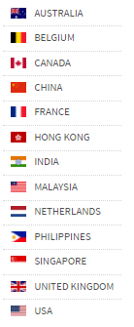

Slide 3
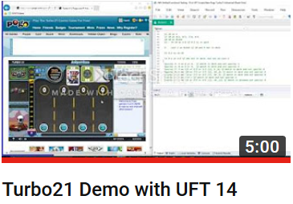
Paul M. Grossman
17 years automation experience with HP/Micro Focus Tools
HP Certified Product Consultant
Tool Experience: UFT, ALM, BPT, TAO (SAP)
Beta Tester of QTP/UFT 9.5 – 14.3, ALM, StormRunner Functional
Presenter at HP Discover Conferences & Automation Guild
Started career with a practical joke

Slide 4
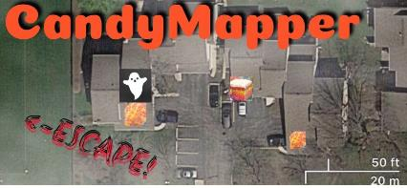
Paul M. Grossman – Social Media
Started career with a practical joke
TestTalks.com/103
TestTalks.com/176
AutomationGuild.com
Linkedin.com/in/pmgrossman/
www.CandyMapper.com
@DarkArtsWizard
YouTube.com/user/qtpmgrossman/videos
Facebook.com/groups/AdvanceTestAutomation

Slide 5
Chicago Quality Assurance Association
Today’s Agenda
What’s Changed in the past 5 years?
Leveraging Record and Playback
Thinking Outside the Box: Class Override
Free and Easy Object Collections
Thinking Outside the Box: Folder Override
Running Automation in the Cloud
Static Code Analysis

Slide 6
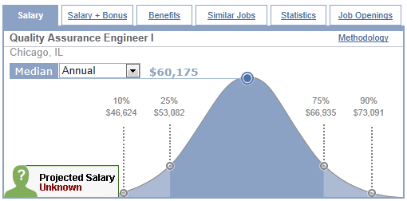
What’s Changed in the Last Five Years?
Title of a Manual Tester
Quality Assurance Engineer I – V
Quality Assurance Specialist I – IV

Slide 7
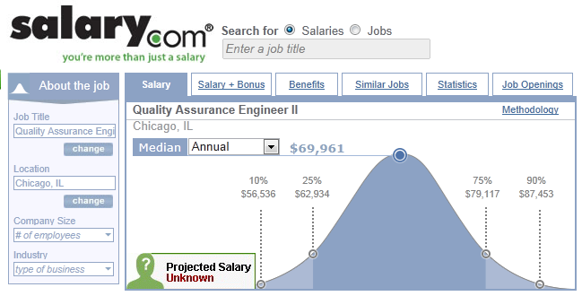
Manual Tester Salary - 2013

Slide 8
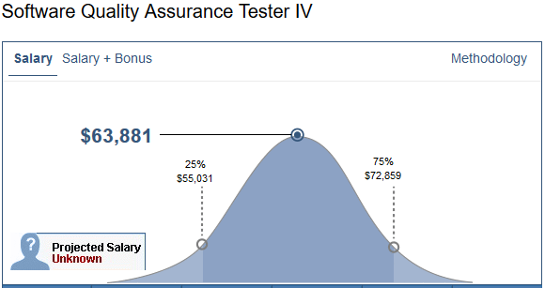
Manual Tester Salary - 2018
Title of a Manual Tester
Software Quality Assurance Tester I - IV

Slide 9
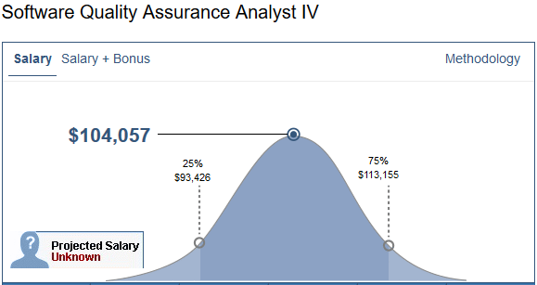
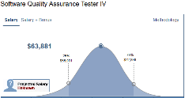
Automation Tester Salary - 2018
Software Quality Assurance Analyst I - IV

Slide 10
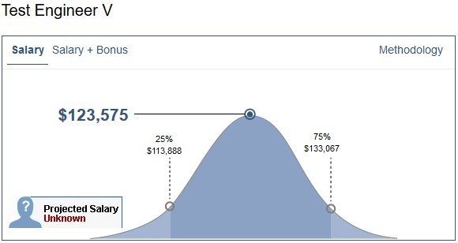
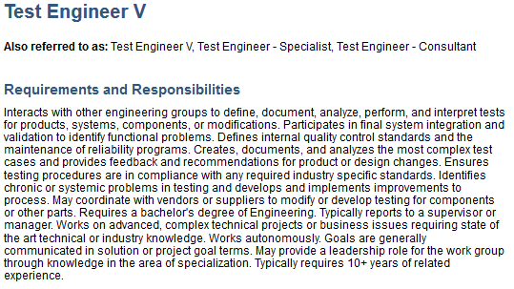
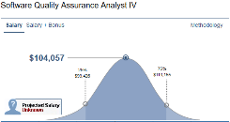
Automation Tester Salary - 2018
Test Engineer I - V

Slide 11
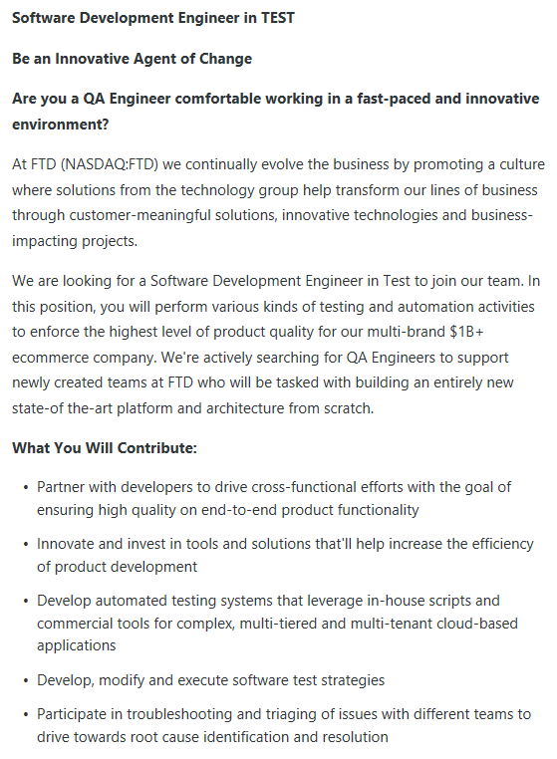
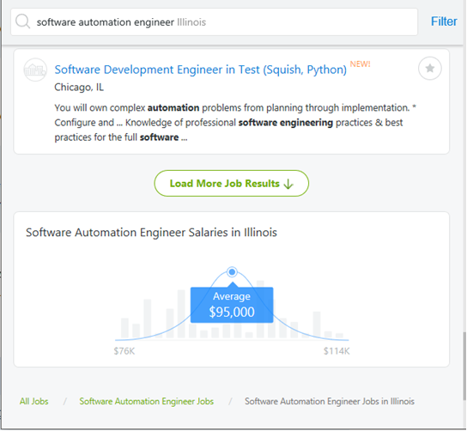
Software Development Engineer in Test

Slide 12
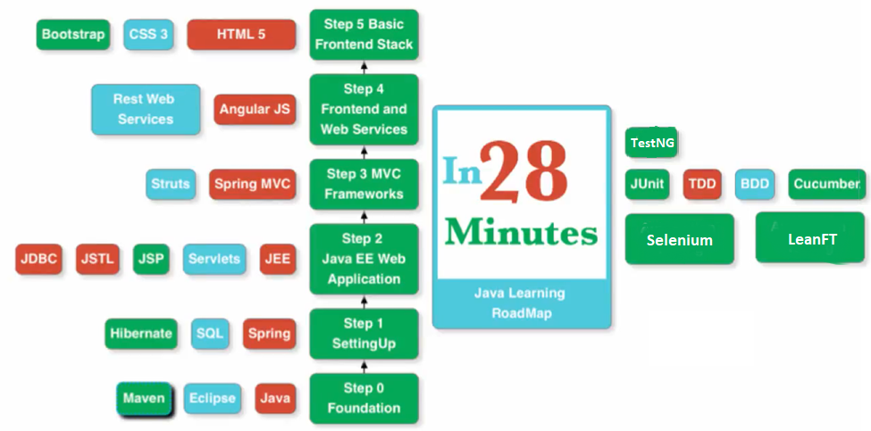
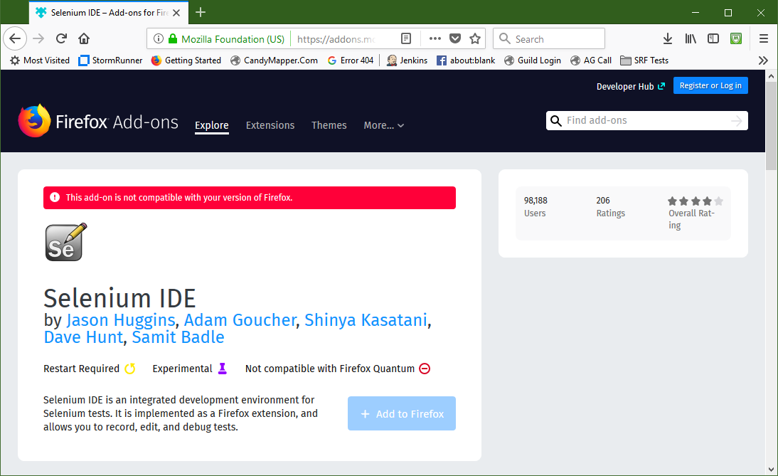
2018 – “Automation” not part of test qa
Are testing tools so complex that only the dev team is capable of testing their own software?

Slide 13
2018 – “Automation” not part of test qa
Are testing tools so complex that only the dev team is capable of testing their own software?

Slide 14
Commercial tool options from microfocus
UFT
LeanFT
Selenium

Slide 15
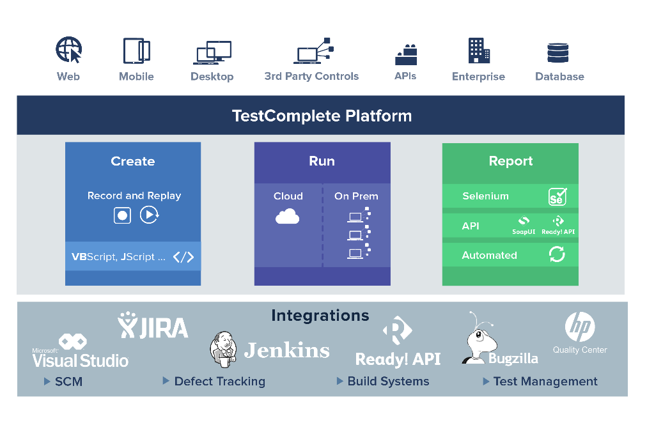
Commercial tool options from Smartbear

Slide 16
What are the smartbear products
DEV
TEST
OPS
UI
Collaborator
Code
TestComplete
Script
CrossBrowserTesting
LoadComplete
Perform Code & Doc Review
Create Automated UI
Functional Tests
(Web, Desktop, Mobile)
Run Tests On Real Devices in the Cloud
Create Web Load Tests
AlertSite
QAComplete
Monitor Web & API Performance, Availability, & Functional Correctness
Manage Manual & Automated Tests
SwaggerHub
Spec
SoapUI Pro
Script
ServiceV Pro
LoadUI Pro
API
Design, Develop, & Document APIs
Create Automated API
Functional Tests
(REST, SOAP, and more)
Virtualize API & Database Services
Create API Load Tests
Integrations
…100
+

Slide 17
DEMo – Leveraging record and playback
TestComplete
LeanFT
UFT
Selenium
UFT only supports vbScript
Ruby
Selenium supports these five programming languages

Slide 18
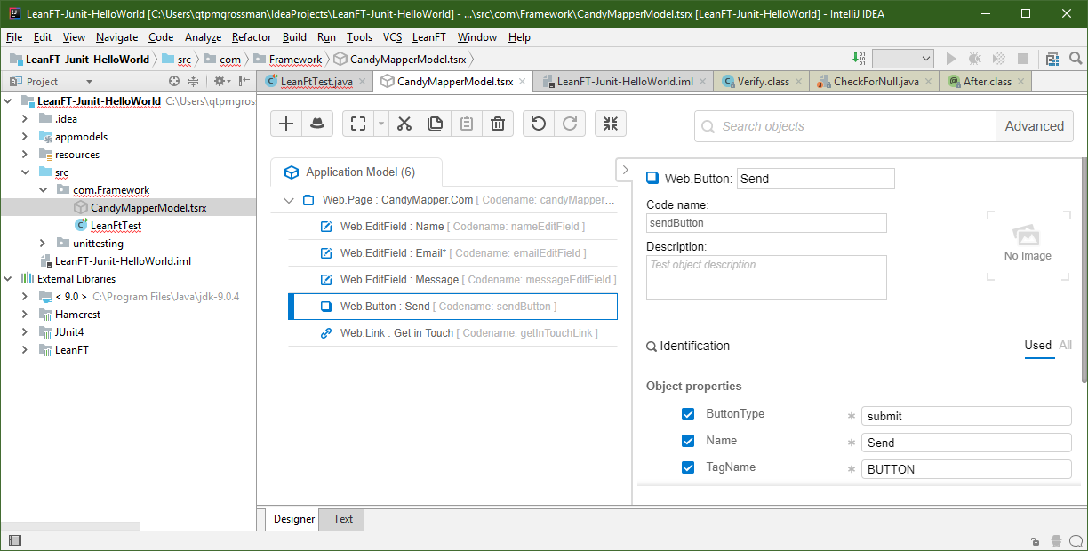
Free and Easy – Page Object Models
Selenium

Slide 19
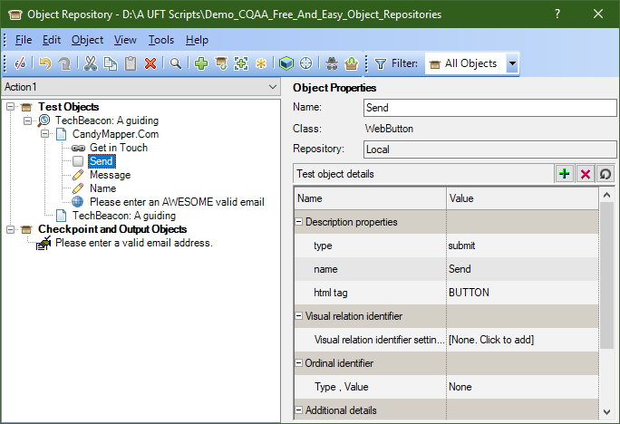
Demo – Free and Easy object Repositories
Object Repository UFT
Application Models
LeanFT public sendButtonNode sendButton { get; private set; }
sendButton = new sendButtonNode(this, applicationModel); <object technology="Web" type="Button">
<name>Send</name>
<codeName>sendButton</codeName>
<description />
<identification>
<properties>
<property name="ButtonType" type="string">submit</property>
<property name="Name" type="string">Send</property>
<property name="TagName" type="string">BUTTON</property>
</properties>
</identification>
</object>

Slide 20
Demo – Free and Easy object Repositories
Page Object Model Repository - SELENIUM
package pageObjects;
import org.openqa.selenium.WebDriver;
import org.openqa.selenium.WebElement;
public class CandyMapper_Landing_Page {
public static class Product_1{
public static WebElement btnSend(WebDriver driver){
WebElement btnSend = driver.findElement(By.cssSelector("#contact-form-submit")); return element;
}
}

Slide 21
Free and Easy object Collections
UFT
Object Collections
Set oDesc = Description.Create
oDesc("Type") = "Submit"
oDesc("Name") = "Send"
oDesc("TagName") = "BUTTON"
Set colButtons = Browser("b").ChildObjects(oDesc)
Set btnSend = colButtons(0)
btnSEND.Click
LeanFT
ButtonDescription oDesc = new ButtonDescription.Builder()
.type("Submit") .tagName("BUTTON")
.name("Submit") .build();
Button[] colButtons = browser.findChildren(Link.class, oDesc);
colButtons[0].Click
Selenium String sDesc="input[type='Submit'][name=Send'][tagName='BUTTON']";
List<WebElement> colButtons=driver.findElements(By.cssSelector(sDesc)) ;
colButtons.get(0).click();

Slide 22
Thinking Outside the Box: Class Switching
Case Study
Following a new build 50+ objects changed Class from Link to WebButton
Standard Solution:
Create 50+ replacement objects in the repository
Update all scripts that reference these objects
1-2 days down time
Our Solution: Programmatically search for matching class Object
Map the properties from the Link to the WebButton properties
Get a collection of matching objects
Find the first visible match
Pass this new object out of the function

Slide 23
Thinking Outside the Box: Class Switching
NAV COMPONENT Link("Billing").Click
Click() Function
VerifyObj(oLink)
oLink.Click
Record and playback creates brittle code If the object does not exist an error gets generated
VerifyObj()

Slide 24
Thinking Outside the Box: Class Switching
NAV COMPONENT
Click Link("Billing")
Click (oLink)
VerifyObj(oLink)
oLink.Click
VerifyObj()
oObj.Exist = TRUE

Slide 25
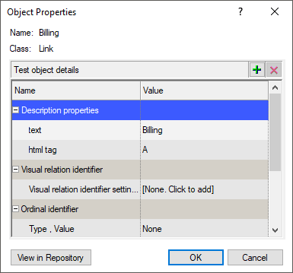
Thinking Outside the Box: Class Switching
NAV COMPONENT
Click Link("Billing")
Click (oLink)
VerifyObj(oLink)
oLink.Click
VerifyObj(oObj)
oObj.Exist = FALSE

Slide 26
Thinking Outside the Box: Class Switching
NAV COMPONENT
Click Link("Billing")
Click (oLink)
VerifyObj(oLink)
oLink.Click
VerifyObj(oObj)
oObj.Exist = FALSE
Property | Value
micClass | "Link"
Text | "Billing"
Html tag | "A"

Slide 27
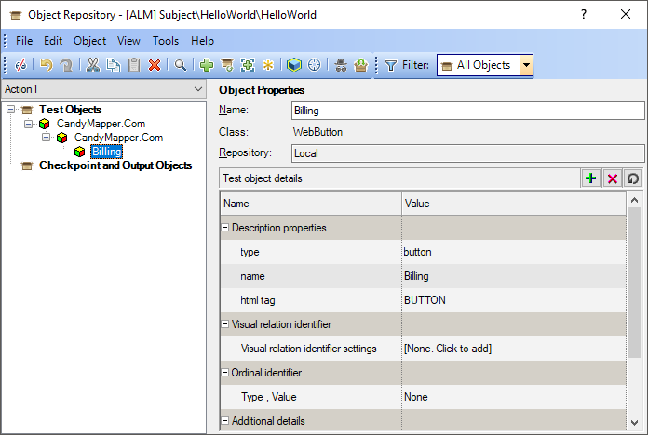
NAV COMPONENT
Click Link("Billing")
Click (oLink)
VerifyObj(oLink)
oLink.Click
VerifyObj(oObj)
oObj.Exist = FALSE
Collection
WebButton
WebButton
WebButton
Property | Value
micClass | "Link"
Text | "Billing"
Html tag | "A"
Property | Value
micClass | "WebButton"
InnerText | "Billing"
Html tag | "BUTTON"

Slide 28
Thinking Outside the Box: Class Switching
NAV COMPONENT
Click Link("Billing")
Click (oLink)
VerifyObj(oLink)
oLink.Click
VerifyObj(oObj)
oObj.Exist = TRUE
Collection
WebButton
WebButton
WebButton
Property | Value
micClass | "Link"
Text | "Billing"
Html tag | "A"
Property | Value
micClass | "WebButton"
InnerText | "Billing"
Html tag | "BUTTON"

Slide 29
Thinking Outside the Box: Class Switching
NAV COMPONENT
Click Link("Billing")
Case Study Result: PROs and CONs
PRO: All scripts running within two hours
PRO: Weeks to update the objects and code CON: ¼ second increase in object recognition
Click (oLink)
VerifyObj(oLink)
oWebbutton.Click
VerifyObj(oObj)
oObj.Exist = TRUE Set oObj=oWebButton
Collection
WebButton
WebButton
WebButton
Property | Value
micClass | "Link"
Text | "Billing"
Html tag | "A"
Property | Value
micClass | "WebButton"
InnerText | "Billing"
Html tag | "BUTTON"

Slide 30
Best practices – When should a test keep running?
Continue a test when a validation fails to:
Verify Object Exists
Verify Text Appears
Verify List Contains
Verify A Field Contains Text
Selenum/TestNG: Stops Execution
Assert FAIL
Try/Catch
LeanFT/TestNG Verify: Continues execution, returns state
Verify.areEqual (Exp, Actual, Description)
Stop a test when a validation fails to:
Verify Button Fails to be clicked
A Navigation Function Fails to Execute Assert is the last and only validation of the test

Slide 31
Thinking outside the box
2013
Automated the common interfaces
Proposed automating easy features first
Modular functions made maintenance manageable
2018
Automate the common interfaces
Automate easy features and tests first
Page Object Model \ Application Model to keep maintenance manageable

Slide 32
Thinking outside the box – Folder Override
Application Area
Object Repository
Recovery Scenarios
VERIFY
NAV
INPUT
Function Libraries
LAUNCH
LOGIN
Release | URL
R1 | .com/10
R2 | .com/20
Role | User | Password
Admin | Test1 | Pwd@1
Viewer | Test2 | Pwd@2
NAV
INPUT
NAV
LAUNCH LOGIN
TOOLS
VERIFY

Slide 33
Thinking outside the box – Folder Override
Application Area
Object Repository
Recovery Scenarios
VERIFY
NAV
INPUT
Function Libraries
LAUNCH
LOGIN
Release | URL
R1 | .com/10
R2 | .com/20
 | .com/30
Role | User | Password
Admin | Test1 | Pwd@1
Viewer | Test2 | Pwd@2
NAV
INPUT
NAV
LAUNCH LOGIN
TOOLS
VERIFY

Slide 34
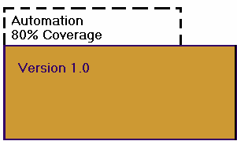
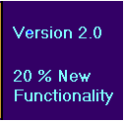
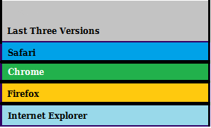
2013 - The Clock is Ticking Avoiding "100% Automation" Trap
90% Automation can be approached but it is generally not cost effective
New releases will have more functionality with constantly decreasing code coverage
A percentage of the code could be unreachable code, such as uncalled functions
Pick one: Functionality or Browsers Do the math: You won't have time for everything!
20 - 40% Automation makes a significant impact on the testing process.
Math: App Developers outnumber your team?
Do they have 6-18 Months head start?
Do they have more than one tool?

Slide 35
2013 - The Clock iS Ticking
Solution: Use Jenkins
Manual Testers work 9AM to 5 PM
Automation Scripts run 5PM to 9AM
Bonus: Give QA automation team Continuous Integration
2018 – The Clock is Still Ticking
This Photo by Unknown Author is licensed under CC BY-SA

Slide 36
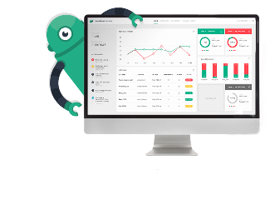
2018 – cloud based Virtualized Testing
Testing in Parallel
This Photo by Unknown Author is licensed under CC BY-NC-ND
This Photo by Unknown Author is licensed under CC BY-NC-SA

Slide 37
2018 – cloud based Virtualized Testing
Testing on Multiple Operating Systems
This Photo by Unknown Author is licensed under CC BY-NC-ND
This Photo by Unknown Author is licensed under CC BY-NC-SA

Slide 38
2018 – cloud based Virtualized Testing
Testing on Multiple Browsers
This Photo by Unknown Author is licensed under CC BY-NC-ND
This Photo by Unknown Author is licensed under CC BY-NC-SA

Slide 39
2018 – cloud based Virtualized Testing
Testing on Mobile Devices
This Photo by Unknown Author is licensed under CC BY-NC-ND
This Photo by Unknown Author is licensed under CC BY-NC-SA

Slide 40
DEMo – Cloud testing
Running in the Cloud
Microfocus/HP UFT
Micro Focus/HP LeanFT
Selenium

Slide 41
Cloud testing vs local testing
Cloud
PROs
Concurrent Browser Execution
Multiple Browsers
Multiple Operating Systems
Instant Availability
CONs Limited access to
Windows API
Notepad and other utilities
AutoIt Compiled .exe
Local
PROs
Concurrent Browser Execution
Multiple Browsers
Customized Environment
Windows API
Notepad and other utilities
AutoIt Compiled .exe
CONs One Operating System

Slide 42
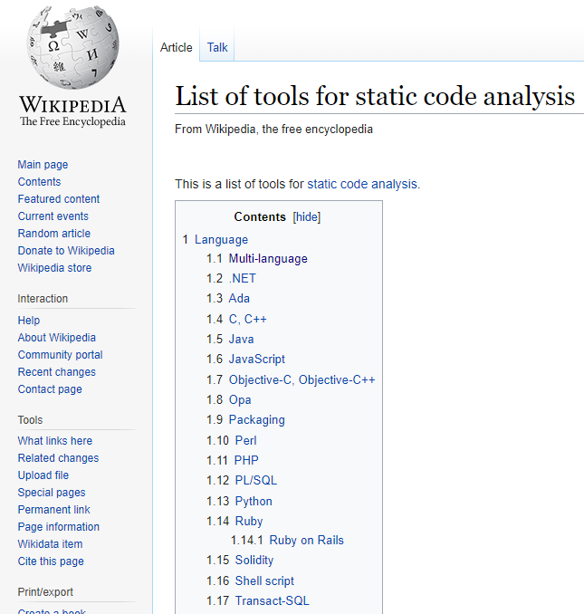
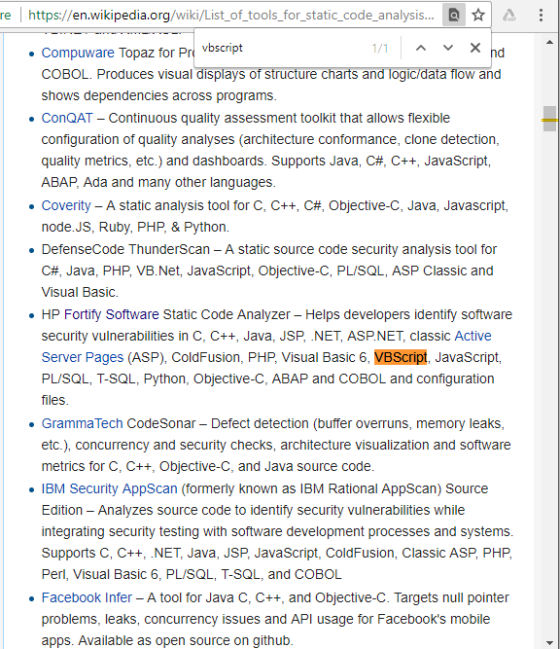
Static Code Analysis

Slide 43
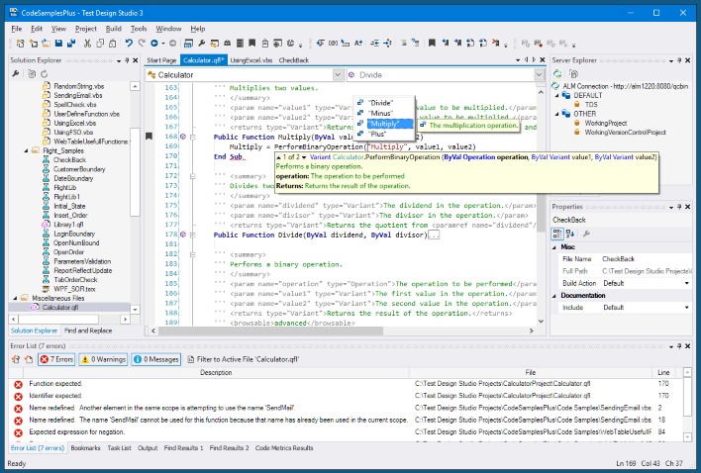
DEMo – Static Code Analysis
Test Design Studio
(Lint for vbScript)
Find all your code
Problems in five
Minutes!

Slide 44
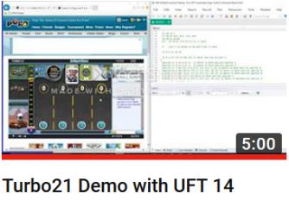
Thank you! Any questions?
Started career with a practical joke
TestTalks.com/103
TestTalks.com/176
AutomationGuild.com
Linkedin.com/in/pmgrossman/
@DarkArtsWizard
YouTube.com/user/qtpmgrossman/videos
Facebook.com/groups/AdvanceTestAutomation

Slide 45
Presentation Source links
You can find all the code for the demos presented at my DropBox share:
www.dropbox.com/home/CQAA-New-automation-ToolKit-2018
Check out my GitHub code share:
https://github.com/qtpmgrossman/
Links to Static Code Analysis tools:
https://en.wikipedia.org/wiki/List_of_tools_for_static_code_analysis
www.patterson-consulting.net/products/test_design_studio/Default.aspx
Paul Grossman's YouTube Channel – Always have a backup plan for the unexpected!
www.YouTube.com/user/qtpmgrossman/videos
Join the conversation with 6000+ Test Automation Engineers around the world on FaceBook
www.Facebook.com/groups/AdvanceTestAutomation

