Slide 1

"From Nuclear Submarines to Widgets: What QA and Test Defect Rates Are Saying."
Michael Mah
Managing Partner
QSM Associates, Inc.
e-mail:michael.mah@qsma.com
Website: www.qsma.com
Notes:
1

Slide 2
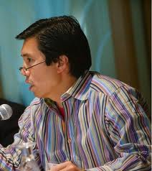
Michael Mah
Michael Mah is the director of the Benchmarking Practice at the Cutter Consortium, a Boston-based IT think-tank, and served as past editor of the IT Metrics Strategies publication. He is also managing partner at QSM Associates Inc. based in Massachusetts USA.
Michael teaches, writes, and consults to companies on measuring, estimating and managing software projects, whether in-house, offshore, waterfall, or agile.
With over 25 years of experience, Michael and his partners have derived productivity patterns for thousands of software projects collected worldwide across engineering and business applications. His current work examines time-pressure dynamics of teams, and its role in project success and failure. In addition to his background in physics and electrical engineering, he is a mediator specializing in dispute resolution for technology projects.
He has a degree in electrics engineering from Tufts University. His training on dispute resolution, mediation, and participatory processes is from the Program on Negotiation at Harvard Law School and the Radcliffe Institute for Advanced Study. Michael is also a private pilot and lives in the mountains of Western Massachusetts.
He can be reached at michael.mah@qsma.com.

Slide 3

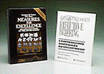

The QSM SLIM Database
QSM maintains the world’s largest benchmarking database of 12,000+ completed software projects collected worldwide. We put industry productivity statistics on the desktop.
The QSM SLIM database contains projects in all industries, waterfall, Agile, offshore/outsourced, in-house, new development, and maintenance.
SLIM tools enable managers to measure and estimate Agile and/or waterfall projects.

Slide 4
Partial List of Clients
British Telecom
SAP
Microsoft
Intel
AT&T/BellSouth
BMC Software
Motorola
VerizonWireless
Roche Diagnostics
Fiserv Corp
IBM Global
Misys Healthcare
Nationwide
Boeing
Bank of New York Mellon
Lockheed Martin
Progressive
DirecTV

Slide 5


Slide 6
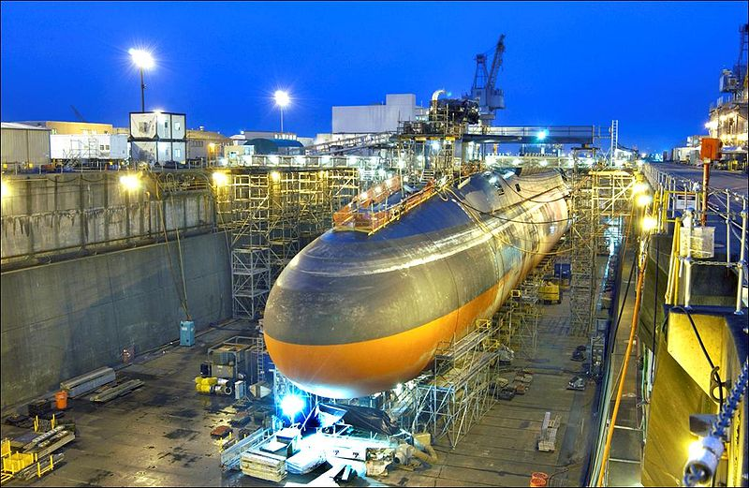

Slide 7
A Rayleigh Bug Curve

Slide 8
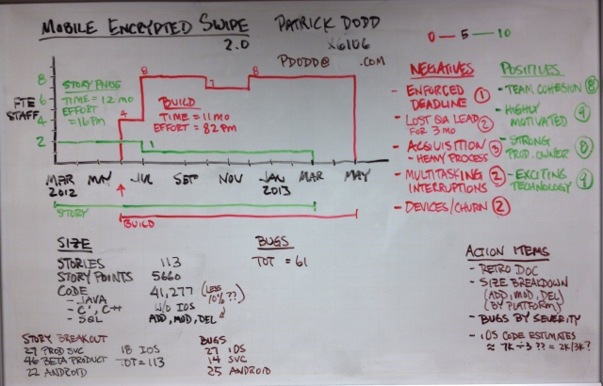
Project Profile - Card Swipe Project

Slide 9
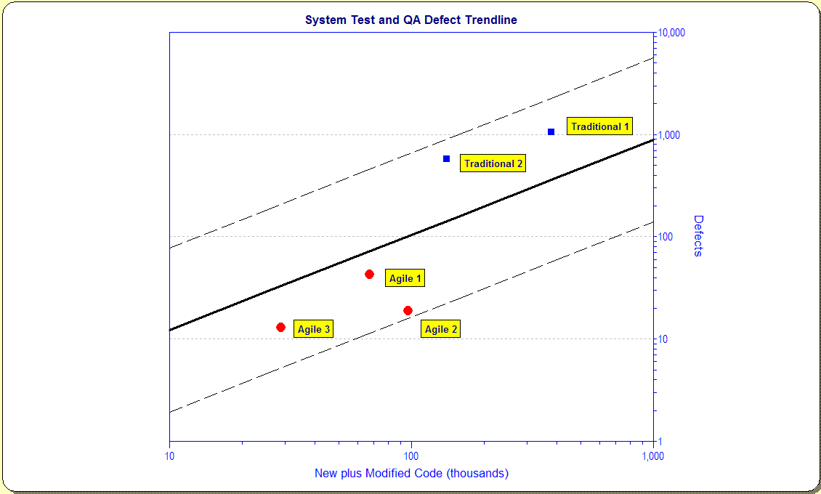
Agile and Waterfall at a
Medical Devices Company

Slide 10


Slide 11


Slide 12
Real Work,… Optional Chaos
But if we severely compress a project schedule, most of the effort goes into the Optional Chaos. This increases costs but does not add value to the product
Effort →
If we have the latitude to take longer on a project, we can greatly increase the proportion of work that goes into the product
Source: Armour, Phillip G.
“Real work, Necessary Friction, Optional Chaos”
Communications of the ACM Vol 47 No 6 June 2004
Time →

Slide 13
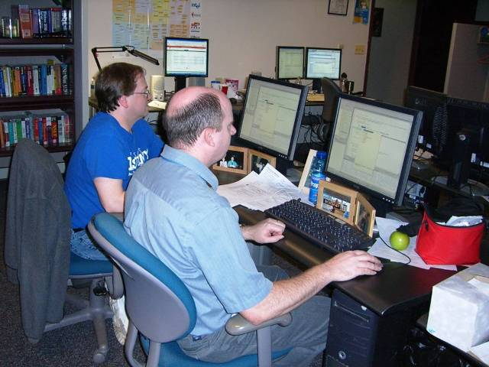

Slide 14
Trendline Assessment – Defects/Quality
Far Fewer Defects: 50% - 66% Below Industry

Slide 15
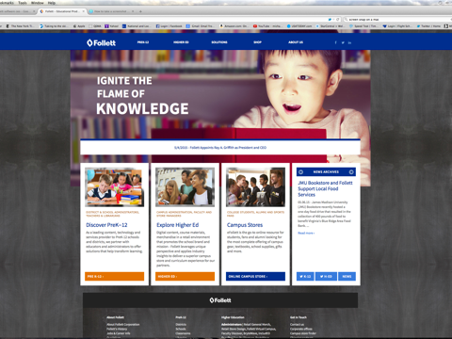

Slide 16
Company A vs. Industry Average
Industry
Average
Current Performance
Delta
Project Cost
$3.5 Million
$2.2 Million
-$1.3M
Schedule
12.6 months
7.8 months
-4.8 mos
QA Defects
242
121
-50%
Staffing
35
35
n/a

Slide 17
2017 vs. Industry Average
Industry
Average
Current Performance
Delta
Project Cost
$1.8 M
$924k
-50%
Schedule
10.3 months
5.1 months
-5.2 mos
QA Defects
159
40
-75%
Staffing
23
15
-35%
* Average Code Size 163k SLOC

Slide 18


Slide 19
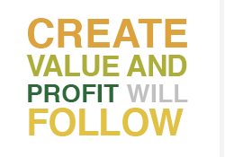

Slide 20
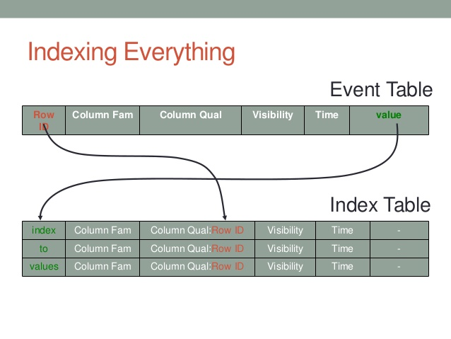

Slide 21
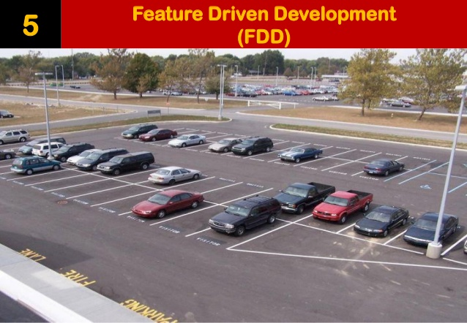
Feature/Value Driven Development

Slide 22
“IRACIS” Index
IR – Increase or Improve Revenue
AC – Avoid Costs
IS – Improve Service
Scale of 1-5
Weighting Schema
… Market Share? Others?

Slide 23


Slide 24
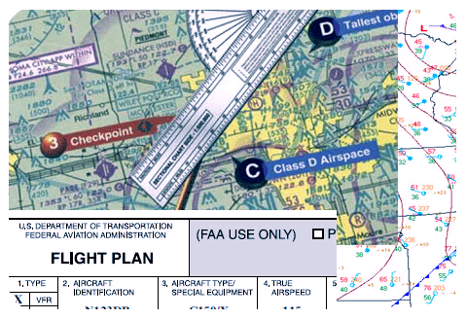
Proper Planning

Slide 25


Slide 26


Slide 27


Slide 28


Slide 29

FAA Radar Flight Following

Slide 30
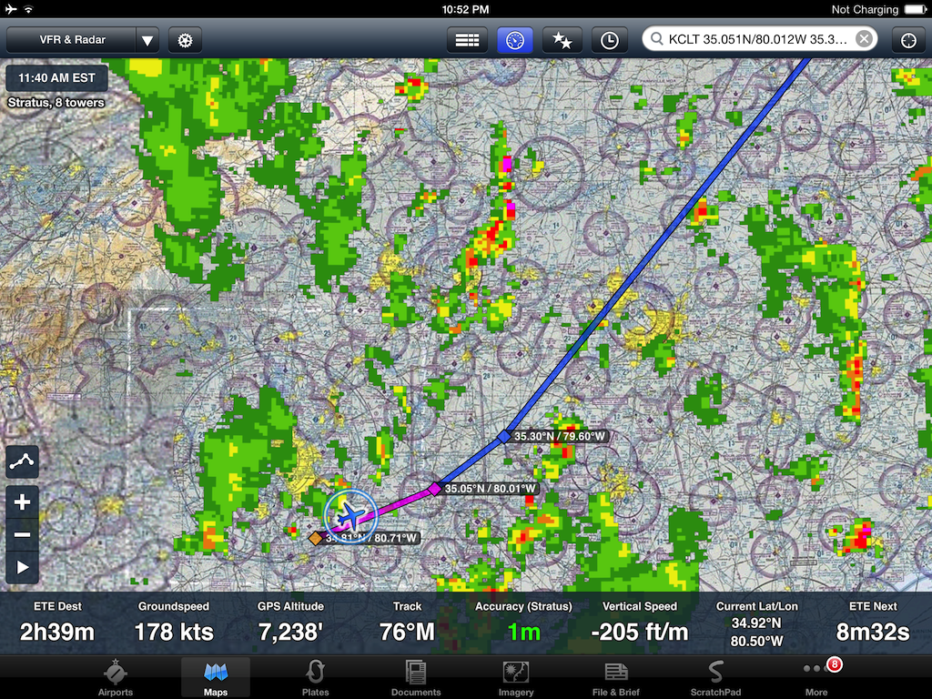
Radar Flight Following (Foreflight)

Slide 31
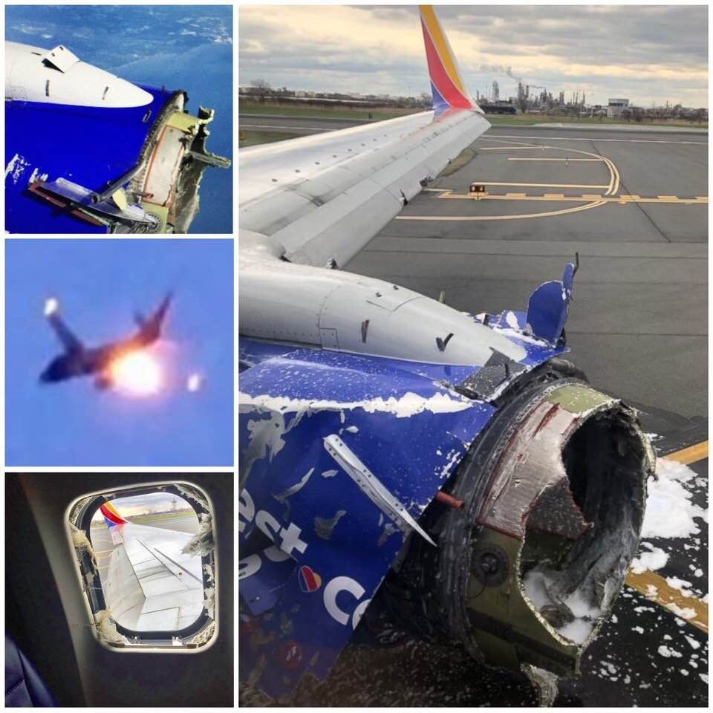

Slide 32
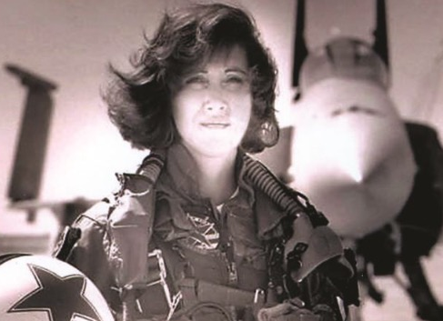

Slide 33
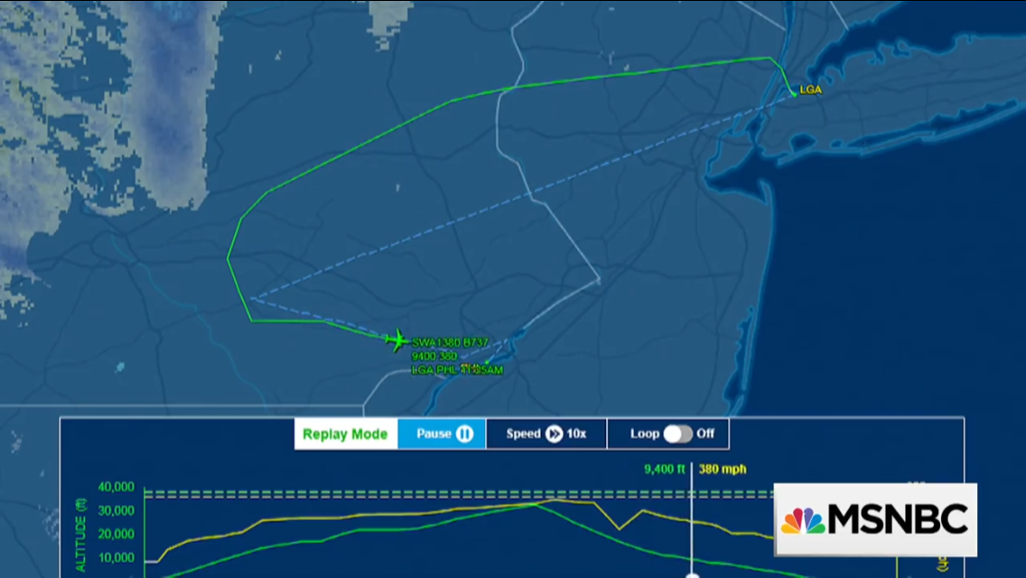

Slide 34
Rayleigh Defect Curve Schedule Forecasting

Slide 35
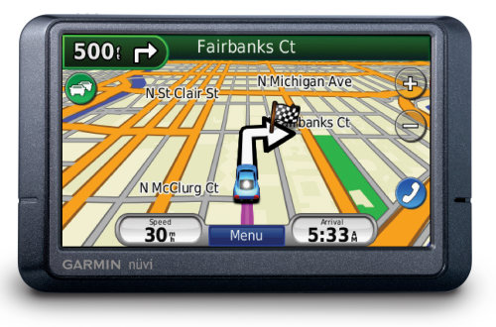

Slide 36
Prediction Accuracy?
90 - 95%
No Joke

Slide 37
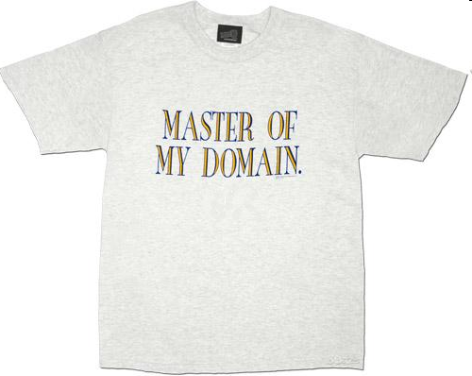
Domain Knowledge
Smart people, experienced people
Coding is moving knowledge from mind into the machine
Inexperience costs money

Slide 38

Short Feedback Loops
Paired programmers
Instantaneous code reviews
Accelerated learning and execution
Face to face communication channel

Slide 39
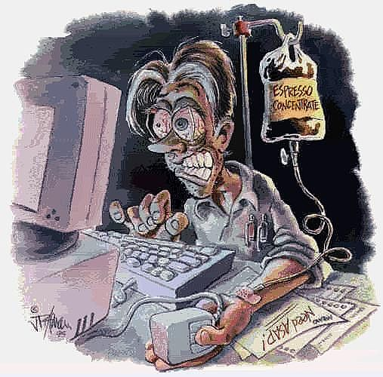
Avoiding Burnout
XP = Sustainable pace
40 Hour Work Weeks
Prevent productivity collapse for overworked teams

Slide 40

Transparency
“Transparency is a great floodlight. People who thrive in political maneuvering hate SCRUM…”
- Ken Schwaber

Slide 41

High-bandwidth Communication
The best teams have “wide-open pipes”
Domain knowledge moves among the team
Information flows rapidly and accurately

Slide 42
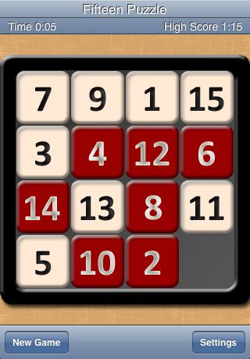
Build a Little Less

Slide 43


Slide 44

QSM SLIM Benchmark Defect Trends

Slide 45
SLIM Model Architecture Overview
Mathematical Models
1) Program Estimation
2) In-Flight Forecasting
3) Benchmarking
Based on 20+ years of research
Industry Database of 12,000 projects
Government and Commercial
Manage
Project
Portfolios
Track &
Forecast
Projects
Estimate
& Plan
Projects
Analyze &
Benchmark
Projects
Portfolio
Management
Continuous
Improvement
Cycle
Store and Manage Historical Project Data
Data Storage
and Reuse
Notes:
Slide Build:
Continuous Improvement Cycle: estimate → use estimate to plan and track projects → use estimate and tracking to analyze projects → use analysis to improve estimation
Data Storage and Reuse: store information from estimates, plans on-going projects, and for historical analysis
Portfolio Management: manage collections of projects as a cohesive group, continuously maintain the portfolio view
© QSM, Inc. All rights reserved.
Software Lifecycle Management Lecture
45

Slide 46
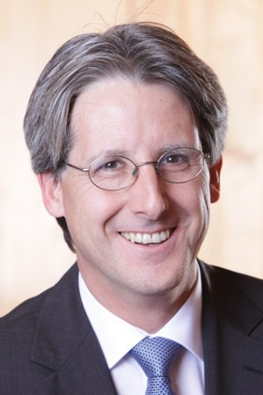
Questions: Contact Us
Michael Mah
Managing Partner
QSM Associates, Inc.
Pittsfield MA USA
email: michael.mah@qsma.com
website: www.qsma.com
twitter: @michaelcmah
tel: 1 413-499-0988
Andrea Gelli
QSM Associates Switzerland
8032 Zurich
tel +41 44 555 9126
email: andrea.gelli@qsma.ch

