Slide 1
Quality Buddy System:
How QA can influence Application Development to achieve High Quality Products
Bosch
September 18, 2018
Sara Joseph

Slide 2
Who am I?
eCommerce Software Development Team , CDW LLC
QA Lead
Release Lead
Product Owner, Web Automation Framework (Website & API)
15 Years of Experience Programming, QA, Business Analysis, and IT Leadership
Microsoft Certified Professional (Windows OS)
Certified Quality Assurance Analyst
Certified Scrum Master
Lean Six Sigma Green Belt
Application Development CoP Practice Lead

Slide 3
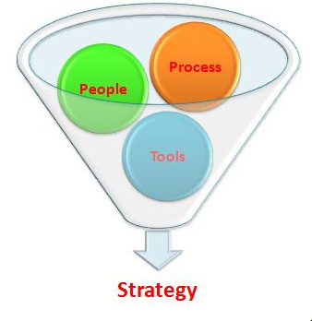
Introduction
Application Development CoP Practice Lead
Training and Development
Managing Knowledge Artifacts
Making our Processes more Efficient
Innovate
our process
Train
our people

Slide 4
Today’s Topic require sharing your thoughts too!
Understand the behavioral changes needed to pair testers and developers
Identify shared quality goals and responsibilities between developers and testers
Take away hands-on procedures to shift activities early to reach these quality goals

Slide 5
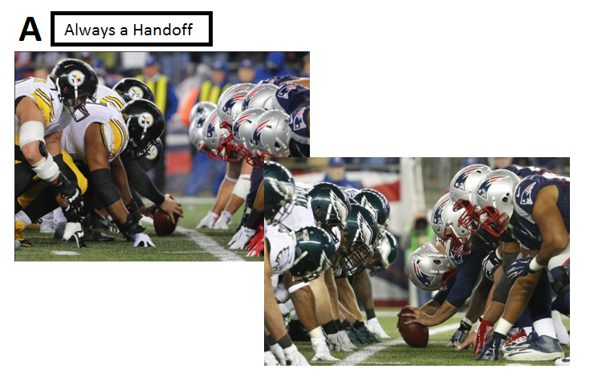
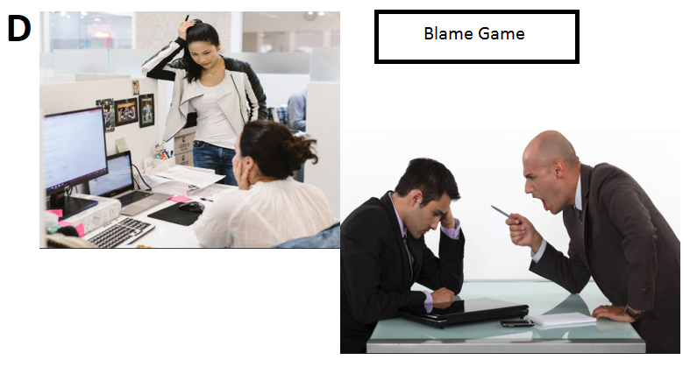
Introduction to Today’s Real Time Polling Developer & QA: Which picture looks most familiar?
How do we behave?

Slide 6
Here’s how we’ll vote anonymously?:

Slide 7
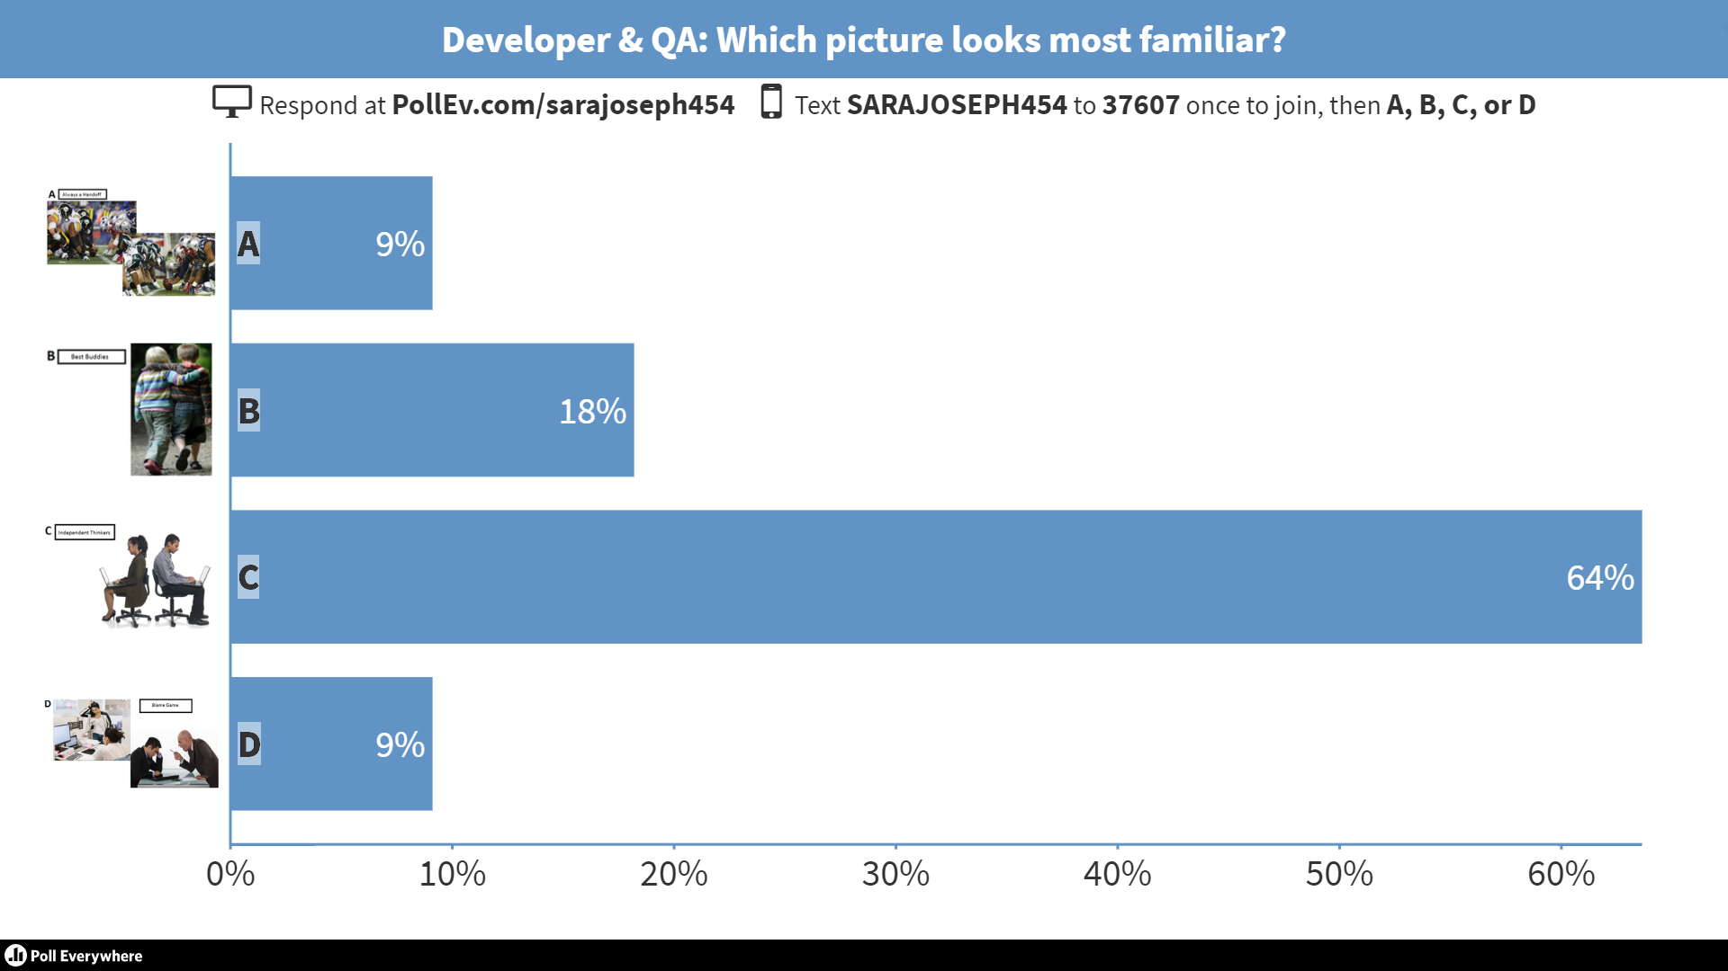
Real Time Poll Results

Slide 8
Why change how we behave?
Continuous Delivery : Continuous Quality
Continuous Delivery is a standard
Continuous Quality is a standard
Continuous Delivery is Continuous Quality
“Speed is the new currency of IT and business”
Marc Beinoff , CEO Sales Force
“DevOps is the union of people, process, and products to enable continuous delivery of value to our end users.”​
-Donovan Brown, Principal DevOps Program Manager with Microsoft
“It’s an application economy”
Satya Nadella , CEO Microsoft
“managing and implementing quality and test measures represent a challenge for teams trying to increase productivity (or release velocity) with acceptable quality” WORLD QUALITY REPORT 2016-2017 (Sealights img)
8

Slide 9
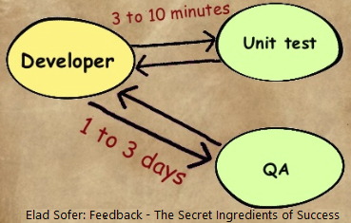
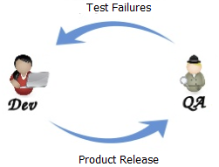
What does this mean for Developers & Testers?
Speed to market requires Developers and QA to have
productive and timely feedback loops…
Requirement gaps
Bugs workflow
Automation Impediments
Customer’s Response / UAT
Build X vs Build Y – Change Focused Tests
Estimation
Change Management
Make feedback loops successful… constant, consistent, clear to act on

Slide 10
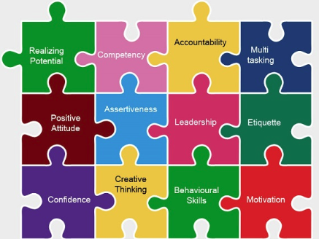
What Behavioral Changes are needed between Developers & Testers?
Great minds think “Quality” alike: Think Test First
Knowledge Exchange: -Developer helps QA understand the code base -Tester helps Developer understand the test cases, suite, and execution
Job Sharing: -Developer volunteers to help out testing -Tester learns high level coding concepts - “QA Developer”
Respected skills supported, complimented, and defended -Avoid saying ‘you missed this, ‘you didn’t do xyz’) -Understand Quality Software does not only mean a Bug Hunt
Quality Culture -Confrontation vs Healthy Debate -Trust yields Accountability -Consistency in Commitment -Visible & Measured Results
Notes:
Think Test First is foremost to support Quality: test on dev, understand unit tests, understand manual tests, understand customer reqs mutually
QA Developer perform both manual, UAT, and automated test scripting and execution.

Slide 11
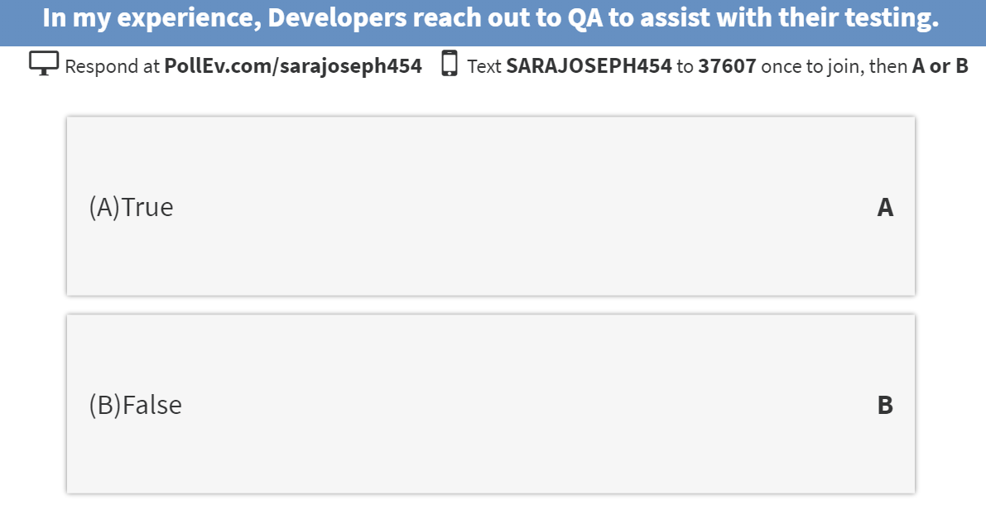
Poll Question #1
Notes:
Text To: 37607 Msg: SARAJOSEPH454

Slide 12
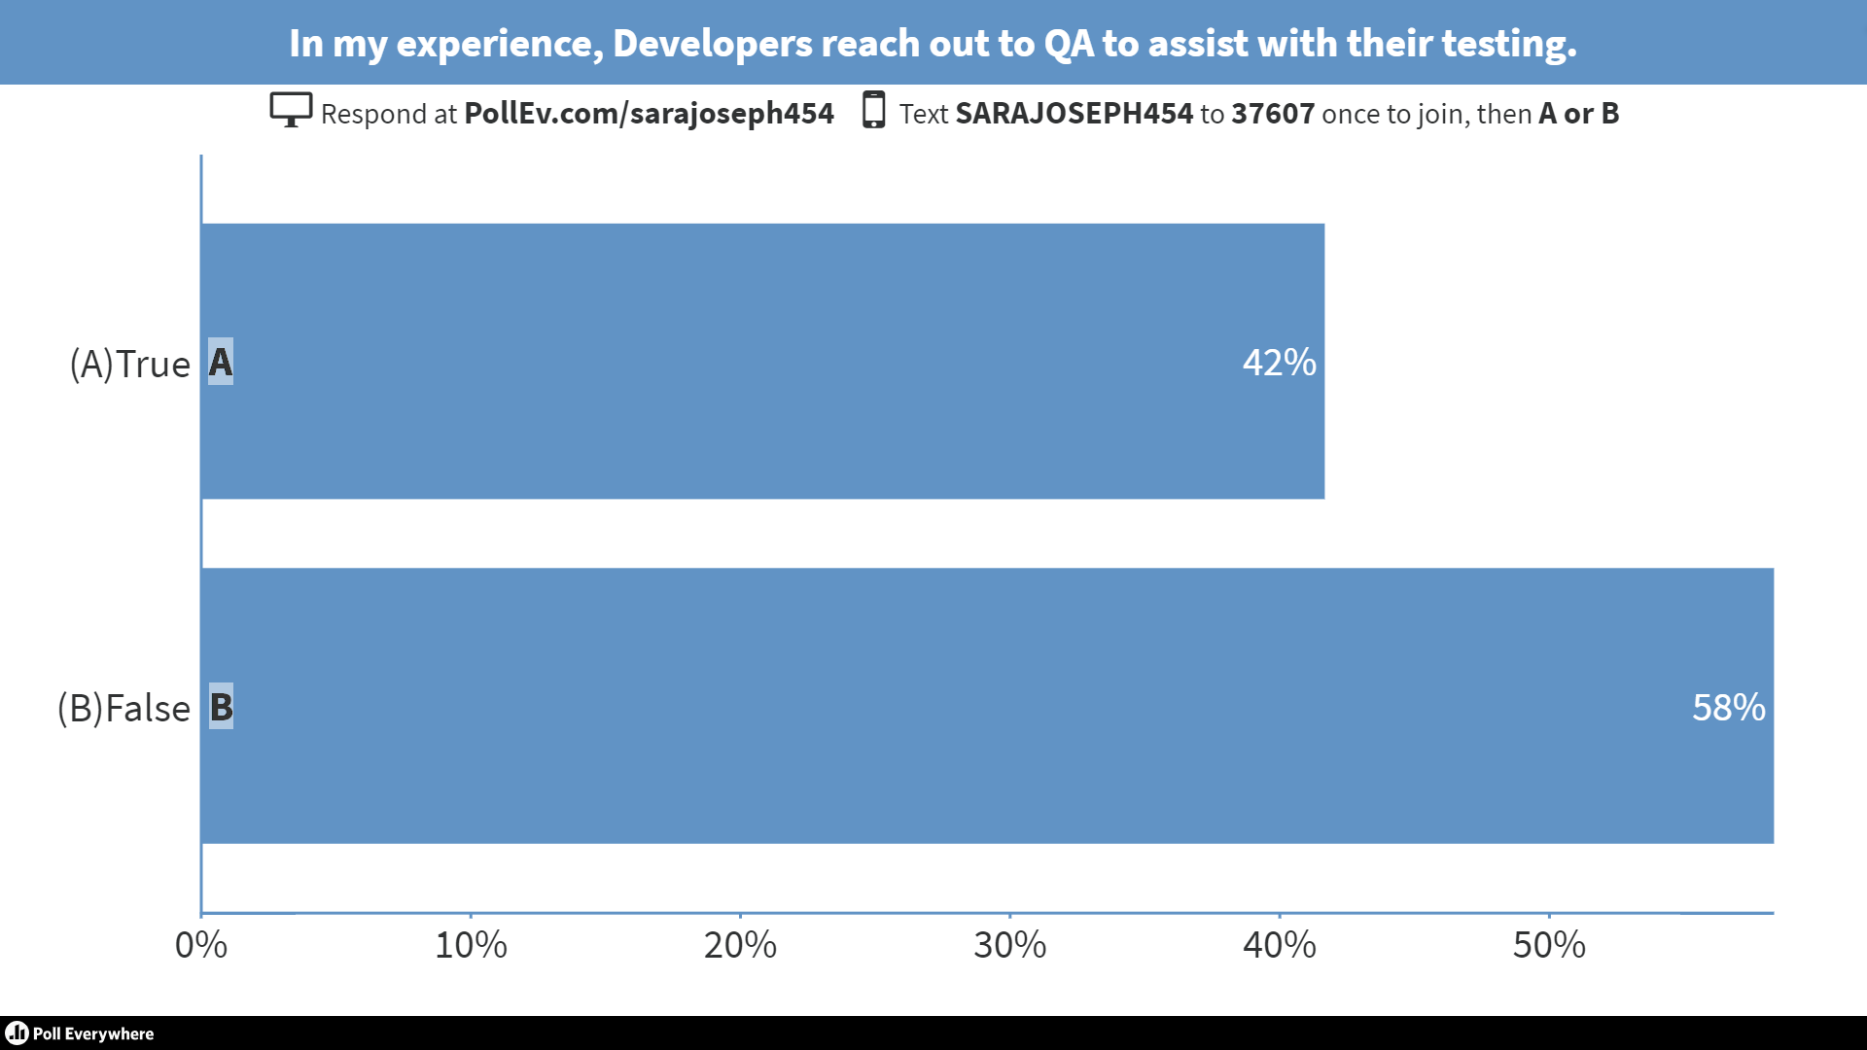
Real Time Poll Question #1 Results
Notes:
Text To: 37607 Msg: SARAJOSEPH454

Slide 13
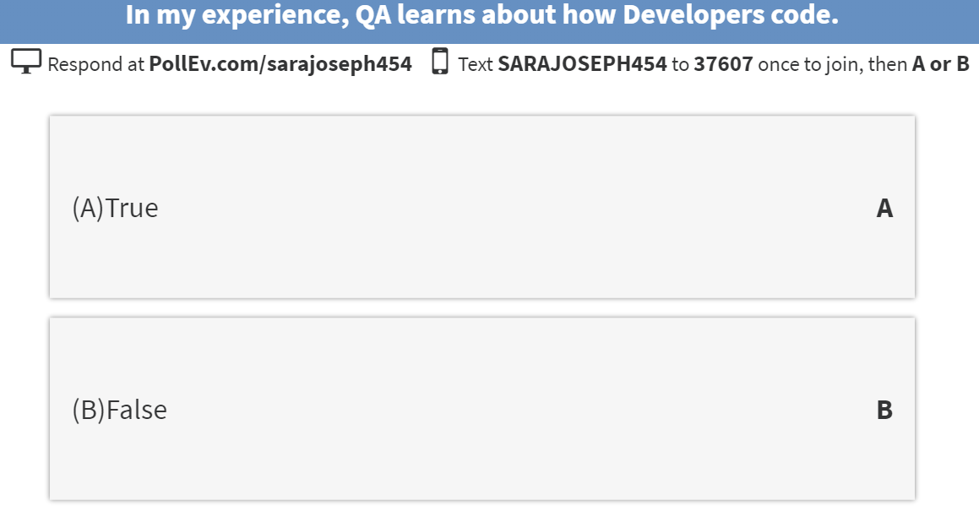
Poll Question #2

Slide 14
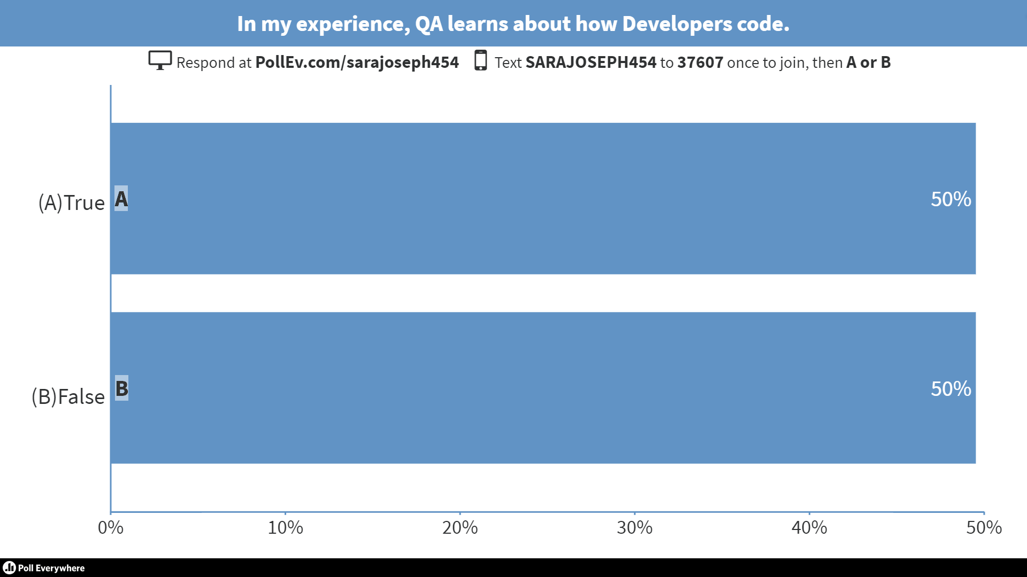
Real Time Poll Question #2 Results

Slide 15
RACI Modeling Responsible, Accountable, Consulted, Informed
RACI (PMBOK) Purpose: Drive responsibility by identifying the roles and tasks. Responsible Those who do the work to achieve the task. There is typically one role with a participation type of Responsible, although others can be delegated to assist in the work required.
Accountable Sometimes also knows as Approver or final Approving authority. This is the one ultimately accountable for the correct and thorough completion of the deliverable or task, and the one to whom Responsible is accountable. In other words, an Accountable must sign off (Approve) on work that a Responsible provides. There must be only one Accountable specified for each task or deliverable.
Consulted Those whose opinions are sought; and with whom there is two-way communication.
Informed Those who are kept up-to-date on progress, often only on completion of the task or deliverable; and with whom there is just one-way communication.

Slide 16
RACI Worksheet Example

Slide 17
RACI Task Examples
Create Acceptance Criteria / Requirements for the User Story
Facilitate the Code Review walk-through and discussion
Message to Testers:
“You did not write the code and a lead dev probably will do the code review approval , but you can be part of the approval process by facilitating what the purpose of the code snippet is…
Understand High Level Line of Code: Method, Function , Data in / Data out
You do the same thing with your functional test!”
Understand the Risks and Patterns in the Coding approach
Message to Testers:
“You naturally think of the ‘What ifs’, Test data to use , Test scenarios eventually understanding risks and patterns in the application
Now apply the same along with your developer on the coding approach
Note developers may think of code hygiene and design using static code analysis identifying security vulnerabilities and concurrency issues”
Perform Stakeholder Milestone Demos
Notes:
Help developers improve their craft…
Why should we care about code coverage in a unit test?
Should we be accountable?
Should we be responsible?
Walk thru a RACI on quality goals

Slide 18
RACI Workshop: Assign a RACI value for each task by role linking Quality Goals between Developers & Testers
Step 1
Break into small groups
Step 2
Indicate RACI value for each Task against Role
(add additional tasks and roles as needed )
Step 3
Designate a spokesperson
Step 4
Share your discussion with the larger group (Where was Developer & QA both Responsible? Accountable?)

Slide 19
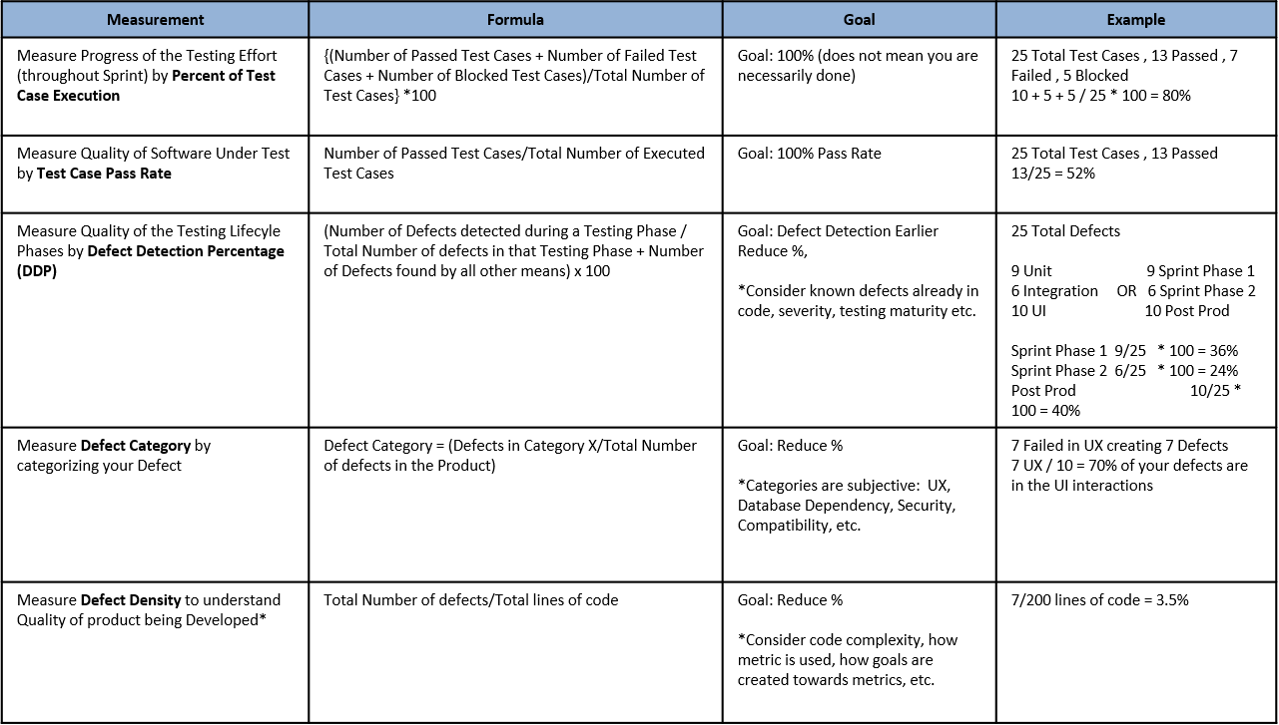
Developers & Testers shared metrics
Quality Goals: What we need to measure
# of Defects Fixed Per Day
% of Requirements Coverage (Test Case : Requirement)
# of Requirements Passed
# of Automation Tests Executed (early) on Local , Dev
Defects By Design or “Rejected Defects”
% of Defect Removal Efficiency (DRE) a comparison of all bugs found during development vs customer/production defects reported during first 30, 60, 90 days)

Slide 20
How do we get there? Shared Quality Goals
Same Performance Review Measurements
Same Project Tracking interests
Quality gates are alike for code and test case review …do them at the same time
Code that tests functionality compliments Test cases that tests functionality
Culture of peering and cross training
Notes:
Project Tracking Interests: Scheduled Delivery, Rollbacks, Versions due to mixed requirements/bugs etc

Slide 21
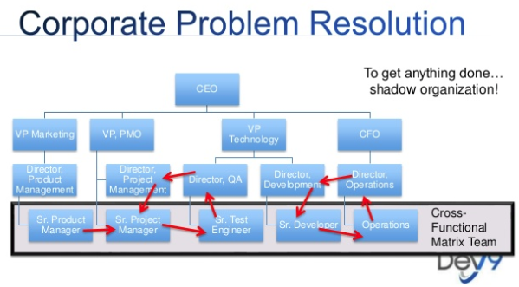
Are we structured correctly?....an important side note
Faith Cooley, Organizational Design for Effective Software

Slide 22
Hands-On Techniques #1 Understand the code to function workflow together
You can understand and eventually do each other’s work
Read code , have it explained , understand it at a high level
TDD , where is it? Have it walked thru to ensure there is a test first approach
Unit Test , show me how you ran a scenario?
Integration Test , how do you call that service when it’s down?
Developers understand QA’s test cases
QA understands Developer’s code

Slide 23
Hands-On Techniques #2 Understand the Quality of the Code
Quality of the code is dependent on the team’s continuous synergy around the code base
Peer Reviews – Daily frequency of team members walking thru each other’s code ensuring sound coding practices and efficiencies ​
Team Reviews – Weekly feature level review by a larger team for outbound the release item(s)
Architect review – Initial planning using a architecture checklist to confirm the design and code logic meet security standards and the end product can deployed, released, and operationalized ; this is revisited with frequent architect specific reviews verifying checklist deliverables are met
Random Reviews – Weekly team or peer reviews on select coding approaches as part of a technical demo
Pull Request Reviews – Prior to merging into your feature and master branch, the official approval process occurs during code checkin ; this is your last step towards accepting or rejecting the change

Slide 24
Hands On Techniques – Laundry List!
Mutual ownership of Test Automation – Peer To Peer Testing
Ability to Flex Features
Release Scheduling - ‘All aboard, the train is leaving the station’
Swarming in your Sprints – ‘All hands on deck’ Got capacity, Got Skills, Got Delivered
Scrumban – Scrum + Kanban but where you talk every day multiple times a day
Designate ‘adjunct professors’ SMEs on your team
Frequent Demos…multiple in a day (extreme Peer To Peer programming/QA)
Think of code hygiene and design using static code analysis security vulnerabilities and concurrency issues
Bottleneck Exposition – Best Efficiency Award!
Shorter Feedback Loops
Give the functional tests to the devs…maybe all of them, definitely the basics (avoid the crash scenarios)
Panic Button / Red Siren Signal – High Critical Test Cases Failed! (dashboard/above cubes)
Notes:
Swarming in your Sprints – ‘All hands on deck’

Slide 25
Workshop: Apply a Hands On Technique
Step 1
Select a Hands On Technique (or two…)
Step 2
Identify an area you can bring it into Practice
Share how you would apply the Hands On Technique
Step 3
Include the following:
How did you make your selection? Are new skills required? What outcome are you striving for?

Slide 26
Thank YOU CQAA, Bosch and participants!

