Slide 1
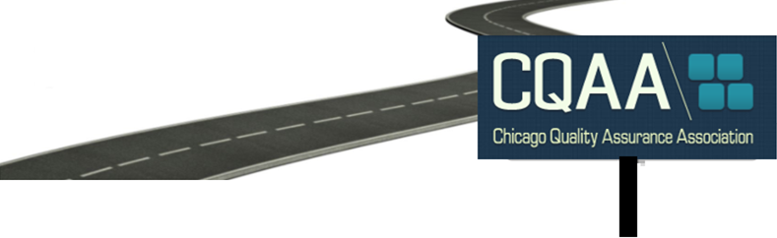
Designing a Roadmap towards Continuous Quality
Sara Joseph
July 25, 2017

Slide 2
Introduction
eCommerce Software Development Team , CDW LLC
          QA Lead
          Release Lead
          Web Automation Framework
Areas of Experience:
Programming, QA, Business Analysis, and IT Leadership
Microsoft Certified Professional (Windows OS)
Certified Quality Assurance Analyst
Certified Scrum Master
Volunteer at CQAA, Junior Achievement, & Lumity ☺

Slide 3
Today’s Topics
Agile Testing Mechanics
Mechanics of agile testing and how QA partners with their engineering teams towards Continuous Quality
Continuous Integration : Continuous Delivery : Continuous Quality
Exploration of microservices architecture to produce a testable quality MVP ready for shipment
QA Tester Career Routes
Traditional testing to analysis and engineering roles
Design your Roadmap!

Slide 4
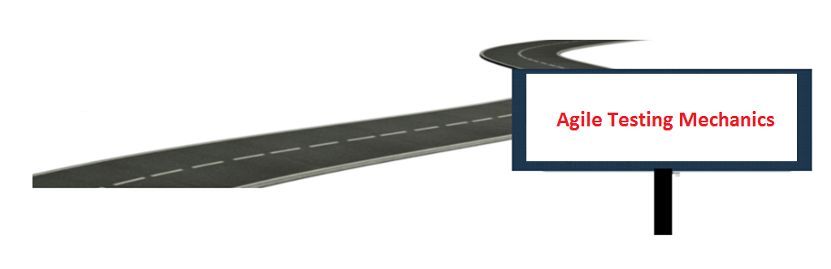

Slide 5


Waterfall vs Agile: What do we do differently?
Test Plan
Created after requirements are provided
Test Case Construction
Designed and reviewed before testing can begin
Test Execution
Performed when product as a whole is ready
Test Plan
Created as a team as part of feature acceptance criteria
Test Case Construction
Designed and reviewed during development with ability to change during testing
Test Execution
Performed when feature is ready with ability to change during testing

Slide 6
Waterfall vs Agile: Test Case Scenario
“After considering its inventory information and production schedule, which are provided as separate data web services in the system, the supplier makes decision on the items to deliver and responds to the general contractor electronically with a confirmation number. The contractor can obtain the updated item status and purchase order information from the SC Collaborator system instantaneously. For all the products, a timestamp is generated at every change in item status. This information is stored in the system to evaluate the performance of business partners and plan the life cycle of each material product.”
http://eil.stanford.edu/supply_chain/case2.html

Slide 7
Waterfall vs Agile: How do we do it differently?
Test Plan
Researched w/ Workflows and Full Scope in mind , BA on team
Risk: What if Collaborator System is down?
Test Case Construction
Complex and full end to end test cases
Reusable and Customer Focused
Ensure Supplier can interact with General Contractor
Test Case Execution
Overwhelming, Stop & Go, Heavy Process Dependency, Demo when done
Test Plan
Simple and focused features (may just be the test case itself)
Risk: What if web services is down?
Test Case Construction
Built against specific acceptance criteria for the current workflow (changes?)
Reusable and Customer Focused
Ensure Supplier can interact with the General Contractor
Test Case Execution
Features: confirmation number, item status, PO, timestamp
Ready to Demo each feature throughout its respective Sprint (changes?)
API testing for web services as Collaborator System may not be ready

Slide 8
Agile Testing Mechanics: Engineering Partnership
“C” is for COLLABORATION amongst Engineers (QA + Dev) to deliver quality
Integrated Automation Development Environment with Unit, Integration, and UI
          Microsoft CodedUI / Selenium + Visual Studio IDE + TFS Repo
          PhantomJS + CasperJS + Eclipse / Atom IDE + Git Repo
          This enables integrated automated unit, integration, and UI test frameworks
          (flip the traditional testing pyramid and scope)
        Test Scenarios, Test Cases and Test Data are transient
          Behavioral Driven Development used to collaborate and tell a story
    Test Execution Across Environments (Local, QA, Dev, Stage, Production)
    Growing knowledge of Scripting / Programming within Manual QA Team
    Investment in People, Process, & Tools towards rapid delivery
Notes:
Morningstar: Manual tester does analysis , subject matter expert , CFAs on manual testing team

Slide 9
Agile Testing Mechanics: What we need to know
Measurement | Formula | Goal
Business Value | % of Test Case Coverage , requires tagging product features | Features by Priority and Percentage as per KPI of product performance
Effectiveness | Number of Defects found | Reduce #
Efficiency | Number of Test cases executed divided by unit of time (i.e. seconds, minutes, hours) | Increase #
Cost | ROI = (Manual Testing Cost - Automation Cost)/Automation Cost Automation Cost = Price Of Hardware + Price of Software(Tools) + Development Cost + Maintenance Cost + Execution Cost Manual Testing Cost = Development Cost + Maintenance Cost + Execution Cost | Reduce $
Burndown Chart | Test State: What is Complete? What is In Progress? What is Not Started? | Increase % Complete

Slide 10
Agile Testing Mechanics: What we need to measure
Measurement | Formula | Goal | Example
Measure Progress of the Testing Effort (throughout Sprint) by Percent of Test Case Execution | {(Number of Passed Test Cases + Number of Failed Test Cases + Number of Blocked Test Cases)/Total Number of Test Cases} *100 | Goal: 100% (does not mean you are necessarily done) | 25 Total Test Cases , 13 Passed , 7 Failed , 5 Blocked 10 + 5 + 5 / 25 * 100 = 80%
Measure Quality of Software Under Test by Test Case Pass Rate | Number of Passed Test Cases/Total Number of Executed Test Cases | Goal: 100% Pass Rate | 25 Total Test Cases , 13 Passed 13/25 = 52%
Measure Quality of the Testing Lifecyle Phases by Defect Detection Percentage (DDP) | (Number of Defects detected during a Testing Phase / Total Number of defects in that Testing Phase + Number of Defects found by all other means) x 100 | Goal: Defect Detection Earlier Reduce %, *Consider known defects already in code, severity, testing maturity etc. | 25 Total Defects 9 Unit 9 Sprint Phase 1 6 Integration OR 6 Sprint Phase 2 10 UI 10 Post Prod Sprint Phase 1 9/25 * 100 = 36% Sprint Phase 2 6/25 * 100 = 24% Post Prod 10/25 * 100 = 40%
Measure Defect Category by categorizing your Defect | Defect Category = (Defects in Category X/Total Number of defects in the Product) | Goal: Reduce % *Categories are subjective: UX, Database Dependency, Security, Compatibility, etc. | 7 Failed in UX creating 7 Defects 7 UX / 10 = 70% of your defects are in the UI interactions
Measure Defect Density to understand Quality of product being Developed* | Total Number of defects/Total lines of code | Goal: Reduce % *Consider code complexity, how metric is used, how goals are created towards metrics, etc. | 7/200 lines of code = 3.5%

Slide 11
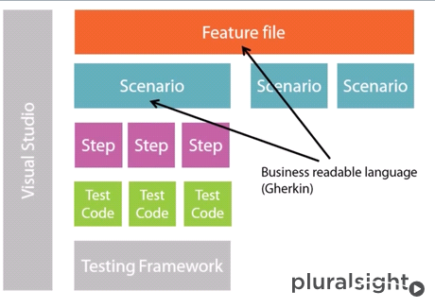
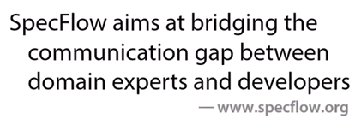
Agile Testing Mechanics: How we tell the story
Spec Flow Structure
Given I want to learn more about QA
When I attend a CQAA event
Then I learn more about QA

Slide 12
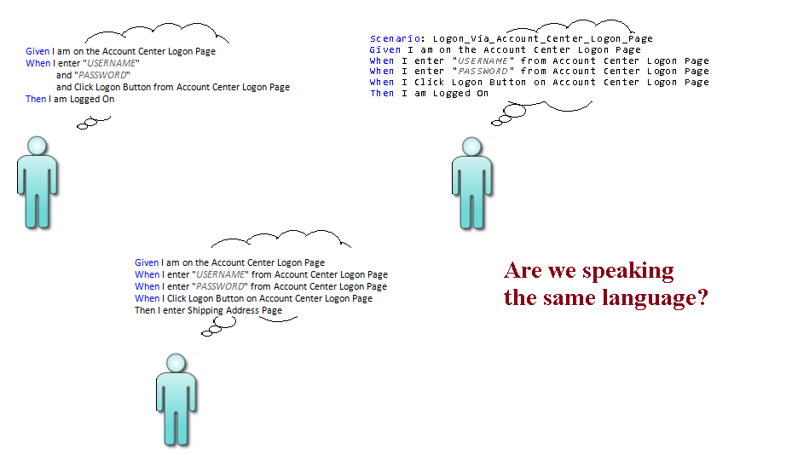
Spec Flow Gherkin Language Usage

Slide 13

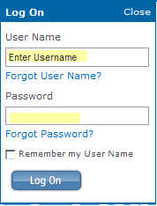
Let’s Automate with BDD in mind….
1
2
3

Slide 14
Spec Flow Scenario: Behavior is automated
How HTML Code Meets C# Coded UI Automation
Step 1) Define Test Case
Feature: SuiteCustomerCenter
Scenario Outline: TC1 Verify Create New Account Fields
Given I Launch Web Site < URL > And < BROWSERTYPE >
When I Click Account Center Tab On Global Header
When I Click 'Create Account' Link On Account Center Logon Page
Then I Land On Create Account Form
When I Select Create New Account Company Type < COMPANYTYPE >
When I Enter Create New Account Email Address < EMAILADDRESS >
When I ReEnter Create New Account ReEnter Email Address < REENTEREMAILADDRESS >
When I Enter Create New Account Username < USERNAME >
When I Enter Create New Account Password < PASSWORD >
When I ReEnter Create New Account ReEnter Password < REENTERPASSWORD >
Then I Draw Highlight On Create Account Button
|URL|BROWSERTYPE|COMPANYTYPE|EMAILADDRESS|REENTEREMAILADDRESS|USERNAME|PASSWORD|REENTERPASSWORD|
# Production
|http://www.xxx.com|IE|Non-Profit|tester@tester.com|tester@tester.com|QA|QA|QA|
C# Step Definition
[When(@"I Enter Create New Account Password(.*)")]
public void WhenIEnterCreateNewAccountPassword(string passWord)
{
new CreateAccountPageObject().EnterPassword(passWord);
}

Slide 15
Spec Flow Scenario: UI Maps & Page Object defined
Step 2) Define the UI Map(s)
//Get 'Password' field on Create Account Form
private HtmlEdit GetPassword()
{
var searchProps = new PropertyExpressionCollection();
searchProps[HtmlEdit.PropertyNames.Id] = "UserPassword";
return GetControl<HtmlEdit>("Password", searchProperties: searchProps);
}
Step 3) Interact with the Page Object
//Enter 'Password' on Create Account Form
public void EnterPassword(string password)
{
GetPasswordLabel().Click();
GetPassword().Text = password;
}

Slide 16
Spec Flow Selling Points
Test specifications in a Business Readable Language (Gherkin)
Automation test code mapping & organization to a product feature
Reusable components
  Spec Flow Features
  Spec Flow Scenarios
  Spec Flow Steps

Slide 17
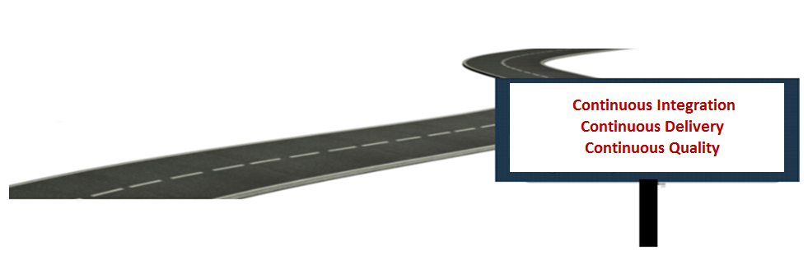

Slide 18
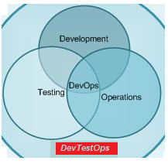
Continuous Definitions
Continuous Integration
Integrating software updates frequently (i.e. several times a day)
Continuous Delivery
          Delivering software on a constant basis
          (i.e. daily, weekly, “release when ready”)
Continuous Quality
Testing during software development and continuous integration
DevOps
        Uniting development and IT Operations towards common product delivery goals
DevTestOps
+ Testing

Slide 19
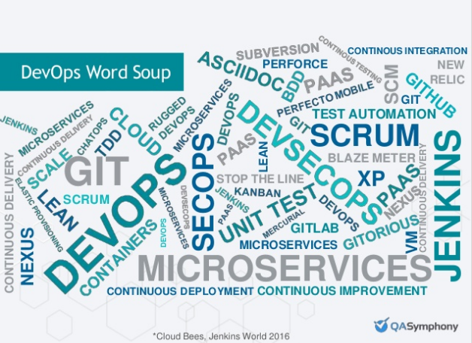
DevOps Word Soup

Slide 20
DevOps Journey: Microsoft Engineering Challenges
Agile
Been doing this for many years
Development is efficient
Developers and Testers efficient at producing product
Operations Bottleneck
Got the product but not able to ship quick enough
What did they do?
Our DevOps Journey - Microsoft Engineering Stories
Source: The 360 on Innovative Applications ​– from Zero to DevOps

Slide 21
DevOps Journey: Successful Engineering Behaviors
Implement DevOps practices and habits
Remain Highly Collaborative
Maintain Visibility and Transparency with Stakeholders
Provide means to Debug, Profile, and Diagnose (metrics, reports, dashboards)
Architect to share and reuse code across the organization
Monitor product quality
Connect Development to Operations
Automate repeatable testing and release management activities to deliver faster

Slide 22
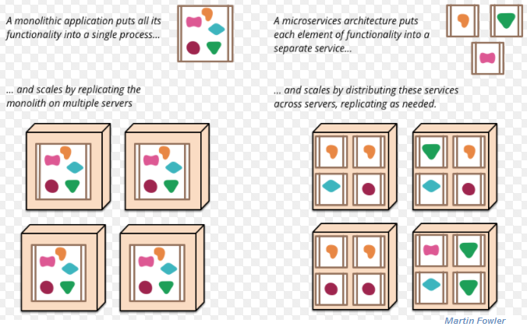
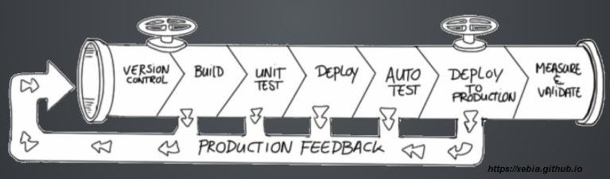
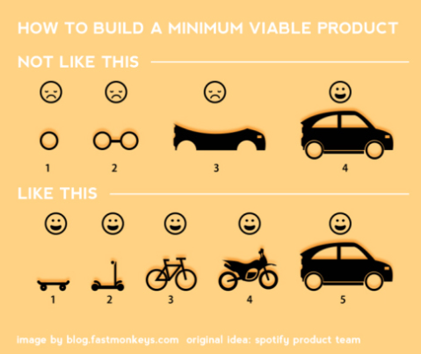
Architecture Continuously Delivering an MVP
Continuous Delivery Pipeline
Monolithic vs Microservices
Continuously Develop, Test, and Deploy a low fidelity stable core set of services which meet a customer's need.
This is followed by scaled enhancements as a new service or against the original MVP.
MVP

Slide 23

Continuous Integration : Continuous Delivery : Continuous Quality
Continuous Integration is a standard
Continuous Delivery is a standard
Continuous Delivery demands Continuous Quality
“Speed is the new currency of IT and business”
Marc Beinoff , CEO Sales Force
“DevOps is the union of people, process, and products to enable continuous delivery of value to our end users.”​
-Donovan Brown, Principal DevOps Program Manager with Microsoft
“It’s an application economy”
Satya Nadella , CEO Microsoft
“managing and implementing quality and test measures represent a challenge for teams trying to increase productivity (or release velocity) with acceptable quality” WORLD QUALITY REPORT 2016-2017 (Sealights img)

Slide 24
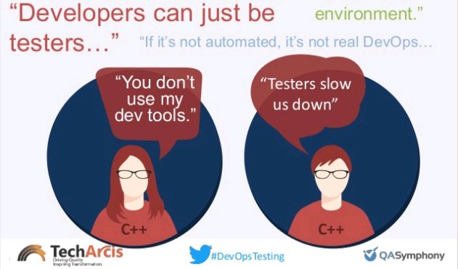
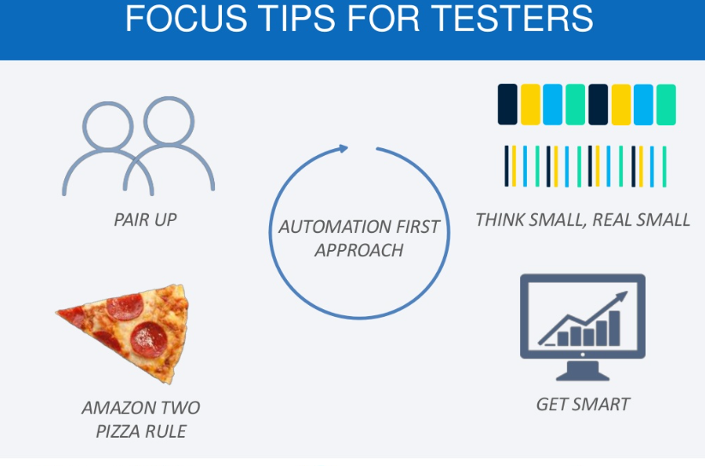
Consider ‘DevTestOps’ – Put ‘Testing’ into DevOps
Traditional testing paradigms must adapt
Testing is changing

Slide 25
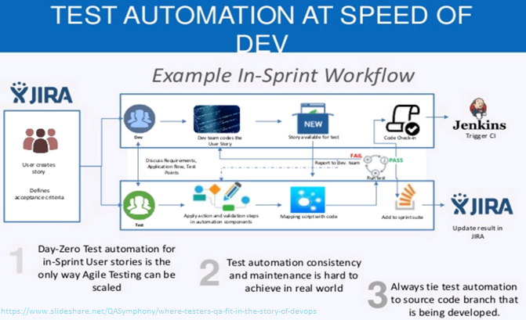
Food for Thought – Could we do this?

Slide 26
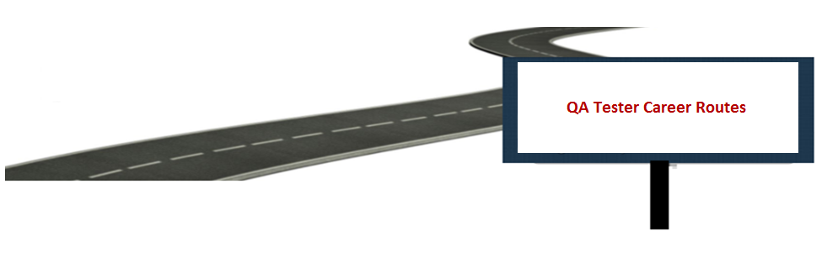

Slide 27

“I like my job” vs “I like how I do my job”
You & Your Technical Skills
        Aptitude
        Do you have a natural ability to tinker around in order to complete a task?
    Personality
    Are you approachable? Are you a problem solver?
    Team Player
      Do people want to work with you? Are you willing to be a servant leader?
    Passion
    Got a passion for technology and design? If so, sky is the limit…..

Slide 28
Everyone owns Quality and Testing
What is Software Quality Assurance?
  Activities to monitor the software engineering practice ensuring quality of the process
What do Software QA Engineers do?
  Engage every phase of the software development process to ensure design quality, business functionality, coding standards, and adherence to organization’s technical and business standards
What is Software Quality Control?
  Detection of defects after a product is developed and before it is released to customers
What do Software QA Testers do?
  Find weaknesses in the software product that could result in a malfunction suggesting improvements or modifications that the original programmers overlooked while creating the code

Slide 29
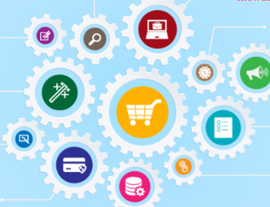
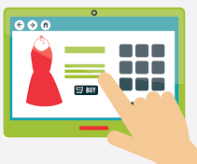
How Engineers should think about product quality?
eCommerce Engineers think about….
Consistent Brand Identity
More Customers + More Value Add To Existing Customers
More Visitors Who Stay On The Page
Distinction From Competitors
Form, Structure And Purpose To Content
Measurements for Analysis and Future Development (KPIs)

Slide 30
Common Goals yield Common Roles
DevTestOps brings testing into the Developer workflow
How will we do this?:
Concentrate on automation to constantly test changes
Help understand risks come with software product changes (bring up those metrics from the last time there was changed)
Work with developers to catch the bugs while they are coding the product instead of testing the product 2 weeks or 2 months after the code was written
How will you do this?:
Start cross-training now
Build the skills in the job you have for the job you want
Automation: Prove you can get a lot done with a little
Develop your personal brand with community involvement
Demonstrate curiosity and empathy

Slide 31

QA Career Routes
QA Manager /
Test Architect
Development Manager
Automation Engineer
Senior Business Analyst /
Practice Lead
Lead Quality Assurance Analyst
Lead Application Developer
Business
Analyst
Senior Quality Assurance Analyst
Senior Application Developer
Quality Assurance Analyst
Application Developer

Slide 32


Slide 33
Designing Your Continuous Roadmap
DevTestOps
Continuous Delivery
Collaboration
1
2
3
4
Production
Did we satisfy the customer?
Software Development
Build Automation
Test Automation
Deployment Automation

Slide 34
Designing Your Continuous Roadmap: Capabilities
Write down the necessities towards Continuous Delivery in your organization or team. | Today’s Capability | Tomorrow’s Opportunity | Infrastructure & Monitoring Must Haves | Delivery Team Specialization Roles (Dev, QA, Operations)
1) Software Development
2) Build Automation
3) Test Automation
4) Deployment Automation

Slide 35


