Slide 1
Beyond Than Just Resizing a Browser: Useful Responsive Web Testing Tips
July 2016
Eran Kinsbruner
erank@perfectomobile.com
http://mobiletestingblog.com
@ek121268
Notes:
Responsive Web Design Testing to Deliver a Consistent User Experience

Slide 2
Agenda
01
RWD Introduction & Motivation
02
RWD Test Plan Building Blocks
03
Test Execution & Automation
04
Q & A

Slide 3
Responsive Web Design (RWD) - Definition
Responsive web design (RWD): approach to web design providing an optimal viewing and interaction experience—easy reading and navigation with a minimum of resizing, panning, and scrolling—across a wide range of devices (from desktop computer monitors to mobile phones) leveraging:
Fluid Grids
Flexible Images
Media Queries
Notes:
As a growing trend in the market we see many organizations moving from mobile to digital aiming to improve their end UX, reduce costs, enhance efficiency (consolidate teams) and quality of their apps
https://www.uxpin.com/studio/blog/responsive-web-design-cheat-sheet/?utm_source=Responsive%20Design%20Best%20Practices&utm_medium=ebook&utm_campaign=Responsive%20Design%20Best%20Practices

Slide 4
RWD vs Non RWD
http://www.geico.com/
vs
http://www.cqaa.org/

Slide 5
Drivers & Benefits To Moving to RWD
Provide consistent DX and coverage across all digital platforms
Support end user work flow across multi screens (Volume)
Consolidate resources & align business goals across platforms
(SEO)
Be ready for any new OS/Platform release faster

Slide 6
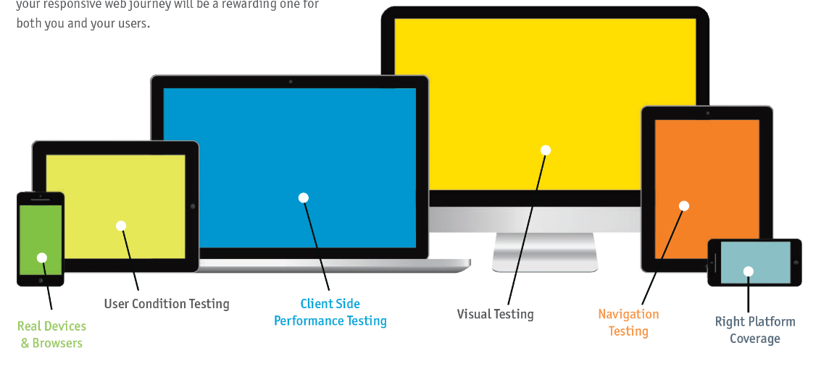
Building Blocks for RWD Testing

Slide 7
Where To Start From?

Slide 8
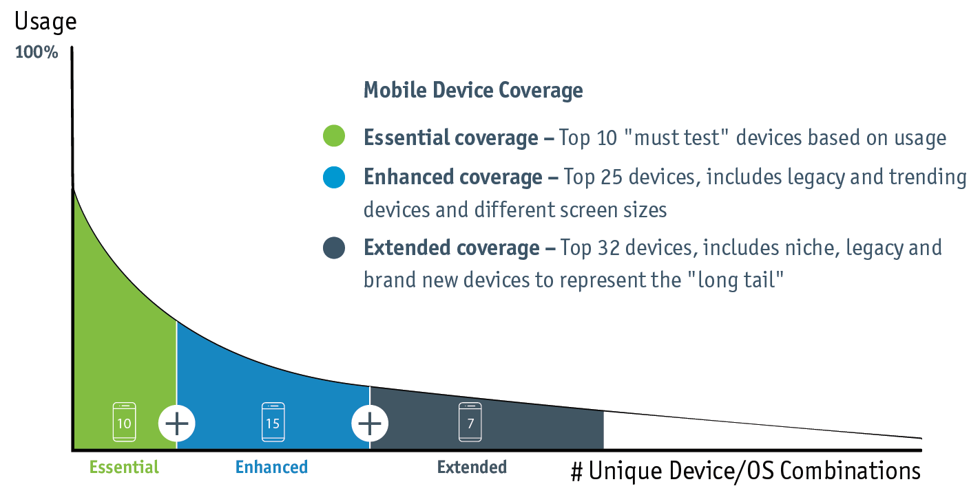
Mobile Test Coverage Method

Slide 9
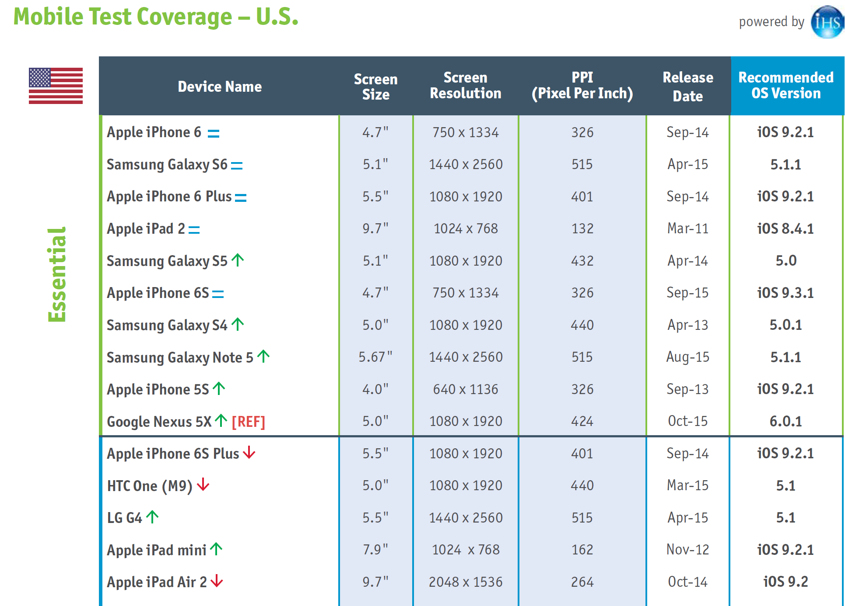
U.S Mobile Test Coverage Example

Slide 10
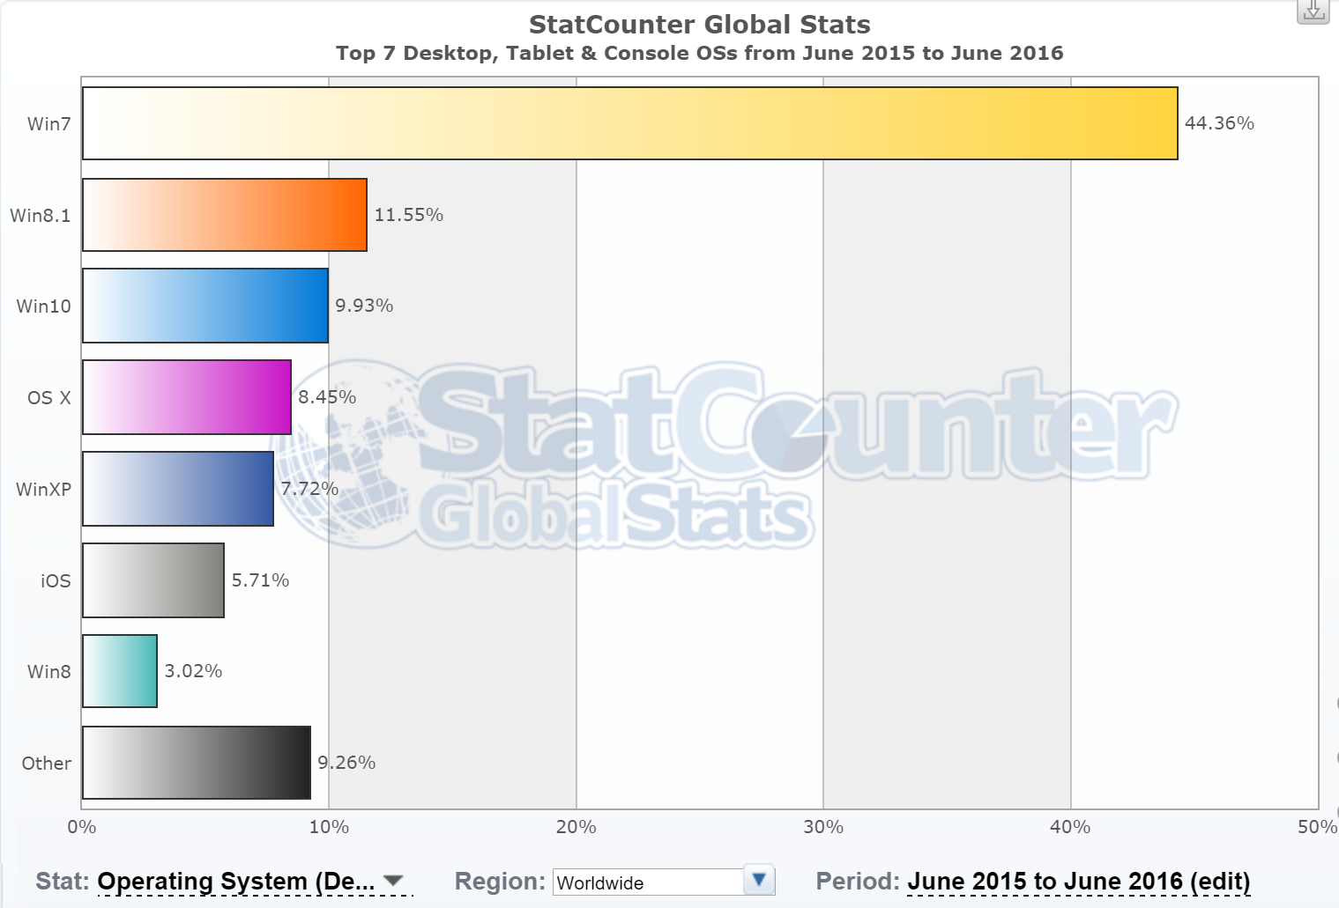
Start Your Web Coverage From Market Analysis Browsers & Operating Systems
Source: StatCounter

Slide 11
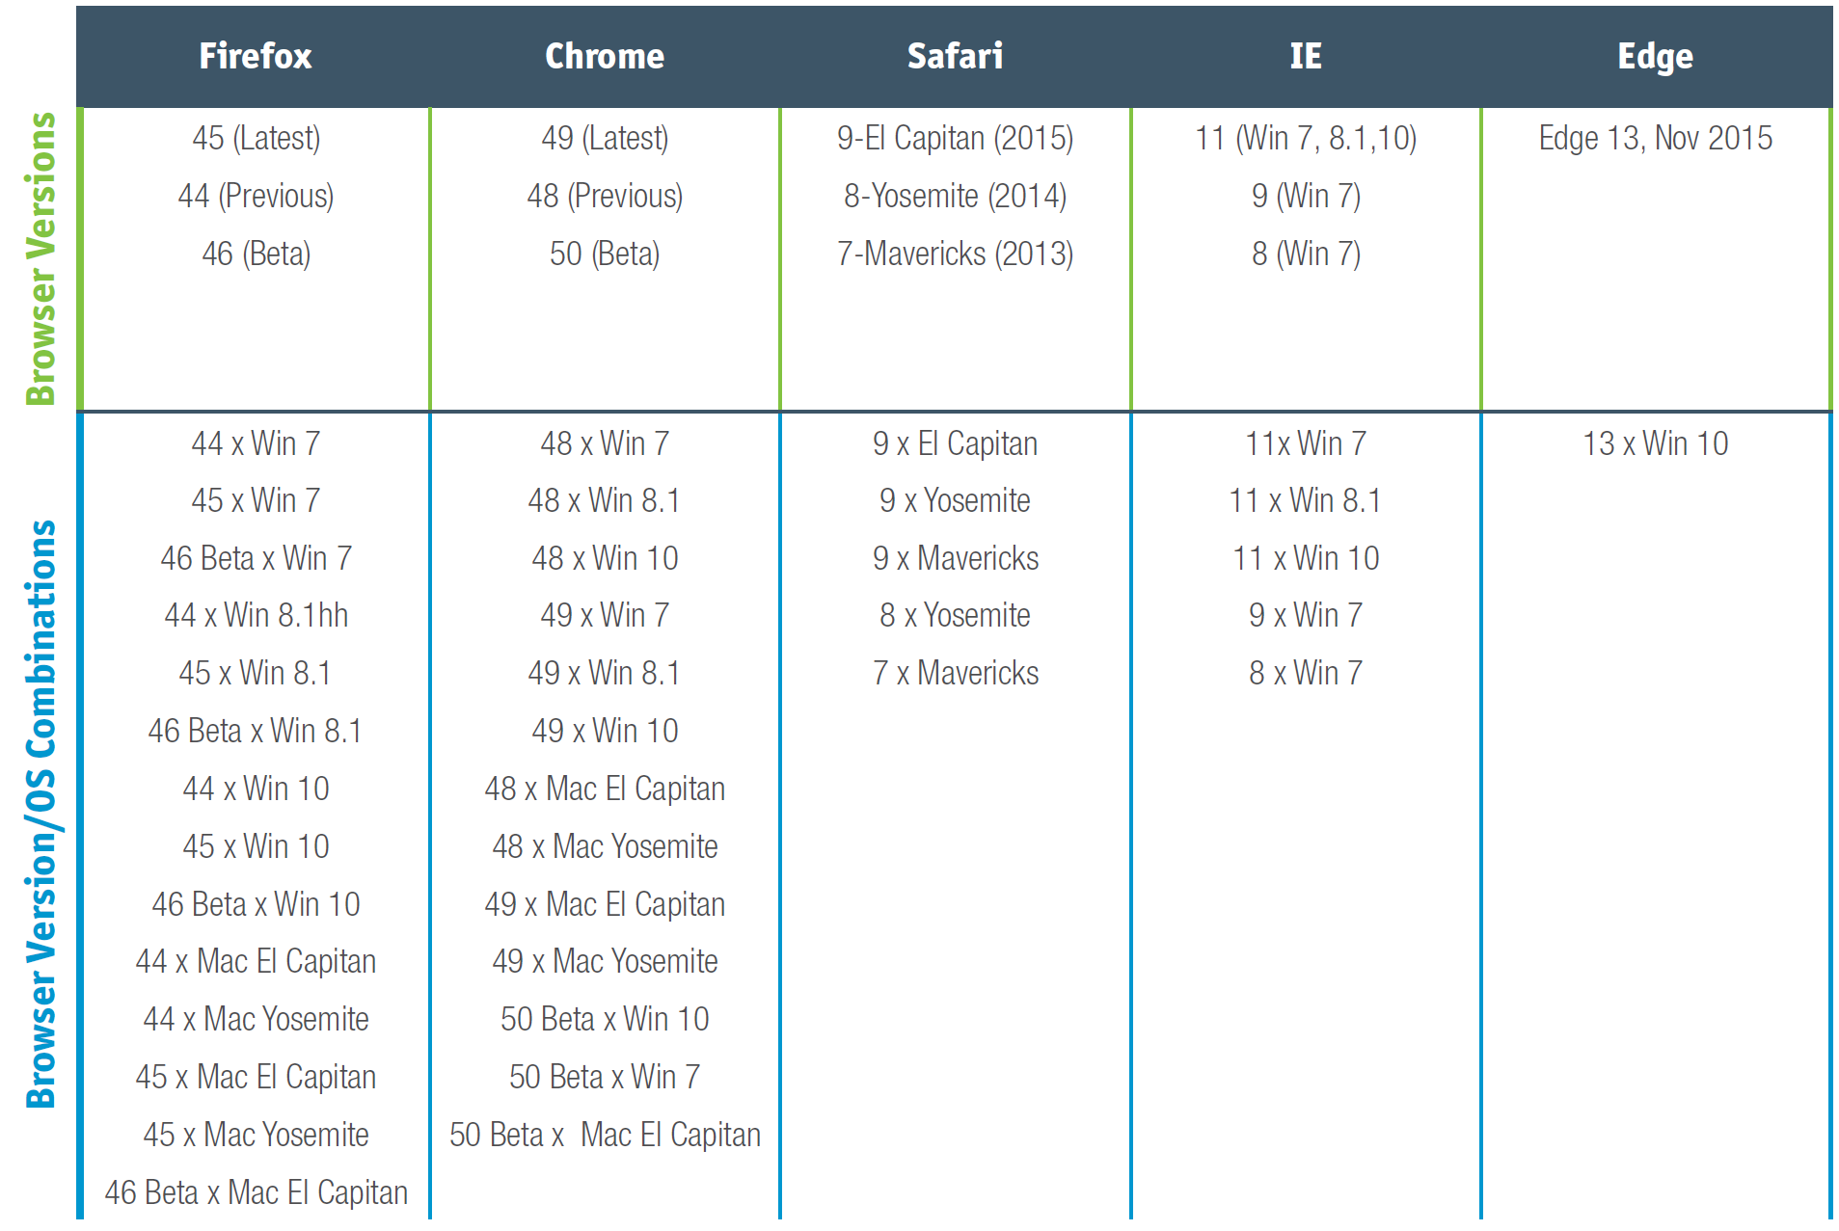
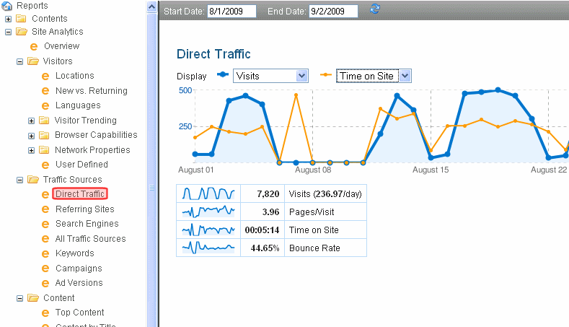
Suggested Method: Leverage Your Analytics with Market Coverage
Validate against Analytics

Slide 12
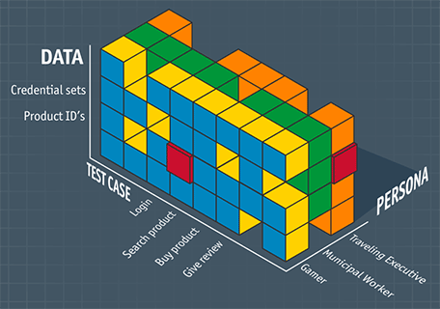
User Condition Testing – Bring The End User Into Your Lab

Slide 13
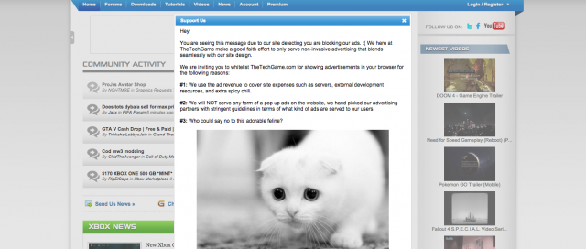
User Condition Testing
Locations & context
Playing Video across platforms, different screen orientations
Incoming events and interrupts
Mobile – Calls, SMS, BG apps pop ups
Web – ads, plugins
Network conditions
Poor, good, no network

Slide 14
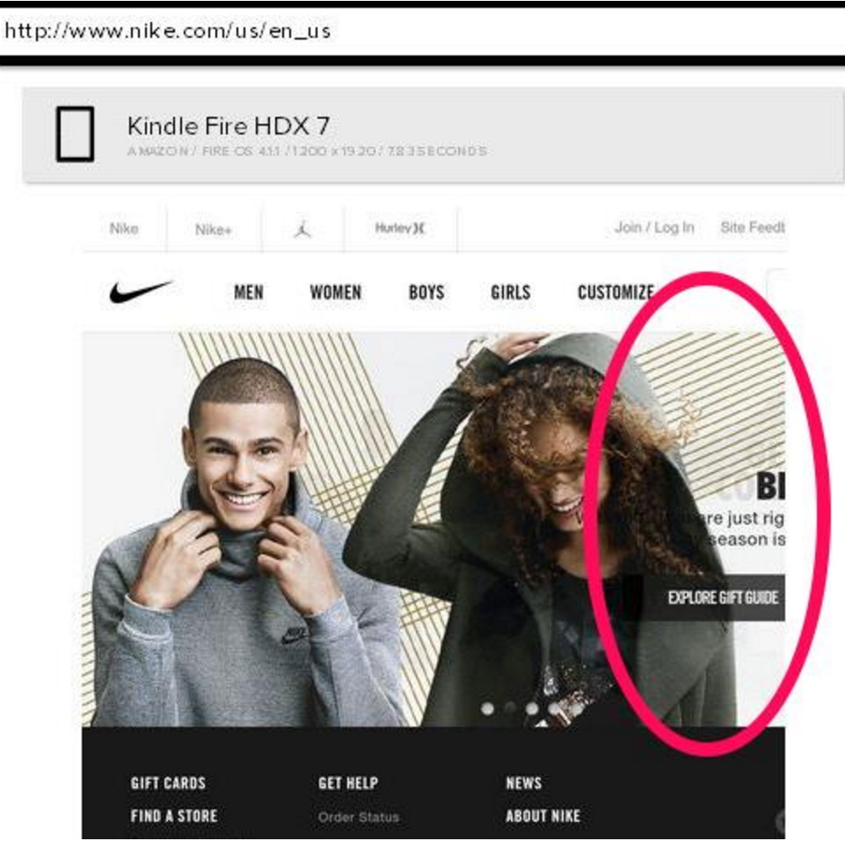
Visual Testing Is Critical For RWD!
The majority of RWD bugs are visual and can’t be detected using traditional functional test automation tools
Assure that Important page content is visible in all resolutions and screen orientations (Displayed Above the Fold)
Test the Alignment, size, style and color of text, controls and images
Validate that Elements aren’t cut at the edges of the screen
Assure that Typed text (data entry) scrolls and displays properly

Slide 15
Execution & Automation
Release cycles keep getting shorter

Slide 16
Why Automation
The test matrix is too big to cover manually
Web browsers
Devices
Operating systems
Screen resolutions
Responsive design
L10n
3rd Party upgrades

Slide 17
Code / Test – Common Challenges
1) Execution of One script across platforms
4) Object id Identification
5) Does it work over time ?
6) Maintenance of scripts and Objects
7) Matching Dev/Testers skill set
2) Automating build/deploy and acceptance testing during CI
3) Test results analysis

Slide 18
Digital Transformation Requires Changes Around Test Automation
Performance Security
UI
Integration
Unit Testing
Target
Devices
Target
Env.
OS
OS versions
Form factors
CPU & Memory
Manufacturers
Wearables
IOT
Networks
Orientation
Location
Notifications
Events
Device events

Slide 19
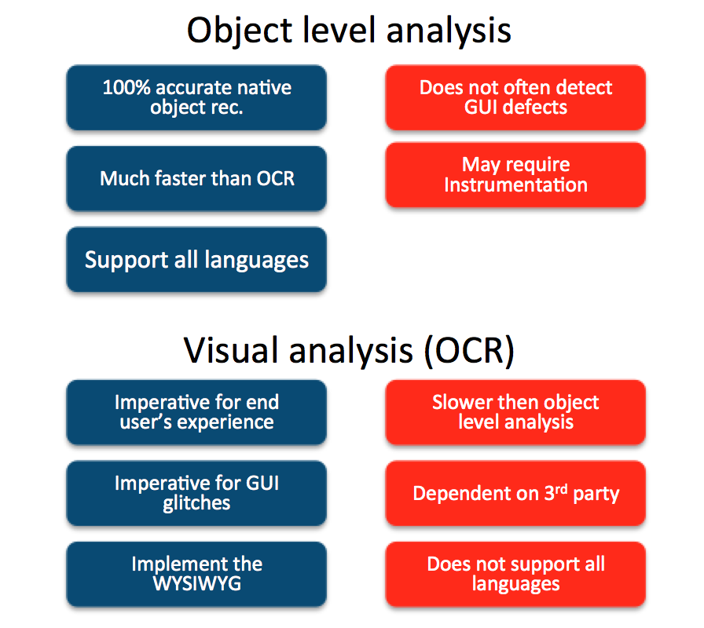
Object Identification Is Key For Robust Automation
Selenium
Appium
XCTest
UIAutomation
Perfecto
Abby OCR
Applitools
Perfecto

Slide 20
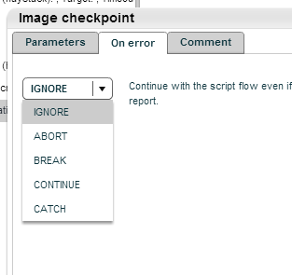
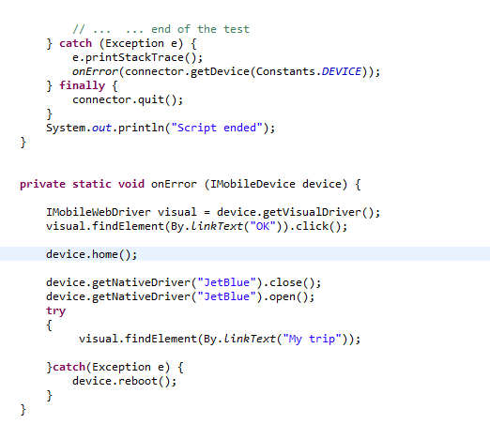
Assure Proper Error Handling (Mobile)
System level control
Application control
Device control

Slide 21
3 Layers Involved In Test Automation Optimization
App
Test Cases
Device
Supports Feature
Doesn’t Support
Define Desired Capabilities
Info.Plist (iOS)
Manifest.MF (Android)
Resource Consumption

Slide 22
7 Keys for Successful Unattended Automation and CI
Start small & Grow
Accept that not every test enters CI
Debug & Debug Again across few platforms
Make your script reusable
Validate within and between the tests
Plan for unexpected events
Keep channel between Engineering, Ops and Biz opened

Slide 23
DEMO

Slide 24
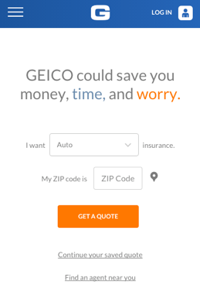
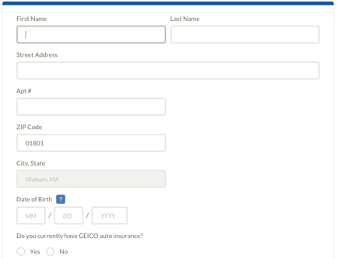
Script Flow - Selenium
Visual validation
Load time

Slide 25
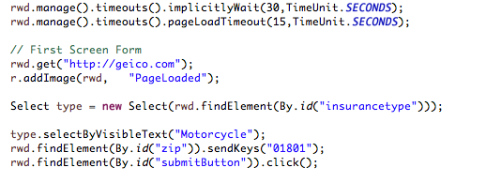
One Script for all Digital Platforms

Slide 26
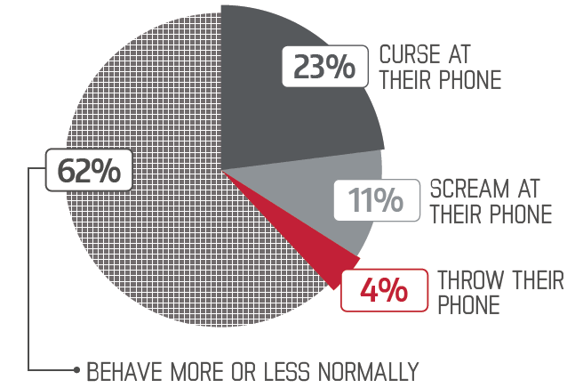
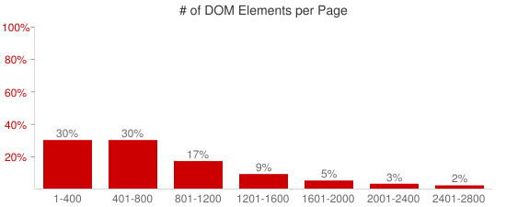
Client Side Performance – Optimize for great DX
Relevant content and content compression
Size allocation
Load testing KPI’s across platforms and networks
Varying locations measurements
Measure UI rendering time (Page Load should be < 4Sec.)
Source: HTTPArchive.org

Slide 27
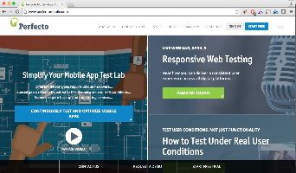
Client Side Performance Testing
Backend Web Server

Slide 28
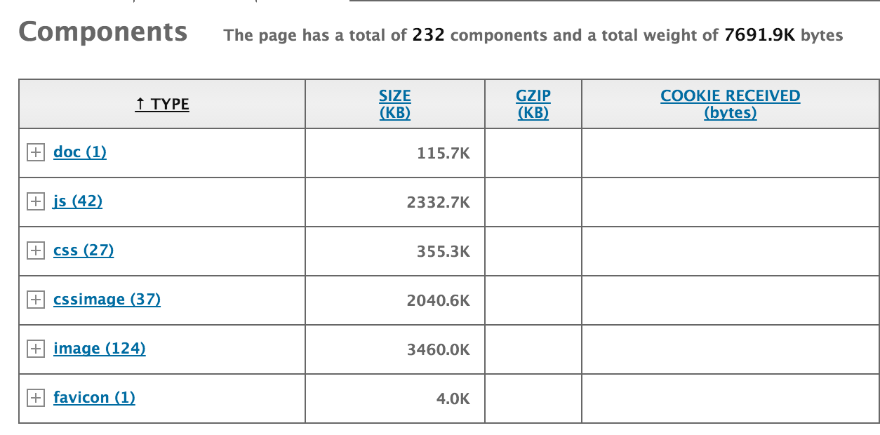
YSlow

Slide 29
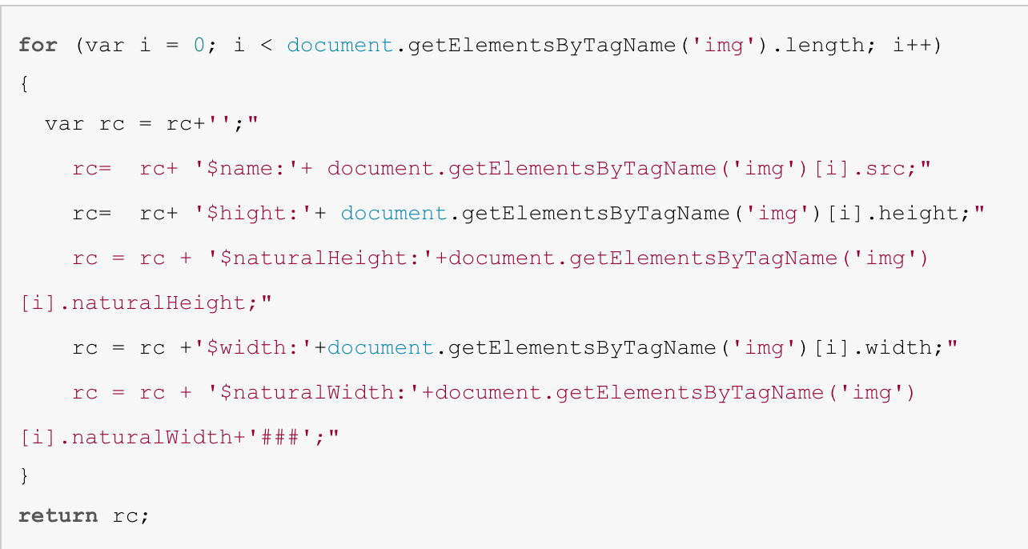
Sample Code For RWD Performance Optimization
Add JS script to analyzed the DOM objects
Validation actual size vs real size

Slide 30
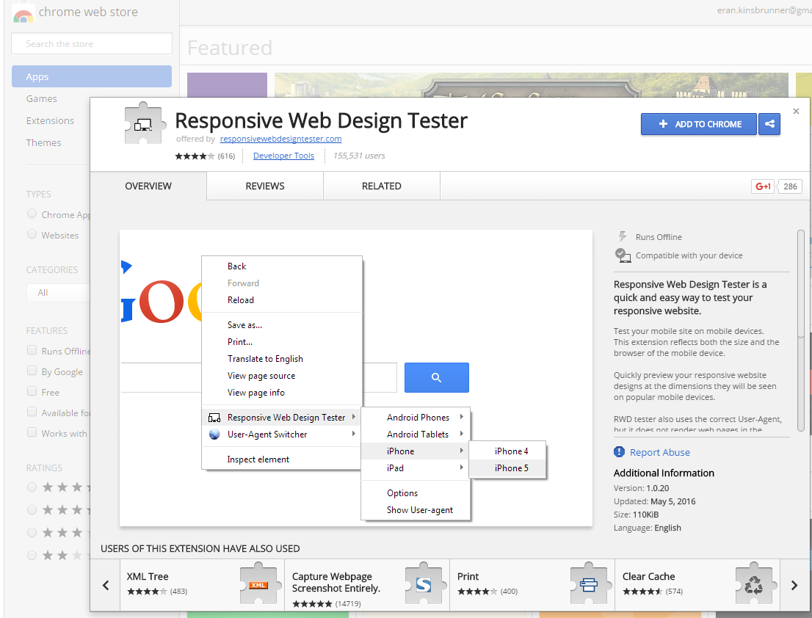
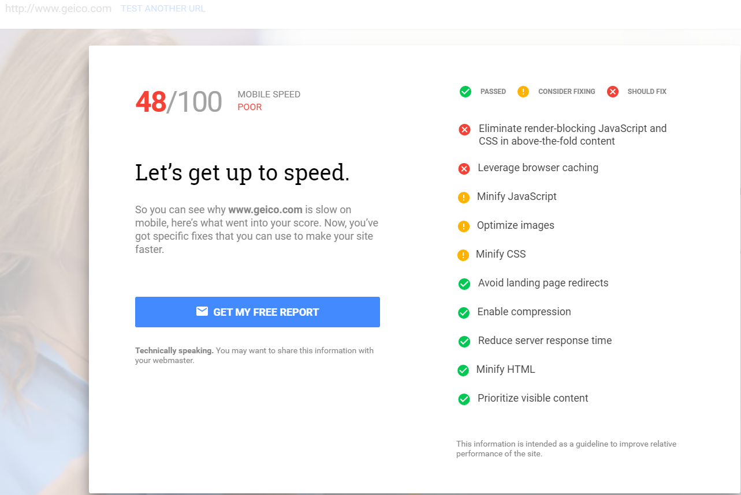
Additional Resources
Responsivetest.net
Responsinator
Google Mobile Friendly Test

Slide 31
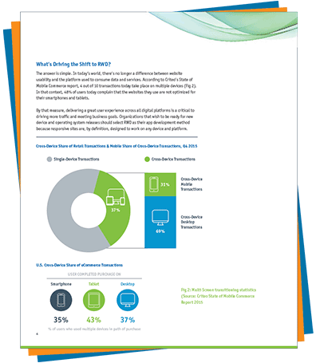
Special Offers to Event Attendees
Free Whitepaper
Complete Guide to Building a Responsive Web Testing Strategy
http://info.perfectomobile.com/responsive-web-design-testing-paper.html
Direct download or email me at: Erank@perfectomobile.com
Follow Me
http://mobiletestingblog.com
@ek121268

Slide 32
Agenda
01
RWD Introduction
02
RWD Test Plan Building Blocks
03
Test Execution & Automation
04
Q & A

Slide 33
Thank You

