Slide 1

The UAT “Chess Game” – how to play your pieces so everyone wins!
Dr. Glenn A. Stout
Technology Consultant

Slide 2
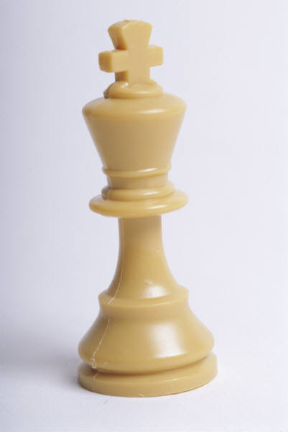
Bio –
Dr. Glenn Stout
IT Technology Experience for more than 23 years
Quality Assurance – 13+ years
Ph.D. in Information Systems from Nova Southeastern University in 2006
Adjunct College Professor at Colorado Technical University and University of Illinois – Springfield, Jones International University, Nova Southeastern University
US Army Veteran (1990 – 1993)
Biggest Project – Created and Implemented entire SDLC (with 5% of 100 people’s time) for multi-billion dollar corporation – 3,500 global IT team members
Craziest Test – Developed approach to test a government based “convoluted” business rules system with more than one million automated test cases – run at the press of a button
Glenn’s testing “philosophy” is published in Software Test and Performance magazine, April 2008

Slide 3

Agenda
Chess Game – Why?
Overview
What is UAT?
Organization Maturity
UAT Philosophy
UAT Game Plan:
People
Process
Technology
Summary

Slide 4

Chess game?
Why I feel that UAT is a Chess Game
  Sometimes UAT feels like an “US vs. THEM”
  It is not an overly fast, aggressive “game” – but a slowly paced, people “jockeying” for position
  There is a definite King and Queen
  Typically – it ends up as a “draw” – or someone concedes, which is not always the best outcome
Therefore, when I thought of this presentation – I felt it was like a Chess Game – but if we do it right – everyone can win!

Slide 5
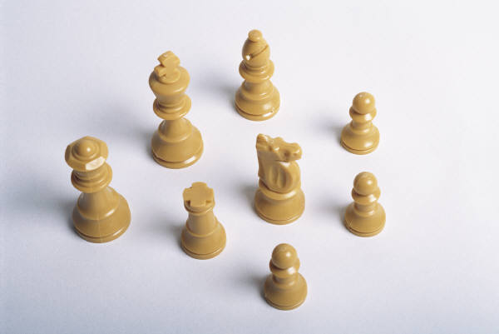
Overview of our discussion
Discuss the overall UAT approach
  Includes questions to ask and suggestions for any UAT effort
  Some may seem be “common sense” - but a good reminder!
  Separated into three categories:
    People
    Process
    Technology

Slide 6
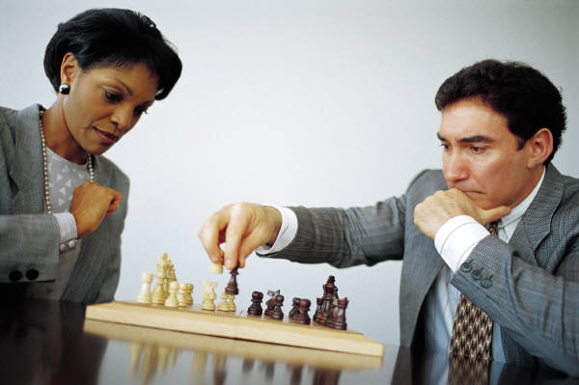
WHAT IS UAT?
User Acceptance Test is the process where the end user, or customer has an opportunity to tell the development team whether or not we provided what they wanted.
The Goal is to have the users review the final product and either accept it or reject it
  Note: It may be the project manager’s goal for them to ‘accept’ it – but the goal of the UAT is to get them to reach a decision one way or another.
In CMMI – this is called ‘Validation’

Slide 7

Organization maturity
Is the organization mature enough to handle a “true” UAT?
Depends of course on:
  Size of application being tested
  Size of organization
  Size of “change” (if an upgrade)
ASSUMPTIONS for this presentation:
Company of more than 1,000
Application that touches all areas of business (ERP) is being upgraded
User community as well as IT is not very process “mature”
(If we can understand for this level of project, we can tailor the process for smaller projects)

Slide 8
UAT Philosophy
Let’s set up our Chess Board with our “guiding principles” and “requirements”
  UAT effort should be OWNED by users, supported by IT
  All (or at least most) tests are written
  UAT Testing should be business-process related
  Negative testing should be minimized, if not zero
  Defects need to be documented by users, closed by users when resolved
  C-level support is needed where time is required by users to test and do “day job”
  “Process – then Tool”
    {Meaning, adjust your tool to meet the process, not the other way around. Don’t let the tool “wag the dog.”}
  Relentless Communication
  One Process – One Tool

Slide 9

PEOPLE

Slide 10

People –
The king and queen
The project needs a Sponsor from the BUSINESS
Ensure that the users have a key person in charge – who is involved significantly.
  UAT ‘Face’ needs to be that of a user – not someone from IT
  UAT User Lead should work hand in hand with the IT UAT Lead

Slide 11
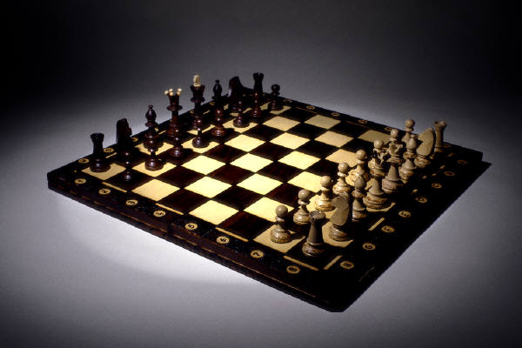
People –
PUT the Pieces on the board
Define Roles and Responsibilities
  Clearly define roles and responsibilities for testers (Pawns)
  As well as the team leaders (Bishops and Knights)
Create an Organization Chart
  One picture is worth 10,000 words – and people like seeing org charts – they need to know exactly where they fit into this testing approach.
  It may look like a matrix, but make it clear who they will take their ‘day to day’ testing direction from.

Slide 12
The board
Departments/Processes | Accounts Payable | Human Resources | Sales | Accounts Receivable
Process #1 | User 1 User 2 | User 3 |  | User 5
Process #2 | User 6 | User 7 | User 8 | User 9
Process #3 |  |  | User 10 | User 11
Process #4 |  | User 12 | User 13
Each user is in a DEPARTMENT
as well as part of a PROCESS

Slide 13

People -
Process Leads → “Bishops”
Divide and Conquer the work
  Review business processes and choose a “Process Lead” for each of your “Enterprise Processes”
    They will run that sub-testing team and give the sign off if that area of system is acceptable.
    If “Process” is to “big” (or too small) for what you are trying to do – break into another “transaction” or some manageable piece.
  Bottom Line – break up your entire testing responsibility into smaller business processes (if not done already).

Slide 14
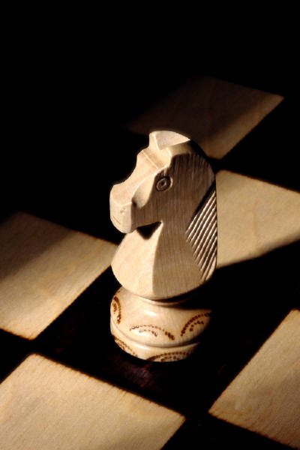
People -
Department Leads → “knights”
The “Vertical”
  After reviewing the processes, you will see what departments they “cut across”
  Define “Department Leads” from the organization – they may not be in charge of testing – but they will control tester’s TIME – so they need to be on board!
  They need to be involved to know how much time is needed from their people to test under the Process Lead’s direction, and find cover for their “day job.”

Slide 15

PEOPLE –
The IT Team → “ROOKS”
Engage your own IT Team
Figure out who will be a point of contact for process each team, OR
Have ONE key “Rook” (maybe you) that gets the first point of contact for issues, and then YOU distribute the issue or defect to the appropriate team.
AVOID “Many to Many” communication models.

Slide 16

People – prepare the players
Clear Testers’ Schedules
  Ensure that Process Leads, Department Leads and UAT Testers have a CLEAR picture on what the expectation of time is required for them to test.
  You can cause quite a stir if you “schedule” 20 people to spend “half a day” every day for 4 weeks. Nothing gets a reaction like a meeting invite.
  Little things:
    How much of their current “8 hour day” will they need to spend testing?
    Ensure you block time for ‘Testing Training’ and ‘Testing Tool Training’ – often not put into the estimates

Slide 17

People – ready the Pawns
Ensure testers are trained on the TESTING PROCESS
  What makes a good test? Do they know?
  Are testers writing tests that are repeatable?
  Types of testing is critical:
    Should be doing Business-Process type tests - as if they were doing their job
    Should not be doing “IT” type testing (field length, required fields, and other “negative” testing. They are too valuable to do that.)
  Do they know how to enter a good, well-written defect?
    Most don’t if they have not been trained
“Just tell me what you want me to do”
  Many times, testers just want you to tell them what to test, where to test, and how to document it, and get out of the way.
  This is good, but be sure before they go on their way that they are following the process.
  Trust…but verify

Slide 18

process

Slide 19
Process –
How will we share our “Moves?”
Define and Publish Communication Model & Plan
  Who to contact for what?
    Defects, system goes down, can’t log in, etc.
  What does the communication model look like? (examples)
    Testers to Process Lead
    Process Lead to UAT Lead
    UAT Lead to IT Lead
    IT Lead to IT staff to fix defects
    IT Lead/UAT Lead to report to management
    UAT Lead reporting info to UAT Testers
    What else?

Slide 20
Process -
Define the rules
Define and document a “simple” Testing Process
  Is there a process that has been documented, and can be described on one page of text, and one diagram?
  Keep it as simple as possible
    We testers sometimes don’t understand that there are some people out there that don’t understand testing!
  INCLUDE EXAMPLES!!!
  Can we support the process with a tool?

Slide 21
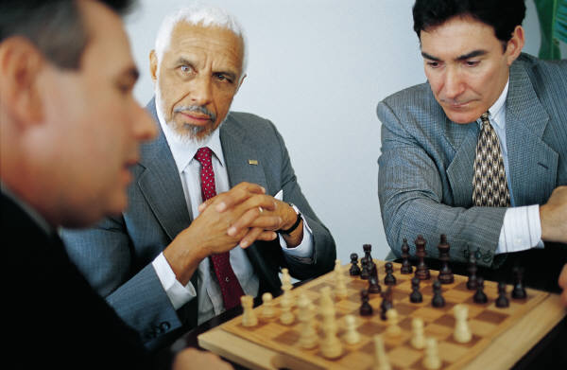
Process –
Share the game plan
Create and Publish the UAT Testing Plan
  Sounds simple, but often skipped
  Should define who is in what role, when things will happen, by who, etc.
Ensure “common dictionary” for testing definitions
  There are many testing “objects” – decide what ones you will be working with.
  For the testing process, have these things been clearly defined?
    ‘Test’ (sometimes called a test case, script, scenario – need to get on the same page with regard to terminology)
    ‘Defect’ (the defect process needs to be clearly defined)

Slide 22
Process – opening gambit
“Prep Work” – get the system ready
  Logins
    Ensure that UATers have login ID’s, with the proper security access
  Workstations
    Ensure that all UATers workstations have proper web browsers (example) with the same plug-ins, etc. – with the goal of having everyone with the same setup as a typical user
  Seed Data
    Whether the data is loaded by IT, or special “seed data” needs to be entered by users, have this be an organized process, whereby users do not “use” other people’s data by accident.

Slide 23

Process –
GAME ON!
“Huddle Up”
  Where possible, define times and places where UAT Testing will take place
  Have all people in particular processes to gather and test at the same time (a training room is a good place)
    Little issues are solved quickly (can’t login, what link?, etc.)
    Focus is on testing, not answering a call or other interruptions
    In a process – sometimes control is passed from one “role” to another – if the person is right next to them, goes quicker (e.g. “I will create the order – you approve it”)
    IT support can be right there, or quickly on call
    Mostly beneficial during early stages of testing

Slide 24

Process –
Review the game progress
Define and hold status meetings with Process Leads
  Depending on the schedule, these may happen DAILY
    A quick, 30 minute meeting to discuss progress from previous day, critical defects, what is going to be tested that day, etc.
    Key is to remove any obstacles that are keeping people from testing
    Invite IT people to help comment and give status on obstacles that are currently being removed.
    Process Leads are key invites, Department Leads should be invited as needed, or to at least 40% of the meetings for awareness.
Define and hold status meetings with IT Leads
  Depending on the schedule, these may happen DAILY
    A quick, 30 minute meeting to discuss UAT progress from previous day, critical defects, what is being done to fix, etc.
    IT team should be fully engaged in the UAT process

Slide 25
Process –
Document bad MOVES
Defect Lifecycle – Clearly Defined
  Defects should be entered into a common defect tool
  ALL users need to know how to use this:
    DO NOT allow the “we will email you the defects and you can enter them into the tool” move
    Whoever creates the defect closes it after a re-test when fixed
    Defects should have both a Priority and Severity
      Priority – order in which it should be fixed
      Severity – level of “damage” to the system
Hold Defect Review Sessions
  Depending on Schedule, these may happen WEEKLY
    Review each defect with representatives from the testing team as well as IT, so there is a clear understanding of the defects, any nuances, priority adjustments, etc.

Slide 26
TECHNOLOGY

Slide 27
Technology –
Using a quality chess set!
One Tool
  Strongly advise a qualified testing tool that houses; Requirements, Tests, and Defects
  If “one tool” is impossible – try to have clearly defined tools that connect in some way.
    For example, if you use Excel – ensure everyone is using the same template, or numbering scheme.
Enable Requirements-Tests-Defects Traceability
  Trace from Requirements to Tests, from Tests to Defects
    Should have a test for every requirement
    Every defect should link to a test
  Regardless if a tool is used or not, each requirement, test and defect should have a unique number for reference.

Slide 28
Technology –
Using a quality chess set!
Tool Training
  Train user/testers on the tool they will be using for testing and defect tracking
  Provide them a “one page” cheat sheet on what they are expected to do regarding the tool
Tool Support
  Users should know who to contact for questions with the tool

Slide 29
Summary
Of course these suggestions may be adjusted to meet the schedule, culture and “process maturity level” of any organization.
One final guiding principle is that it is mostly true is that all players simply want to do the right thing – based on that common ground, anything is possible!

Slide 30

Questions?

